Slide 1
G20/OECD Principles of Corporate Governance
Austin Tyler
Junior Policy Analyst, Corporate Affairs Division
Directorate for Financial and Enterprise Affairs
OECD
Disclaimer: This views expressed in this presentation are those of the presenter and not those
of the OECD or OECD member countries.

Slide 2
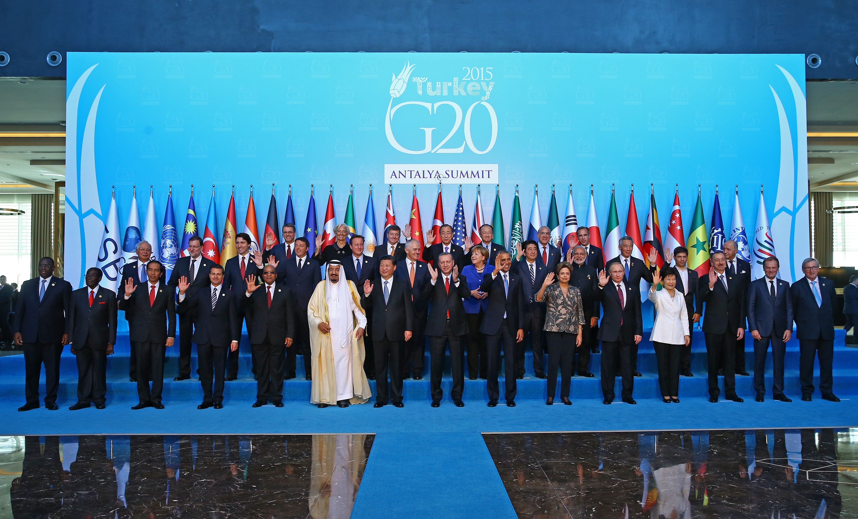
G20 Leaders endorse G20/OECD Principles of Corporate Governance
November 16th, 2015, Antalya, Turkey

Slide 3

A multiple year project
First issued in 1999
Revised in 2004 and 2015
One of the FSB’s Key Standards for Sound Financial Systems
Adapted to new economic reality of business and finance
Notes:
Can be applied in a world characterized by increased cross border ownership, a changing stock market landscape, longer and more complex investment chains, new investment strategies and trading practices and corporations whose success rely on new organisational structures and forms of capital.

Slide 4
Corporate governance is not an end in itself.

Slide 5
Trust, transparency and accountability
Corporate governance is a means to create an environment of
that promotes
corporate access to capital
increased investment
sustainable growth
financial stability

Slide 6

The Principles are also about
inclusiveness
Millions of households around the globe have their savings in the stock market.
That these corporations are well run and that they operate in an environment where they can prosper and develop affects our quality of life.
Publicly listed companies provide for more than 200 million jobs.

Slide 7
The revised Principles
I. | Ensuring the basis of an effective corporate governance framework
II. | The rights and equitable treatment of shareholders and key ownership functions
III. | Institutional investors, stock markets and other intermediaries
IV. | The role of stakeholders in corporate governance
V. | Disclosure and transparency
VI. | The responsibilities of the board

Slide 8
The OECD Corporate Governance Committee
Objective
contribute to economic efficiency,
sustainable growth,
and financial stability ,
by improving corporate governance policies and supporting good corporate practices.
Role
standard setting, monitoring and implementation assessment,
economic analysis, data gathering and information sharing,
country support and reform assistance.

Slide 9
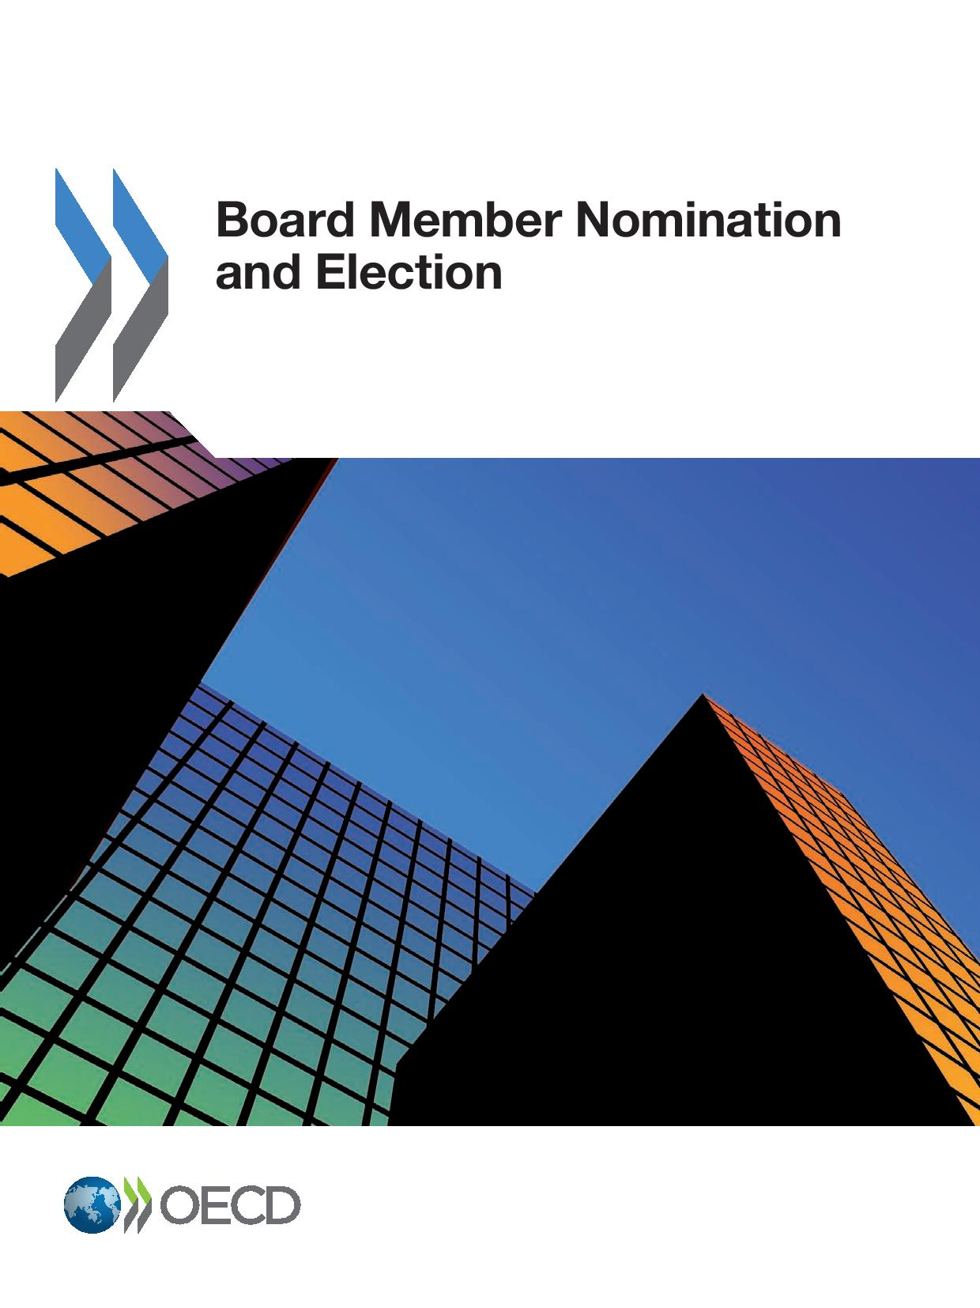


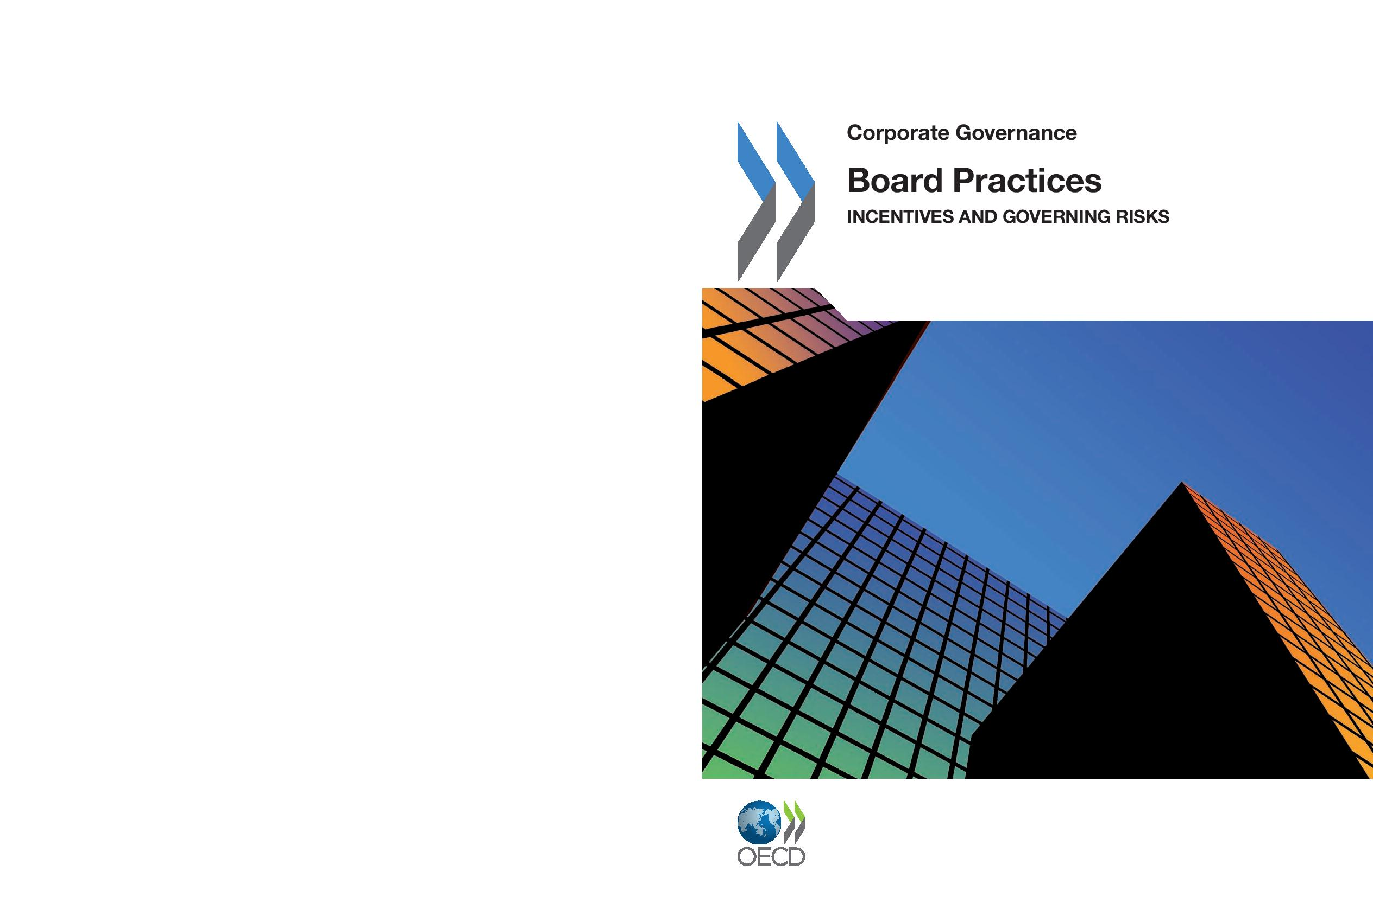
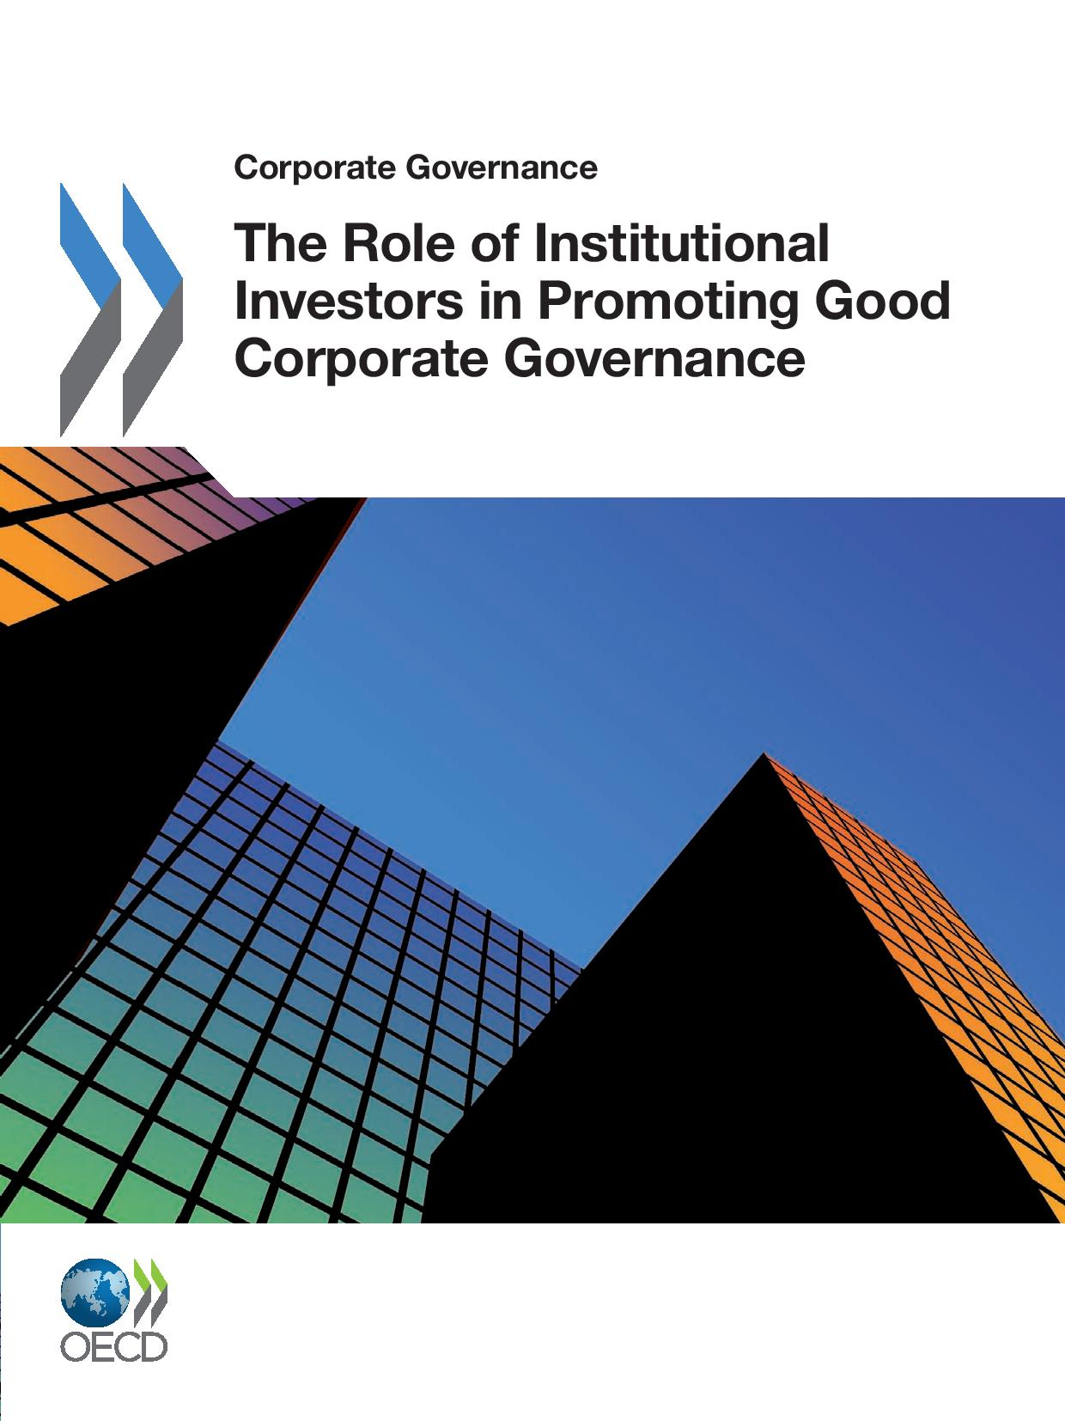

The review process
All G20 countries invited on an equal footing
Regional consultations, including in Latin America, Asia and MENA
Experts meetings and online public consultation receiving submissions from a great variety of stakeholders
6 Completed Reviews:
Supervision and Enforcement in Corporate Governance (2013)
Board Practices: Incentives and Governing Risks (2011) ‌
Related Party Transactions and Minority Shareholder Rights (2012)
The Role of Institutional Investors in Promoting Good Corporate Governance (2011)
Risk Management and Corporate Governance (2014)
Board Member Nomination and Election (2013)

Slide 10
Timeline of the latest review
Expert consultation & Corporate Governance Committee
March 2014
Corporate Governance Committee
Public consultation (internet)
Nov. 2014 – Jan. 2015
October 2014
Special Session on the Principles Review
February 2015
Corporate Governance Committee
OECD Council Meeting
March 2015
July 2015
G20 Finance Ministers & Central Bank Governors Meeting
September 2015
April 2015
G20/OECD Corporate Governance Forum

Slide 11
truely global reach
The new G20/OECD Principles of Corporate Governance have a
In addition, the new Principles are also backed by
empirical research and evaluations of country policies.

Slide 12
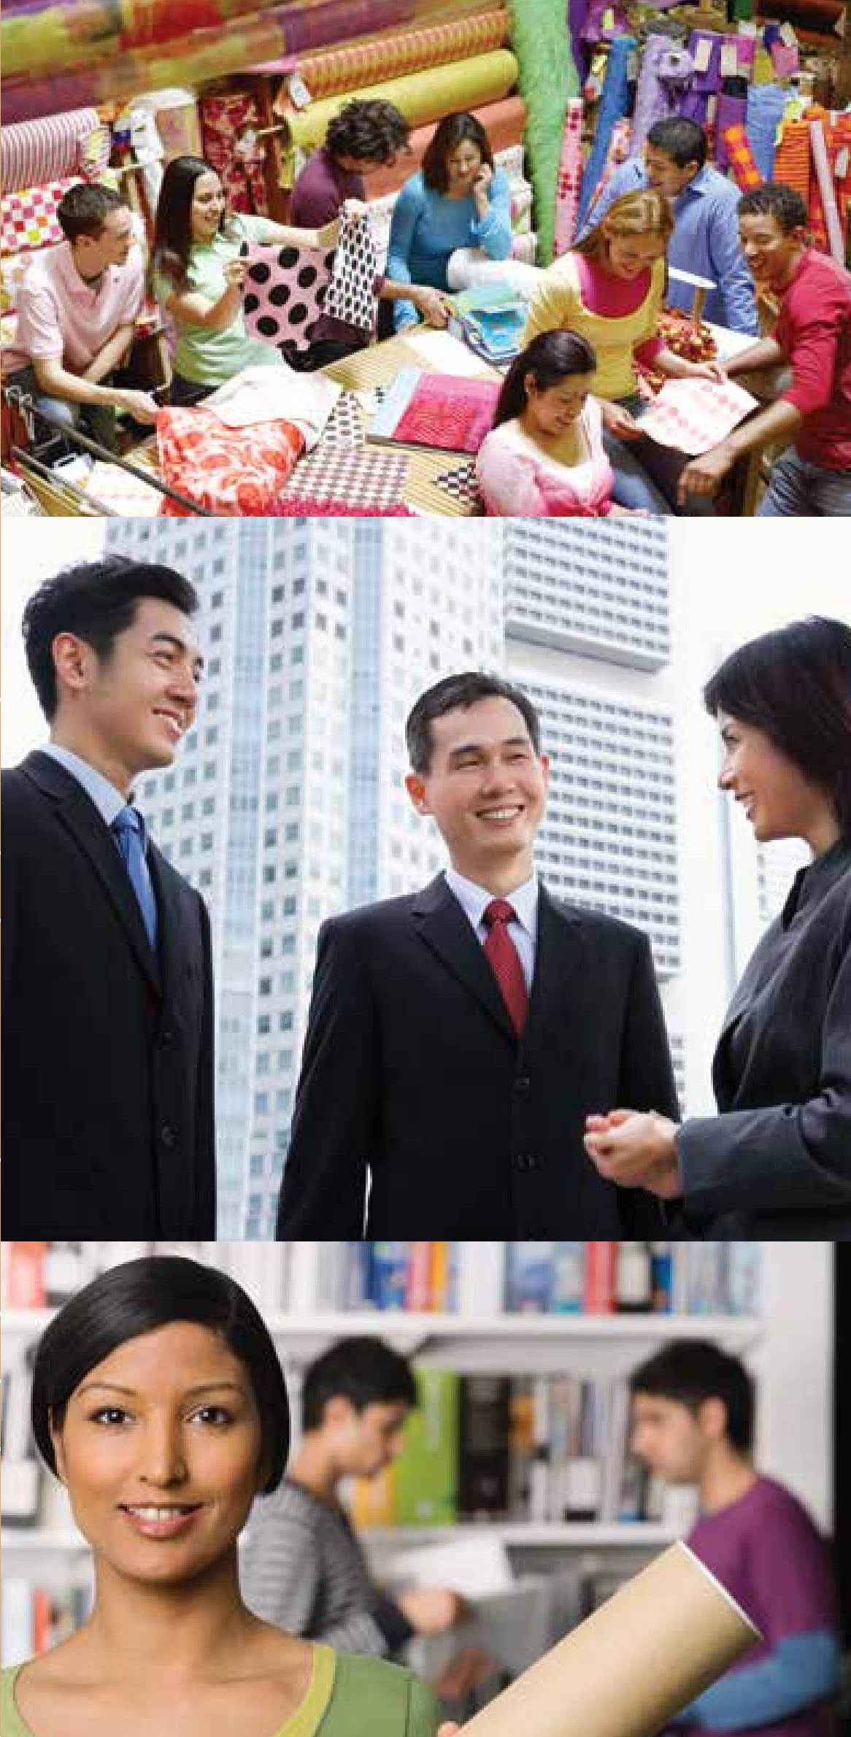
Asian roundtable
Created in 1999 after the Asian Financial Crisis
Annual gathering of senior officials, regulators, and practitioners
Evidence-based comparative policy analysis, consensus-building and knowledge-sharing
Through peer review and in-depth study by task forces, the Roundtable has supported the advancement of corporate governance policy frameworks in 14 countries across Asia

Slide 13
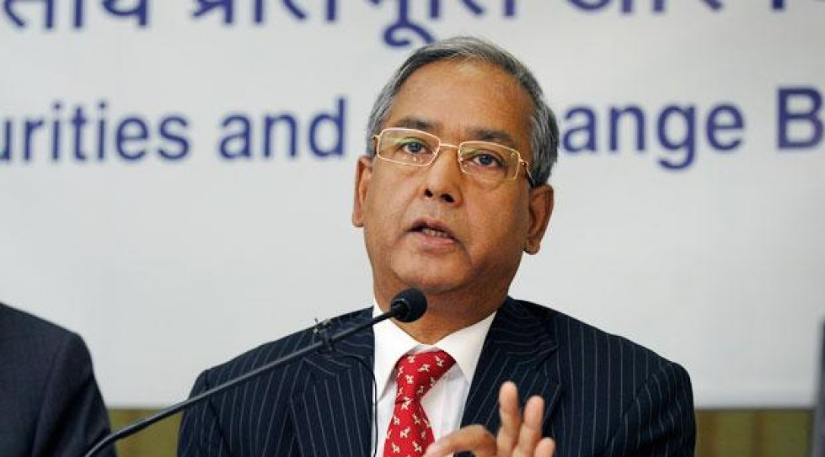
In November 2015, SEBI Chairman U K Sinha urged Indian companies to adopt the new corporate governance principles on a voluntary-basis.
"The feeling I have is that only those corporates will become leaders who adopt many of these developments on voluntary basis," Sinha said. He added that as investors become more informed and smart they would depend not only on financial results but also take a long term view on a company.

Slide 14

Thanks!
Austin Tyler
Junior Policy Analyst, Corporate Affairs Division
Directorate for Financial and Enterprise Affairs
OECD

