Slide 1

Unseen Paraphernalia - ICGD
CS Ahalada Rao V
CS Mahadev Tiruanagari

Slide 2

corporates now-a-days are not restricting to the countries of their origin

Slide 3


Each and every constituent of this world is becoming a stakeholder

Slide 4

Inundates the requirement of having an International corporate governance code – ICGC

Slide 5
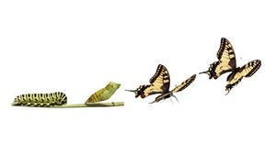
Transformation of whole corporate world into a more transparent, ethical, reliable and sustainable corporate

Slide 6

Significance to this concept by observing a Day as International Corporate Governance Day - ICGD

Slide 7

First and foremost aspect of Corporate Governance is Ethics and morality

Slide 8
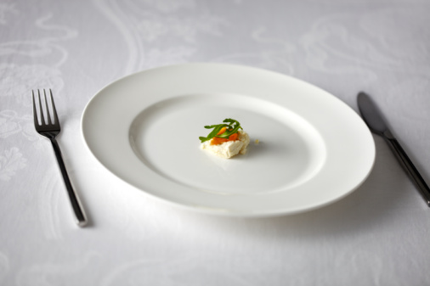
We took only a small aspect of corporate governance i.e, Disclosure aspect and that too limited only to the listed entities

Slide 9

Because of this indifferent approach the total charm of corporate governance is lost

Slide 10

To a large extent majority are indulged in some or other malpractices. However only few are popping out

Slide 11

The corporate governance practices being followed by certain countries like underdeveloped and developing nations are predominantly based on the same practices but still we are facing some or other fraudster companies emanating from time to time. And even the same kind of scenario is prevailing in those developed countries.

Slide 12

That means there is a gap in the corporate governance norms being followed

Slide 13

Do we really need to concentrate on some more disclosure norms? Or are we going to imbibe the ethics and morality into the DNA of corporate

Slide 14


Vs
Corporate governance should work as self-regulation but not to be regulated by a regulator

Slide 15

corporate governance should be enhanced from its existing horizons to newest scales

Slide 16

With this background
ICSI is mooting
International Corporate
Governance Day

Slide 17

Lot of discussion, deliberation, brain storming is needed and then only gradual evolution of good corporate governance is possible
Active support from entire world to take it forward, so that UNO can pass the necessary dictum making a day as ICGD

Slide 18


