Slide 1

User Manual for Knowledge On Demand For Students

Slide 2

Registration URL for Knowledge On Demand for Students
KOD students across 13 batches: https://g25.tcsion.com/EForms/configuredHtml/1677/62804/application.html?id=KOD-FS
KOD Annual Subscription batch : https://g25.tcsion.com/EForms/configuredHtml/1677/62804/application.html?id=KOD-FSAS

Slide 3
Steps to Fill the Registration Form
Select any of the desired topic
Select your Category as Student
Enter your Registration Number and Other Details
Accept the terms and conditions and then proceed to pay
Once the payment is successful the screen will POP-UP with a message.
Please keep screen shot of the message for future reference.
Follow the steps in following slides to continue the content access on LMS

Slide 4
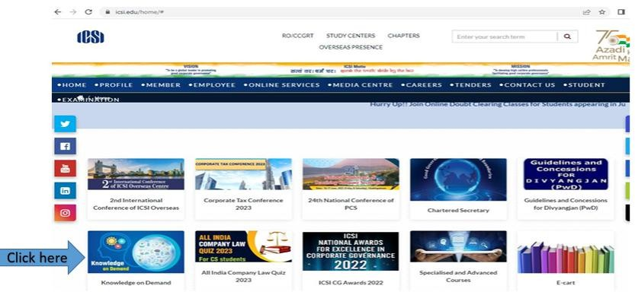
Step 1 :
Please go to ICSI website (https://www.icsi.edu/home/ )
Click on knowledge on Demand as per screenshot attached

Slide 5
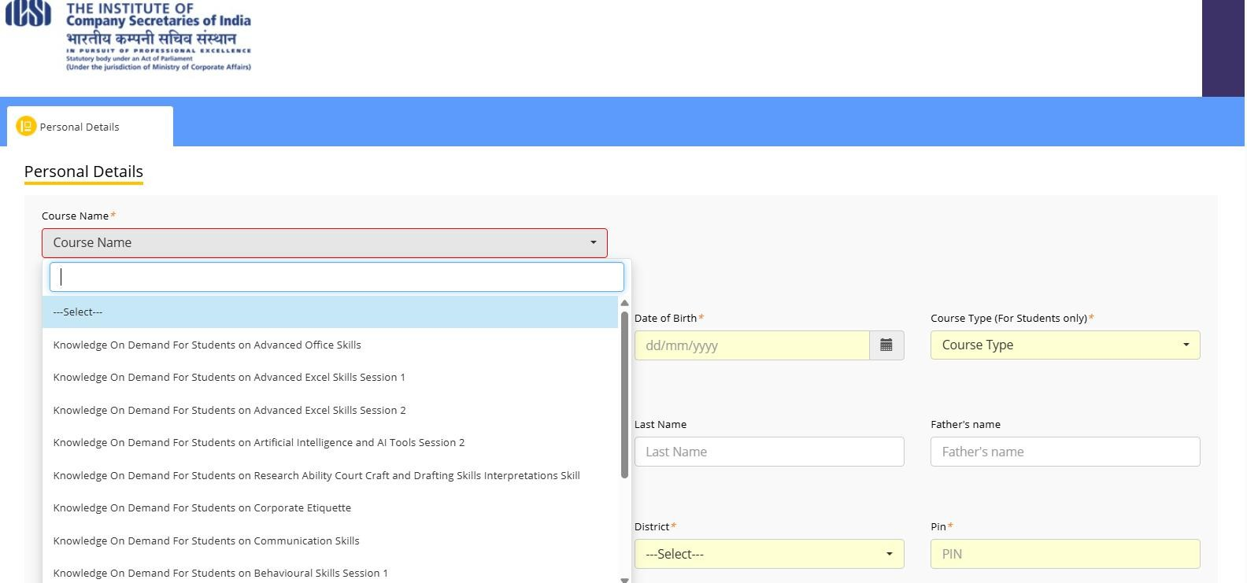
Select any course from drop down option and proceed for registration

Slide 6
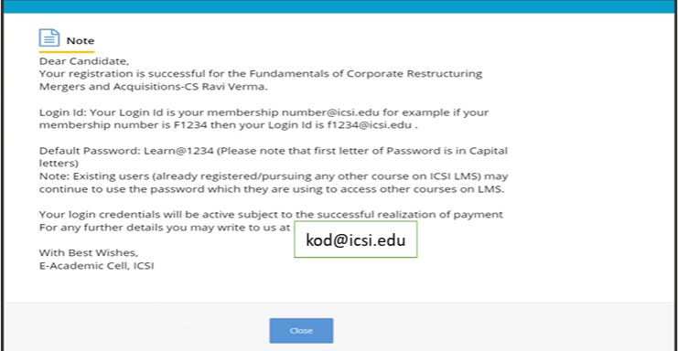
Once registration is complete a popup message will be there

Slide 7
How to Login on LMS

Slide 8
Key Information
Website to login : https://www.tcsion.com/LX/login#lx
If you are ICSI Student Your login Id will be your Registration number(without slash Sign)@icsi.edu for example if your registration number is 123456789/02/2020 then your Login Id is 123456789022020@icsi.edu
Password: Existing users may continue to use the password which has been used for other courses. In case, you have forgotten the password use Forget Password option. The password reset link will be sent to your email id registered in ICSI records.
Password reset link: https://www.tcsion.com/dotcom/PasswordPolicy/forget_pwd.jsp?orgFolder=TCSSMB&loginType=12NaN1
New users (first time users of ICSI online course). The first-time password is Learn@1234 (Please note that first letter of Password is in Capital letters)
Upon first login you will be shown CHANGE PASSWORD PAGE where old password is Default Password Learn@1234 . Please set you password using capital letters, small letters, special character and numbers (for example Light@1234). Detailed on Slide 5.
3) In case you Forgot password use the "Forgot Password" option
Where Login ID is same as above. Use email option to reset password. An email will be sent to your email id registered with ICSI where you can reset password.
We recommend Laptop/Desktop for using on the e-learning platform.

Slide 9
System Requirements
For a better experience on using LMS please ensure the following:
Good Speed internet connection (4MB/s)
Updated version of Google Chrome/Mozilla Firefox browsers. We do not recommend Internet Explorer
Preferred Screen resolution - 1366 x 768 / 1280 x 720.
Regular cleaning of browser cache memory
Pop up enabled from LMS website
Zoom level should be 100%. (You can set it through ctrl+0button)
While watching videos make sure your session is not idle/not expired. In case of buffering, please make sure you have recommended internet bandwidth, if so, please try to login again on your current session.

Slide 10
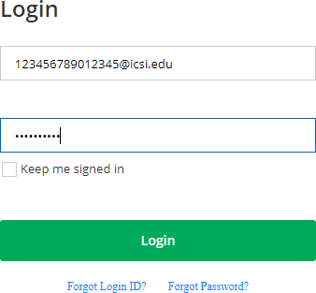
Url to Login: https://www.tcsion.com/LX/login#lx
Login with the default password and then follow the steps to reset password given in next slides
Learn@1234

Slide 11
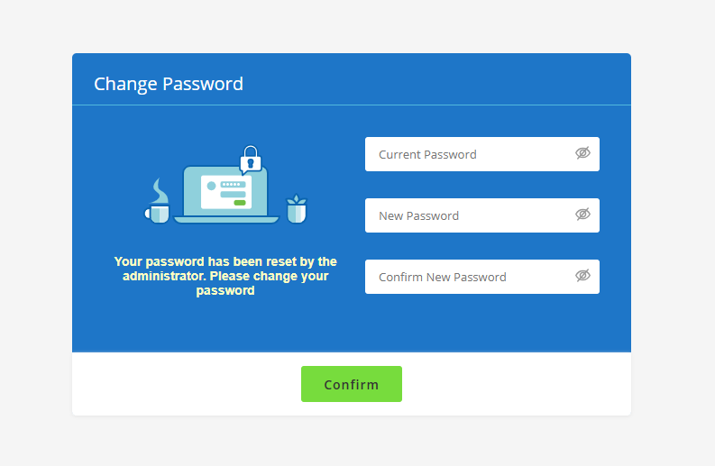
Please use your existing password in the first row. Use second and third row to set a new password that is Alphanumerical with minimum One capital , One small, one number and one special character.
Example Ace@1234
Learn@1234
Ace@1234
Ace@1234

Slide 12
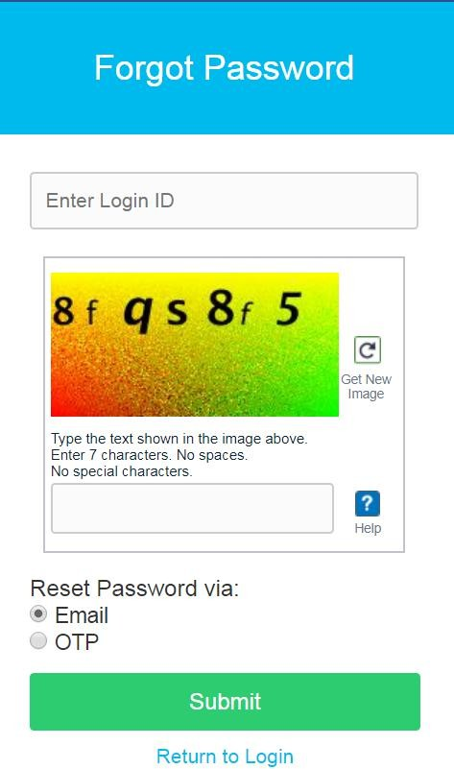
Login id :
123456789012345@icsi.edu
For Students:
Registration Number (without slash sign) @icsi.edu

Slide 13

Steps to view the Video on LMS

Slide 14
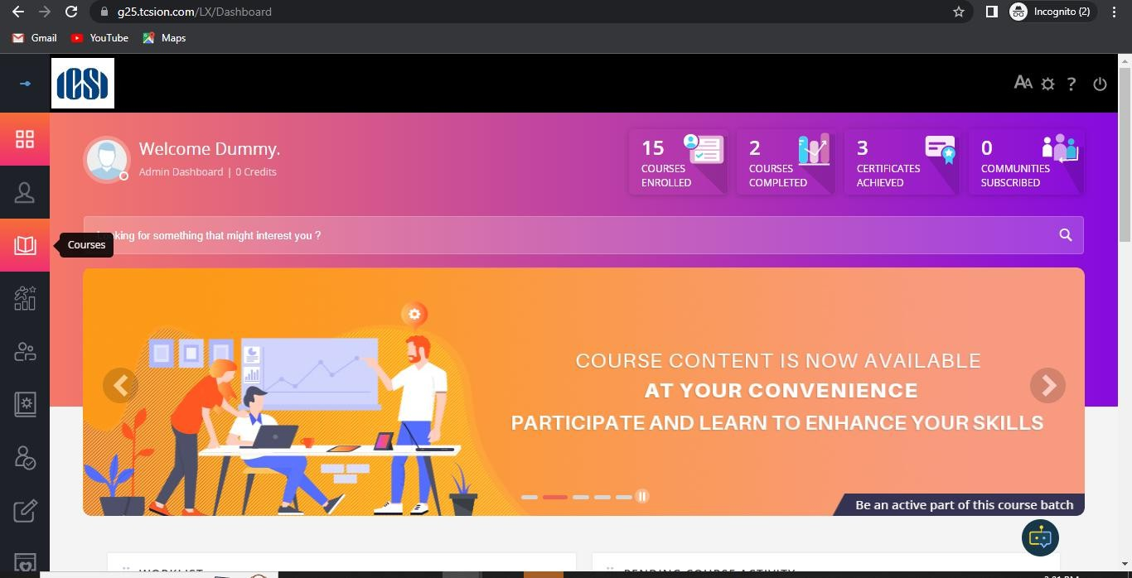
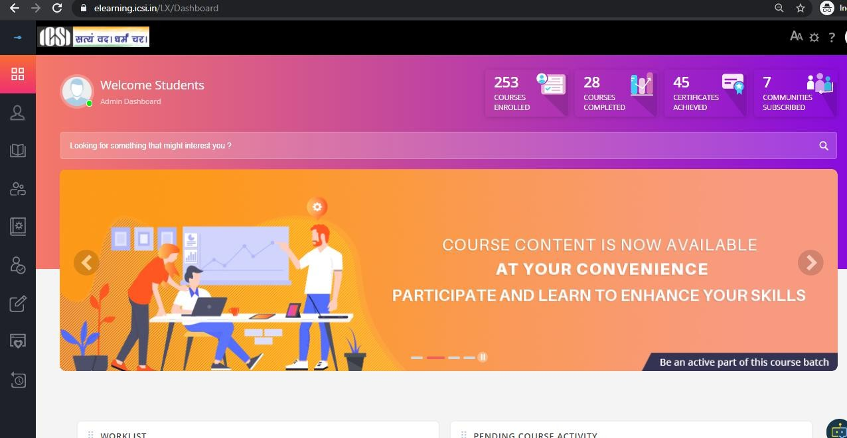

After login, click on Courses
Click on Courses
Name Display

Slide 15
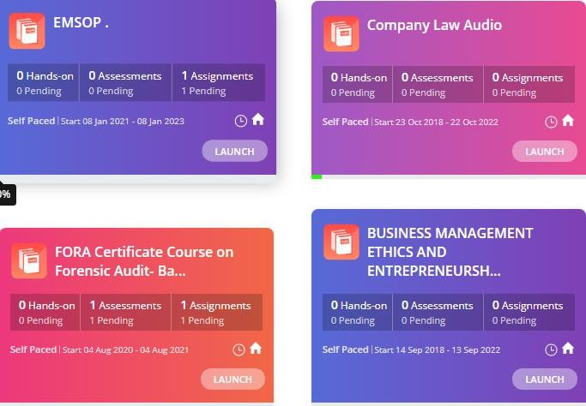

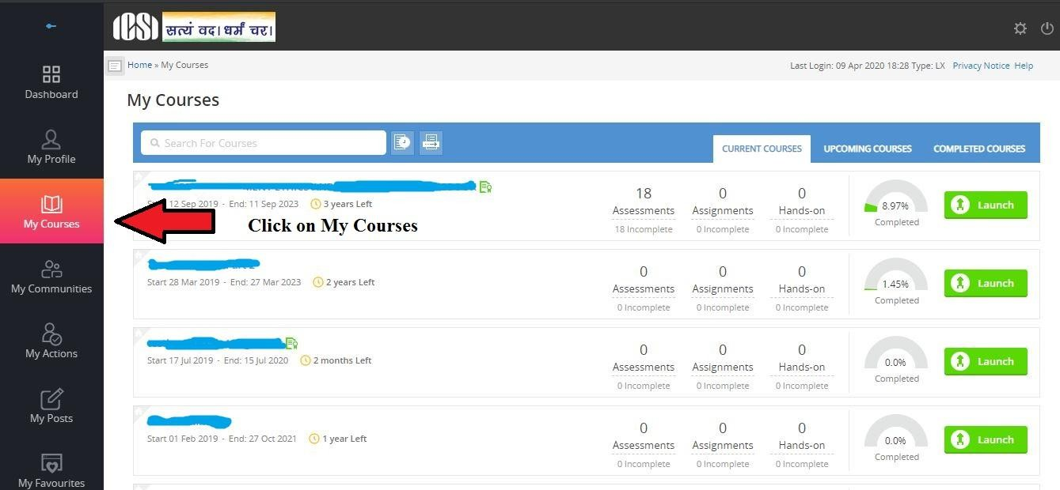



Home Page/Landing Page
CLICK ON THE LAUNCH BUTTON TO
Knowledge On Demand Batch
Course Name

Slide 16
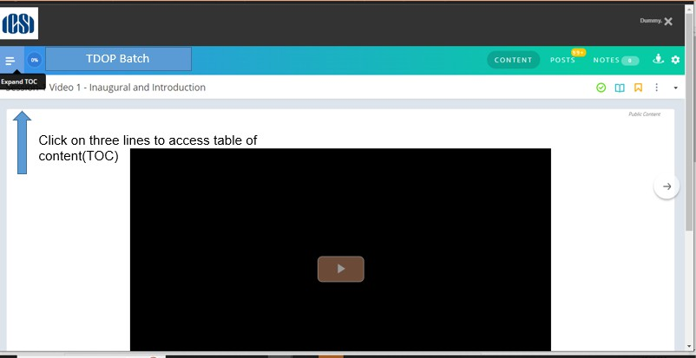
Knowledge On Demand Batch

Slide 17
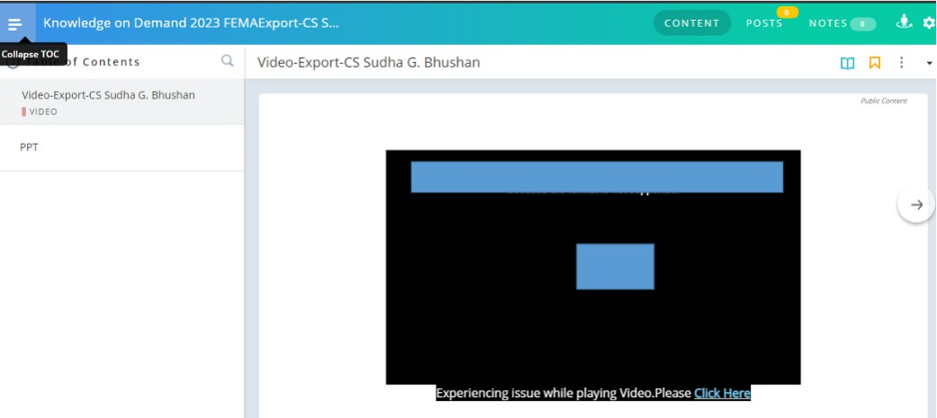
Complete all the nodes after that your course completion percentage will become 100%
Knowledge On Demand Batch

Slide 18
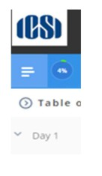
Progress Monitoring
You will be able to see the Course Completion Percentage meter in
green color on the screen from time to time

Slide 19
Contact Us
In case you still face some difficulty please write to us and mention your login ID
For assistance :
Email id for Knowledge on Demand Department: kod@icsi.edu

Slide 20
Thank You

