Slide 1

AI & EMERGING TECHNOLOGIES
VIS-À-VIS
ROLE OF COMPANY SECRETARIES
CS Haresh Jani
FCS, LLB, Fintech Professional
Image Courtesy: verdict.co.uk

Slide 2

AGENDA
Background
World Leaders on AI
Artificial Intelligence
Other Emerging Technologies
Machine Learning
Role of a Company Secretary
Compliance & Governance
Explainable AI
Cross Profession
Legal & Drafting
Consultancy & Advisory
New Opportunities
How to Stay Relevant
Image Courtesy: Chawton Parish Council

Slide 3
BACKGROUND
World is Undergoing 4th Industrial Revolution, Driven by Emerging/Digital Technologies
1st
2nd
used electric power to create mass production
used water and steam to mechanize production
4th Industrial Revolution has built upon 3rd Revolution, that is computer, electronics, internet, & automation, and is characterized by emerging Technologies. It blurs lines between physical, digital and biological spheres, thereby completely disrupting the way industries, Banking Financial Services and Insurance (BFSI), and other Business and Service Sectors work world over. Their extent and impact are seen transforming entire production, management and governance system world over. To prepare India for the economic transformation resulting from IR 4.0, Indian Government has setup an AI Task Force.
3rd
used electronics, IT, & Internet to automate
4th
Emerging Techs like AI, IoT, Blockchain

Slide 4



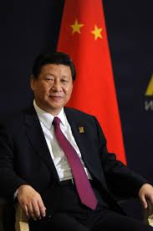
WORLD LEADERS ON AI
“Make Artificial Intelligence in India, Make Artificial Intelligence Work for India. The road ahead for Artificial Intelligence depends on and will be driven by Human Intentions.”
“continued American leadership in AI is of paramount importance to maintaining the economic and national security of the America.”
Image Courtesy: wikipedia
Image Courtesy: Youtube.com
“China must develop control and use Artificial Intelligence (AI) to secure the country’s future in the next technological and industrial revolution.”
The Nation which leads in AI will Rule the World. Russia must ensure its technological sovereignty in the field of AI.
Image Courtesy: time.com
Image Courtesy: news.sky.com

Slide 5
Artificial Intelligence
Deep Learning
Machine Learning
Artificial Intelligence
Artificial intelligence (AI) is an area of computer science that emphasizes the creation of intelligent machines that work and react like humans.
Machine learning (ML) Machine Learning is the scientific study of algorithms and statistical models that computer systems use to effectively perform a specific task without using explicit instructions, relying on patterns and inference instead.
Deep learning (DL) is part of a broader family of machine learning methods based on artificial neural networks. Learning can be supervised, semi-supervised or unsupervised.
Natural Language Processing (NLP): A subset of AI, concerned with the interactions between computers and human (natural) languages, in particular how to program computers to process and analyze large amounts of natural language data.
NLP
NLG
NLU
Natural Language Generation (NLG): A branch of NLP. It is a software process that transforms structured data into plain Natural Language content. It can be used to produce long form content for organizations to automate custom reports, as well as produce custom content for a web or mobile application. It can also be used to generate short blurbs of text in interactive conversations (a chatbot) which might even be read out loud by a text-to-speech system.
https://youtu.be/dMrX08PxUNY?t=169
Natural Language Understanding (NLU): is a subtopic of natural-language processing in artificial intelligence that deals with machine reading comprehension. Natural-language understanding is considered an AI-hard problem. In the field of artificial intelligence, the most difficult problems are informally known as AI-complete or AI-hard, implying that the difficulty of these computational problems is equivalent to that of solving the central artificial intelligence problem—making computers as intelligent as people, or strong AI.
AI needs Data to Analyze, Interpret, & give Insights & Recommendations for Decisions. AI in collaboration with other technologies like Blockchain & Smart Contracts, Big Data Analytics. IOT, RPA etc. gives a synergetic effect.

Slide 6



OTHER EMERGING TECHNOLOGIES
Blockchain, Smart Contracts, Cryptography: Blockchain is a data structure that allows to create a digital ledger of transactions and share it among a distributed network of Computers. It uses cryptography to allow each participant on the network to manipulate the ledger in a secure way without the need for a central authority. Smart Contracts are verified on the Blockchain, allowing for programmable, self-executing and self-enforcing contracts.
Big Data and Analytics: The strategy of analyzing large volumes of data gathered from a wide variety of sources, including social networks, videos, digital images, sensors, and banking & sales transaction records. It helps to uncover patterns and connections that might otherwise be invisible, and that might provide valuable insights about the users who created it.
BIG DATA
Robotic Process Automation (RPA), Robo Advisory and Chatbots: is a technology which can be used to automate various repetitive tasks that are currently being performed by humans. Using virtual robots or as they are simply called bots, this tasks can include filling online forms using an existing database excel or other database utilities.
RPA

Slide 7




OTHER EMERGING TECHNOLOGIES
APIs
Application Programming Interface (API): It is a set of protocols, routines, functions and/or commands that programmers use to develop software or facilitate interaction between distinct systems.
Internet of Things (IoT): It is a system of interrelated computing devices, mechanical and digital machines, objects, animals or people that are provided with unique identifiers and the ability to transfer data over a network without requiring human-to-human or human-to-computer interaction.
IoT
Augmented Reality, Virtual Reality and Mix Reality (AR/VR/MR): AR adds digital elements to a live view often by using the camera on a smartphone. VR implies a complete immersion experience that shuts out the physical world. In MR experience, which combines elements of both AR and VR, real-world and digital objects interact.
AR/VR
Regulatory Technology (RegTech): A blend word of ‘Regulatory Technology’ that was created to address regulatory challenges in the financial services sector through innovative technology. RegTech consists of a group of companies that use technology to help business comply with regulations efficiently and inexpensively.
RegTech

Slide 8
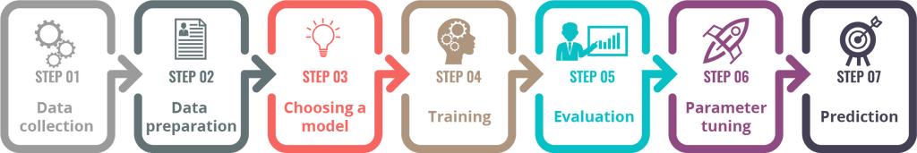
MACHINE LEARNING
Machine Learning Techniques
Machine Learning
Supervised Learning
Classification
Regression
Unsupervised Learning
Clustering
Typical Steps in ML

Slide 9




ROLE OF A COMPANY SECRETARY
Compliance
Regulatory - Form filing, disclosures & submissions
Secretarial Compliance Audit
CSR
Governance
Board
Shareholders/Investors
Other Stakeholders
Consultancy & Advisory
Setting up and managing businesses
Fund raising & Due diligence
Risk Mitigation – AML, FCPA etc.
Cross border compliance
Cross Profession
Auditing & Certification
Accounting & Reporting
Legal & Taxation
Others
Image Courtesy:
Compliance: gb-advisors.com; Governance: Thomas Pocklington trust; Consultancy: thinkcode; Cross Profession: Depositphotos

Slide 10
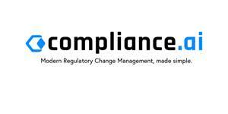




COMPLIANCE & GOVERNANCE
Regulatory - Form filing, disclosures & submissions
It aims to modernize compliance processes for both the regulators and the regulated entities. It provides Automated, customized and real-time stream of the latest Regulatory Contents, Workflows, Summaries and Reports.
It provides GRC (Governance, Risk Mitigation and Compliance) management solutions like Audit & Assurance, Controls & Compliance, Risk Management alongwith Contract Management and Legal Operations.
AI Powered iXPRT Platform for automated KYC/AML Due Diligence, Regulatory Compliance Assurance and Financial Audit.
It provides Customized Bots besides dedicated Bots for Compliance of Financial Regulations like MiFID II, MiFIR and various Cross Border Regulations.
It offers a digital on-boarding solution for banks, NBFCs and other financial institutions such as API based Bank grade digital KYC in real-time, Algorithmic Risk Intelligence - Due Diligence based on Datasets Intelligence and Blockchain based Secured Digital Contracts enabled by Biometrics.

Slide 11
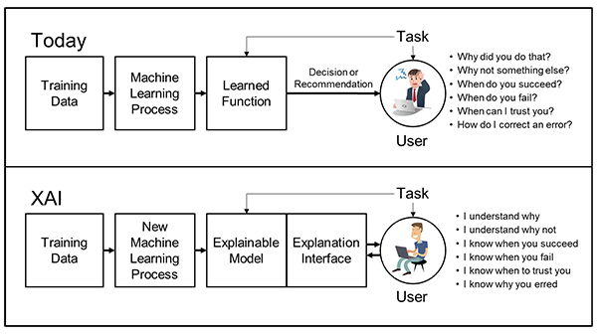
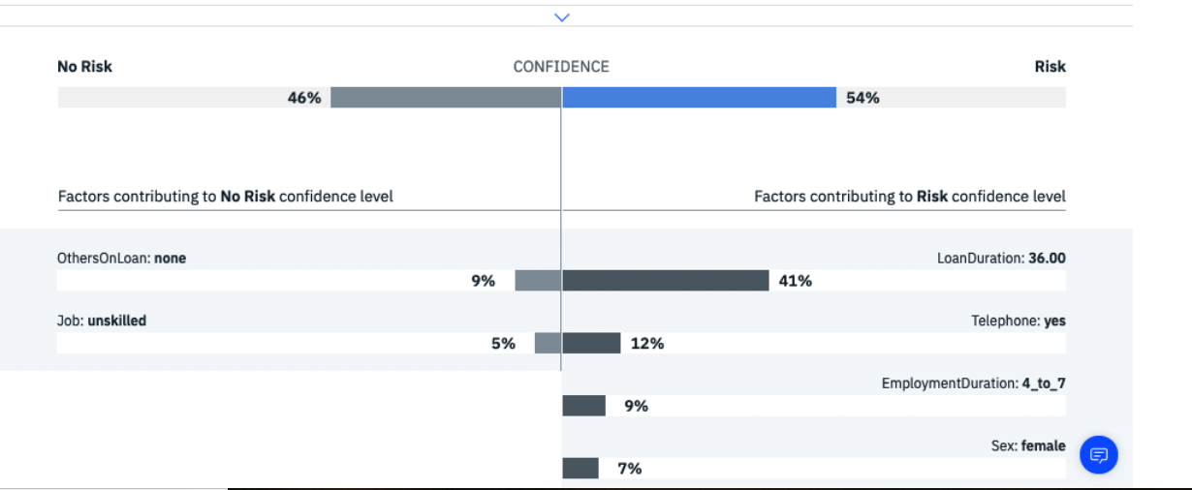
EXPLAINABLE AI

Slide 12








COMPLIANCE & GOVERNANCE
Board, Shareholders & Investors
By using Microsoft Virtual Assistant – Cortana, AI, cloud, Microsoft 365, Microsoft Graph API, Holography, IoT etc., Meetings can be made more productive.
Employees can use Alexa as their intelligent assistant to be more productive in meeting rooms, at their desks, and even with the Alexa devices they already have at home.
Minutes as a Service (MaaS) platform, in which, Robo attends Meeting by whatever means available. It records Meeting, classifies minutes by applying AI algorithms, analyses productivity of Participants using sentiment analysis. Creates minutes and action points using ML and NLP.
It provides advanced technology and operations, communications, data and analytics solutions for the financial services industry and businesses. Besides that it Streamlines Shareholder communications and Management and corporate Treasury etc.
Since Taken Over by Schwab Compliance Technologies, its Personal Trading Compliance Software helps to keep a check on, Detect and Prevent Insider Trading as well as Compliance with Code of Conduct.
Digital registry and investor relations platform. It provides Services such as Digital Registry and Investor Relations along with end-to-end Share Tokenization based on Blockchain which handles all aspects of issuance, transfers, and managing custody of security tokens and wallets.
It gives an overview of the Registered Companies alongwith graphic presentation of Connections of Directors which helps to get an idea of Related Parties.
It is a blockchain application that makes managing alongwith auditing and distributing the signatory lists and bank mandates of the Companies secure and efficient, whilst mitigating the risk of signatory fraud.

Slide 13





CROSS PROFESSION
Auditing & Certification | Accounting & Reporting | Taxation
AI powered auditing platform which revolutionizes financial analysis Lightning fast, risk-ranked analysis on 100% of transactions, with zero scripting, without risk of missing errors or fraud that may lurk in financial data.
It is a database provider with three professional databases, covering royalty rates, loan interest rates and service fees. It provides High-quality data that complies with the requirements of the OECD BEPS (Base Erosion and Profit Shifting).
Transfer pricing consultancy which simultaneously provides penalty and adjustment protection. It has weaved together it’s transfer pricing expertise with the Amazon Alexa platform to develop Fiona, the AI transfer pricing engine.
It delivers rapid automation of manual, rules-based, repetitive processes. It’s been used to automate millions of tasks for business and government organizations for improving productivity, customer experience, and employee job satisfaction.
It provides a facility of filing Tax Returns via a ChatBot named ‘TAXBOT’ which is a Registered Tax Agent with Australian Taxation Office. The Chatbot is operated via Facebook Messenger.

Slide 14






LEGAL & DRAFTING
Contract Management | Drafting | Legal Research & Analysis
It provides Contract Analytics, DMCA (Digital Millennium Copyright Act) Safe Harbor Bot, DMCA Compliance Bot, Website Term Analyzer, Legal Simplifier which simplifies complex legalese, translate the same and also Create simple visualizations and pictograms of legal language.
Amongst other services, it provides service of Contract Companion which analyses legal documents, quickly reviews defined terms, cross-references and citations and fixes mistakes in the Contract.
It analyzes structured data and describes it in human language. Specializing in the advanced form of AI known as NLG, Arria instantly converts multiple data streams into fluid textual analysis. The insights contained within data are discovered and communicated in real-time for immediate action.
It claims to use natural language processing and machine learning to extract relevant textual data from legal contracts and other documents to guide lawyers in analysis, due diligence and lease abstraction. It reduces burden of reviewing multiple contracts as well as missing out important points.
It handles contracts, portfolio reviews and investigations for risk management. It automates summaries of high-volume contract reviews. Users can read content extracts along with the meanings of clauses provided by the AI. The system is capable of flagging risky contracts automatically.
It is a AI-powered platform which can draft and sign contracts, send automated reminders, and receive payments in minutes.

Slide 15



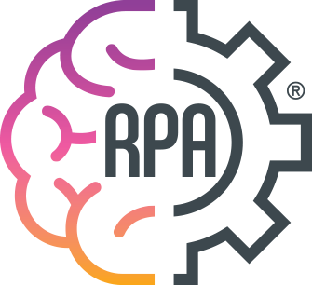

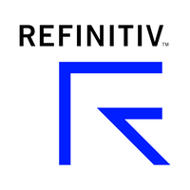
CONSULTANCY & ADVISORY
Setting up businesses | Fund raising & Due Diligence | Risk Mitigation | Automation
A next-gen formation and filing agent for the crypto and blockchain economy. It incorporates entities in some of the world's most optimized jurisdictions, tokenizes their stock and builds tools to help automate funding and governance.
A decentralized protocol that makes it easier to raise capital and create security tokens. The Security Token Standards embeds regulatory requirements into the tokens themselves, restricting trading to verified participants only. The protocol simplifies the complex technical challenges of creating a security token and aims to bring the multi-trillion dollar financial securities market to the blockchain.
A RegTech startup which helps to manage complex financial regulations digitally, Answer complex regulatory questions on the go, Integrate digital regulatory rules into systems, Access ready-to-use machine-readable rules and Turn digital rules into actionable intelligence.
RPA is a product of BPA Technologies. By use of Robotic Process Automation, it delivers cost reduction, both direct and indirect through its operational optimization services. It also provides Robot as a Service.
It has launched a product called ‘RAVN’ which can Classify, Extract and Understand Documents with AI and it can Automate Document Classification and Extraction. Further, they have Robots for various purposes such as M & A Contracts, Due Diligence, Lease Term Extraction etc.
It provides information, insights and technology that drive innovation and performance in global financial markets. It provides Services such as Due Diligence, Data Analytics for various purposes, Risk Management, Trade Execution Management etc.

Slide 16

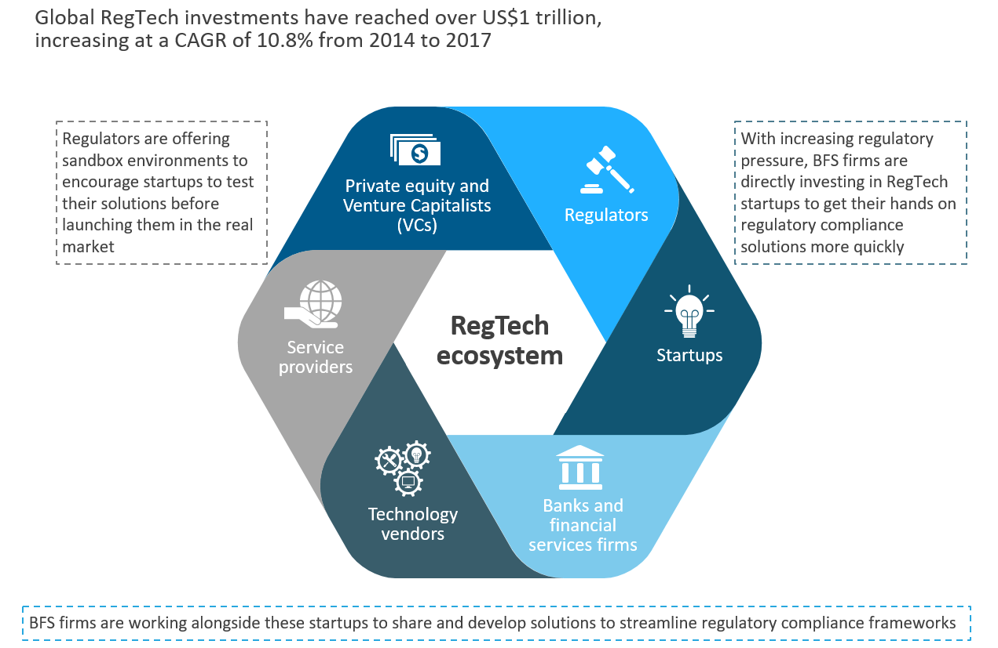





NEW OPPORTUNITIES – REGTECH & TECH-STARTUPS
Emerging Tech Compliance & Regulations
Regulatory Authorities:
SEBI, RBI
Stock Exchanges:
BSE, NSE
Legal-Tech Startups

Slide 17









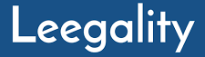


OTHER NEW OPPORTUNITIES
Data protection | Opinion Writing | Dispute Resolution & Litigation | Programmable Equity
Data Protection
Arbitration
Data Protection
Image Courtesy: investsize.com
Image Courtesy: chronicle.co.zw
Image Courtesy: Inc42

Slide 18
HOW TO STAY RELEVANT
What skills must CS develop or strengthen to be relevant and employable in 2030?
Business advisory and Strategic Consultancy: AI will do the number crunching and analysis. The CS must be able to use these to help drive long term business strategy and value creation.
Specialization in complex regulatory niches that are fluid and changing: Not everything can be automated. The importance of Continuing Professional Education (CPE) in staying abreast and remove reliance on tasks that will soon be fully automated.
Understand and Leverage Emerging Technologies & their Use Cases: Technologies like AI/ML, Big Data, Blockchain, IoT and AR/VR etc. are changing the way business happens and CS must be able to understand and embrace the technologies.
Regulatory Compliances using RegTech.

Slide 19


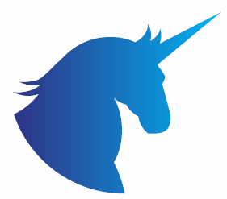
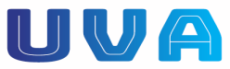
Thank You
Haresh Jani & Associates
Company Secretaries
www.hja.legal
UniVen Advisory LLP
Creating Unicorns

