Slide 1


Orientation Programme on ICSI New Syllabus (2017)

Slide 2
  “The Profession of CS has an important role to play in introducing of Professionalism in area of Corporate Management”
  By P. Shiva Shankar
  (The then Union Law Minister)
  While introducing Company Secretaries Bill, 1980 in Parliament

Slide 3
Why this New Syllabus?

Slide 4

The only constant thing in the world is ‘change’. The New Syllabus has taken utmost care to encompass the contemporary knowledge.

Slide 5

Changing Stakeholders’ Expectations

Slide 6

Stakeholders’ Expectations
Expectations of Trade and Industry
  Expand to new and emerging areas
  Focus on advisory and advocacy
  Develop soft skills
  Develop business orientation

Slide 7


Stakeholders’ Expectations
Expectations of Government and Regulators
  Compliance management
  Reliance on certification and audits
  Support in their new initiatives and policies
  Values, ethics and Professional Conduct

Slide 8

Stakeholders’ Expectations
Expectations of the Students
Quality syllabus, education and training
Employability at comparable salary
Practice opportunity

Slide 9

Stakeholders’ Expectations
Expectations of the Members
Positioning as Corporate Managers / Corporate Advisors;
Enhanced opportunities
Create Brand Equity for the Profession and Visibility
Globalization of the Profession

Slide 10
New Syllabus on Stakeholders’ Expectations
New Syllabus bridges the gaps in fulfilling changing expectations of stakeholders;
New Syllabus aims at meeting current market dynamics.

Slide 11
Our approach to ICSI New Syllabus

Slide 12
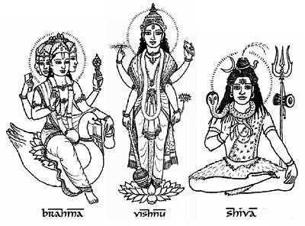
CS at every stage
Section 2 (2) of the Companies Secretaries Act, 1980 enumerates that a Company Secretary performs services in relation to:
Promotion, Forming & Incorporation
Day to day functioning of Companies
Amalgamation & Reconstruction of Companies
Reorganization of Companies
Winding Up of Companies

Slide 13
New Approach
Core
Hybrid
Skills directory
Areas of Work
Ancillary to Core

Slide 14
Broad Coverage of Laws in ICSI New Syllabus
S. No. | Law | Particulars
1. | Corporate Law | Company Law; Insolvency Law; LLP
2. | Securities Law | SEBI Act; SCRA; Depositories
3. | Tax Law | Income Tax; GST; Customs; | GAAR; PoEM Anti tax Avoidance Treaties;
4. | Law relating to other entities | Law relating to Societies; Law relating to Trust
5. | Industrial &Labour Law | Labour Law; Industrial Law; Environment Law
6. | General Law | Constitution of India; Interpretation of Statutes; Specific Relief; Limitation; Evidence; Stamp; Registration; | Arbitration and Conciliation; IPC; CPC; CrPC; RTI; General Clauses Act

Slide 15
Broad Coverage of Laws in ICSI New Syllabus
S. No. | Law | Particulars
7. | Cyber laws | · Information Technology Act
8. | Economic Law | · FEMA; · Competition Act; · Intellectual Property Law; · Consumer Protection; Consumer Protection Act; Essential Commodities; Weights and Measures; · Property Law: Transfer of Property Act; Real Estate Regulation Act (RERA); Benami Transaction (Prohibitions) Act; · SARFAESI; · DRT · Money Laundering; · COFEPOSA;
9. | Business Law | · Contract Act; · Partnership; · Negotiable Instrument; · Sales of Goods;
10. | Human Rights Law | · Sexual Harassment of Women at Workplace (Prevention, Prohibition and Redressal) Act; · Anti bribery; · Disability Law

Slide 16
Broad framework of ICSI New Syllabus
The curriculum of a Company Secretary program can be divided into the following broad areas:
Core Areas
Ancillary to Core
Hybrid
Core areas means areas in which each member of ICSI should possess expertise i.e. Company Law, Securities Law , FEMA and GST;
Ancillary to core areas means areas in which expertise is not required to be possessed by each member; however working knowledge to support core areas is required for proper understanding and application of core areas i.e. Accounts, Finance & Taxation, Business Laws, General Laws; and
Means specialized areas of expertise which require integrated application of several core/ ancillary areas.

Slide 17
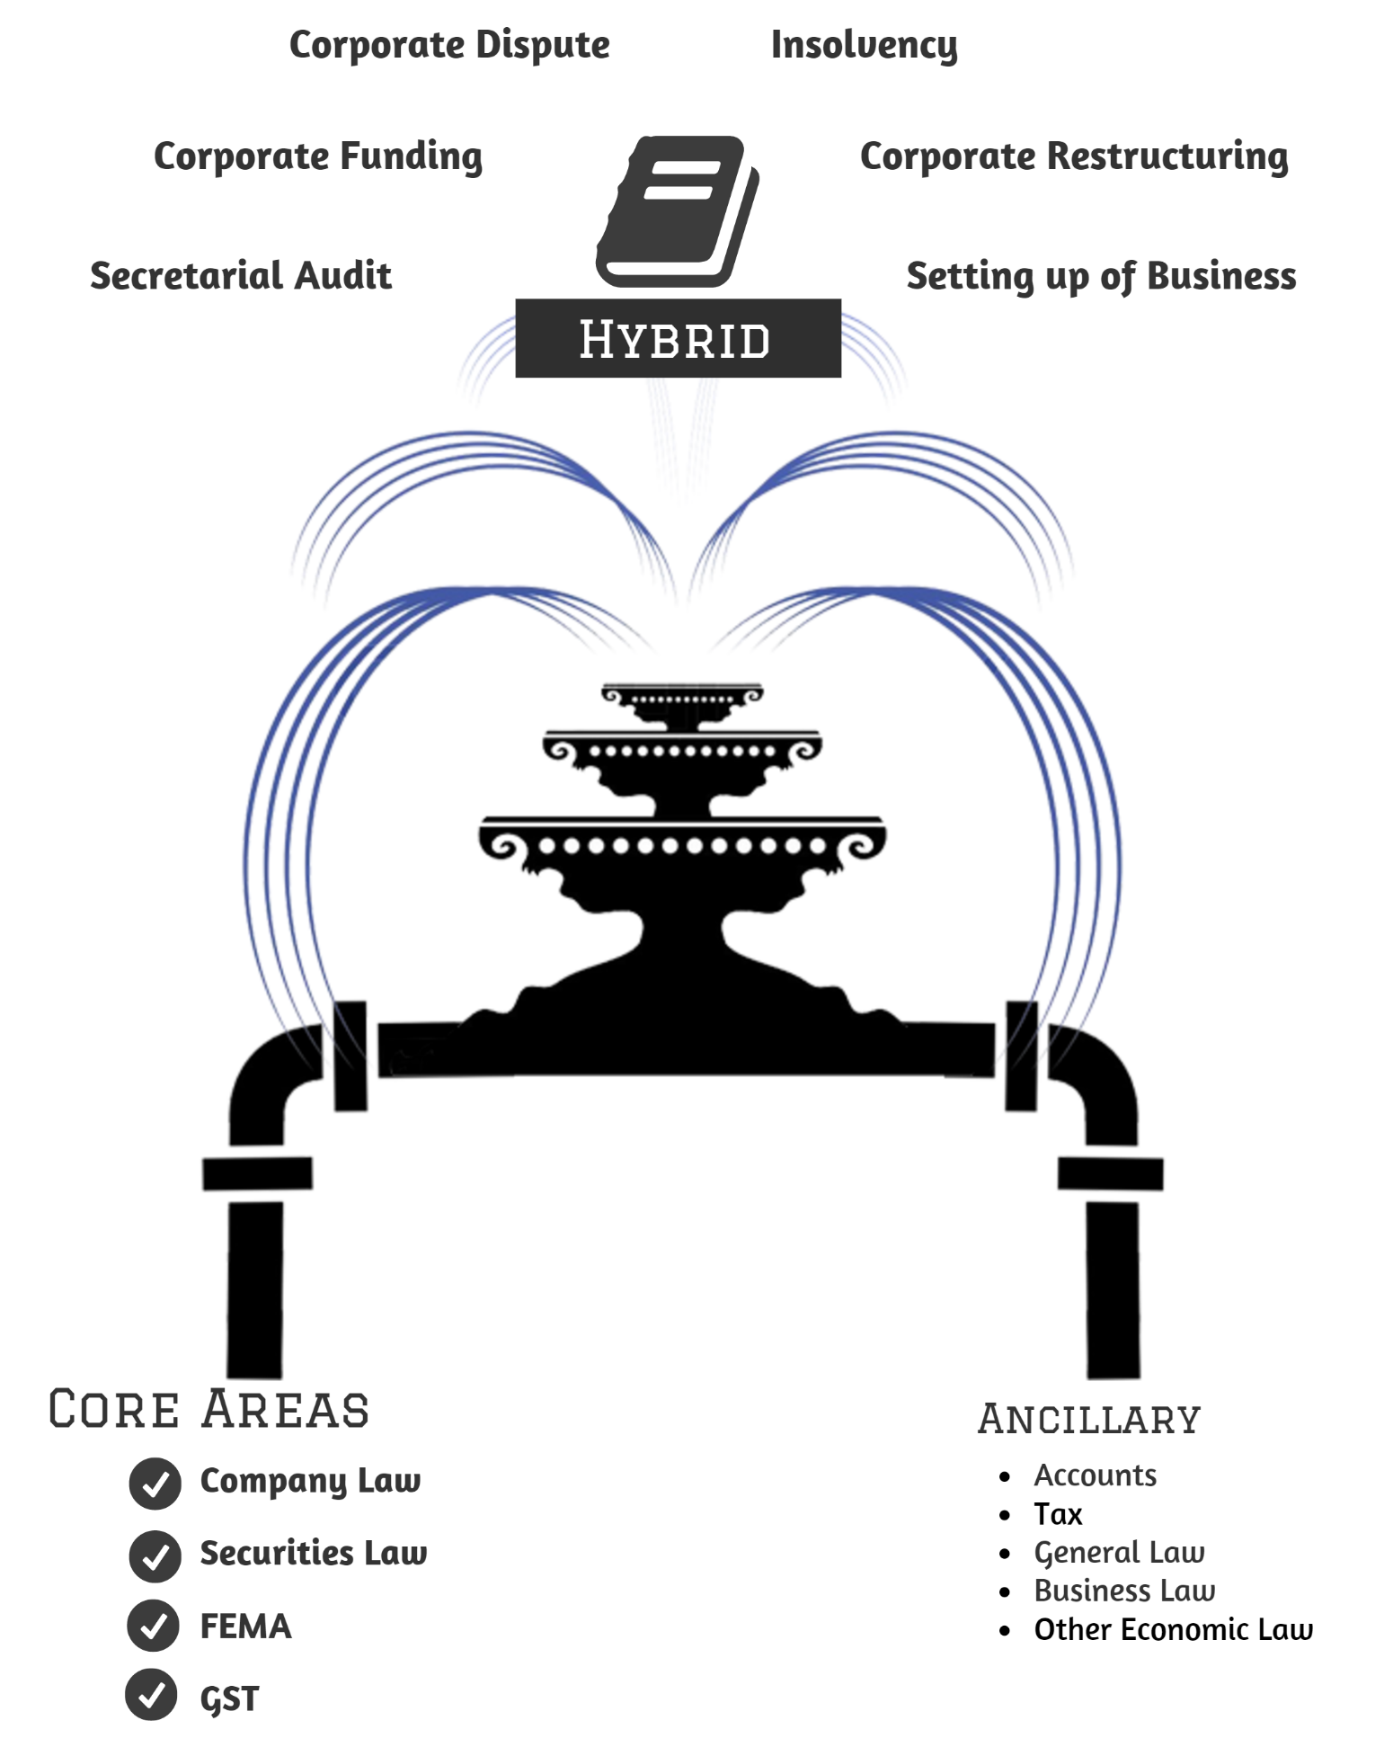

Slide 18
Scheme of ICSI New Syllabus
Executive Programme: Module 1
Paper |  | Coverage
1. | Jurisprudence, Interpretation and General Laws | Constitution of India, Law of Torts, Interpretation of Statutes & Other General Laws (Limitation, Specific Relief, Evidence, Stamp, Registration, General Clauses, CPC, CrPC, Arbitration, RTI)
2. | Company Law | Part I: Company Law, Principles and Concepts - Companies Act, 2013 except areas covered in Paper 3 (50 Marks) Part II: Company Administration and Meetings - Law and Practices (Directors, KMP, Board and General Meetings, Secretarial Standards) (40 Marks) Part III: Company Secretary as a profession (10 Marks)
3. | Setting up of Business Entities & Closure | Part A: Setting up of Business (40 Marks) 1) Setting up of various types of business & other Entities 2) Setting up of professional firms 3) Setting up of business outside India Part B: Registration, Licenses & Compliances (35 Marks) Part C: Insolvency, Winding up & Closure of Business (25 Marks)
4. | Tax Laws | Part A: Direct Taxes (50 marks) Part B: Indirect Taxes - Goods and Services Tax, Customs Act (50 Marks)

Slide 19
Scheme of ICSI New Syllabus
Executive Programme: Module 2
Paper |  | Coverage
5. | Corporate & Management Accounting | Part I: Corporate Accounting (60 Marks) Part II: Management Accounting and Valuation (40 Marks)
6. | Securities Laws & Capital Markets | Part I: Securities Laws (70 Marks) Part II: Capital Markets & Intermediaries (30 Marks)
7. | Economic, Business and Commercial Laws | Part I: Foreign Exchange Management & NBFCs (40 Marks) Part II: Competition Law (25 marks) Part III: Business and Commercial Laws (35 Marks)
8. | Financial and Strategic Management | Part I: Financial Management (60 Marks) Part II: Strategic Management (40 Marks)

Slide 20
Scheme of ICSI New Syllabus
Professional Programme: Module 1
Paper |  | Coverage
1. | Governance, Risk Management, Compliance and Ethics | Part I: Governance (50 Marks) Part II: Risk Management (20 Marks) Part III: Compliance (20 Marks) Part IV: Ethics & Sustainability(10 Marks)
2. | Advanced Tax Laws | Part I: Indirect Taxes (70 marks) Part II: Direct Tax and International Taxation (30 Marks)
3. | Drafting, Pleadings and Appearances | Drafting and Pleadings Appearing before NCLT/ NCLAT/ SAT/ CCI/ ROC/ RD/ RBI/ Stock Exchange/ SEBI/ RERA and other Tribunals/ Authorities Art of Advocacy

Slide 21
Scheme of ICSI New Syllabus
Professional Programme: Module 2
Paper |  | Coverage
4. | Secretarial Audit, Compliance Management and Due Diligence | Part I: Compliance Management (40 Marks) Part II: Secretarial Audit & Due Diligence (60 marks)
5. | Corporate Restructuring, Insolvency, Liquidation & Winding up | Part I: Corporate Restructuring (50 Marks) Part II: Insolvency, Liquidation (50 Marks)
6. | Resolution of Corporate Disputes, Non– Compliances & Remedies | Oppression & mis-management, frauds, Class Action Suits, Inquiries, Inspection & Investigation, Compounding/ Consents/ Adjudication under various Corporate & allied laws, Arbitration, Mediation and Conciliation, Prevention of Money Laundering

Slide 22
Scheme of ICSI New Syllabus
Professional Programme: Module 3
Paper |  | Coverage
7. | Corporate Funding & Listing in Stock Exchanges | Part A: Corporate Funding (60 Marks) Part B: Listing - National and International (40 Marks)
8. | Multidisciplinary Case Studies | Comprehensive and integrated application of knowledge involving multiple areas including corporate & economic laws, taxation and Valuation etc.
9. | Elective Papers | 1. Banking – Law and Practice 2. Insurance– Law and Practice 3. Intellectual Property Rights– Laws and Practices 4. Forensic Audit 5. Direct Tax Law and Practice 6. Labour Laws and Practice 7. Valuations & Business Modelling 8. Insolvency– Law and Practice

Slide 23
Subjects Assessment Cycle
1. Open a new company
Setting up of Business Entities and Closure
Executive Programme
2. Management in company
Governance, Risk Management, Compliances and Ethics
Professional Programme
3. Organic Growth of the company
Corporate Funding & Listings in S.E
Professional Programme
4. Inorganic Growth of the company
Corporate Restructuring, Insolvency, Liquidations & Winding-up
Professional Programme
5. Corporate Actions
Secretarial Audit, Compliance Management and Due Diligence | Resolution of Corporate Disputes, Non-Compliances & Remedies
Professional Programme
Principal Subjects | Company Law | Securities Laws & Capital Markets | Economic, Business and Commercial Laws
 | Executive Programme
Skills Related Subjects | Financial & Strategic Management | Jurisprudence, Interpretation & General Laws | Drafting, Pleadings and Appearances
 | Executive Programme |  | Professional Programme
Ancillary Subjects | Corporate & Management Accounting | Tax Laws | Advanced Tax Laws
 | Executive Programme |  | Professional Programme

Slide 24
Coverage of Subjects
Drafting, Pleadings and Appearances
Corporate Funding & Listings
Drafting
Corporate Disputes, Non-Compliances & Remedies
Accounts
Legal
Company Law
Securities Law
FEMA
GST
Income Tax
Setting up of Business Entities and Closure
Financial Management
GST
Governance, Risk Management, Compliances and Ethics
Strategic Management
Other Laws
Secretarial Audit, Compliance Management and Due Diligence
Corporate Restructuring, Insolvency, Liquidations & Winding-up

Slide 25
Existing ICSI Syllabus (2013)
 | EXECUTIVE |  | PROFESSIONAL |  | TOTAL
 | Marks | %Age | Marks | %Age | Marks | %Age
Core Area | 270 | 38.57% | 500 | 55.56% | 770 | 48.13%
Ancillary | 430 | 61.43% | 400 | 44.44% | 830 | 51.87%
TOTAL | 700 | 100% | 900 | 100% | 1600 | 100%

Slide 26
ICSI New Syllabus focusing on Core
 | Executive |  | Professional |  | Total
 | Marks | %Age | Marks | %Age | Marks | %Age
Core & Hybrid | 415 | 51.88% | 770 | 85.56% | 1,185 | 69.71%
Ancillary to Core | 385 | 48.12% | 130 | 14.44% | 515 | 30.29%
TOTAL | 800 | 100% | 900 | 100% | 1,700 | 100%

Slide 27
Where is Advanced Company Law in the Professional Programme?

Slide 28
Companies Act, 2013
1. Setting-up of business & closure
2. Accounts and Audits
3. Funding/ SEBI
4. Corporate Re-organisation & winding up
5. Management of Companies & Board Structure
Chapter-8 (Sections 123 to 127): Declaration and payment of dividend;
Chapter-9 (Sections 128 to 138): Accounts of Companies;
Chapter-10 (Sections 139 to 148): Audit and Auditors;
Chapter 23 (Sections 394 & 395): Government Companies
Chapter 29 (Sections 447 & 448): Miscellaneous- only fraud;
Chapter-22 (Section 381): Companies Incorporate outside India- Accounts;
Chapter-15 (Sections 230 to 240): Compromises, Arrangements and Amalgamations;
Chapter 17 (Section 247): Registered Valuers;
Chapter-20 (Sections 270 to 365): Winding Up;
Chapter-21: Part-2 (Sections 375 to 378): Winding up of unregistered companies;
Chapter-27 (Sections 407 to 434): NCLT & NCLAT;
Others:
Chapter-4 (Sections 66 to 70): Share Capital and Debentures- only Buy-back & Reduction;
Chapter-2 (Sections 3 to 22): Incorporation of Company and matters incidental thereto;
Chapter-18 (Sections 248 to 252): Removal of names of companies from the register of companies
Chapter-21: Part-1 (Sections 366 to 374) Companies Authorised to register under this Act;
Chapter-22 (Sections 379 to 386): Companies Incorporate outside India;
Chapter-26 (Section 406): Power to modify Act in its application to Nidhis;
Others:
Chapter-29 (Section 455) Miscellaneous- Dormant Company;
Chapter-3 (Sections 23 to 42): Prospectus and Allotment of Securities;
Chapter-4 (Sections 43 to 72): Share Capital and Debentures except Buy-back & Reduction;
Chapter-5 (Sections 73 to 76A): Acceptance of Deposits by Companies;
Chapter-6 (Sections 77 to 87): Registration of Charges;
Chapter-22 (Sections 387 to 391): Companies Incorporate outside India;
Chapter-7 (Sections 88 to 122): Management and Administration;
Chapter-11 (Sections 149 to 172): Appointment and Qualification of directors;
Chapter-12 (Sections 173 to 195): Meeting of Board and its Powers;
Chapter-13 (Sections 196 to 205): Appointment and Remuneration of managerial Personnel;

Slide 29
Companies Act, 2013
6. Corporate Disputes, Non-Compliances & Remedies
Chapter 14 (Sections 206 to 229): Inspection, Inquiry and Investigation; Chapter 16 (Sections 241 to 246): Prevention of Oppression and Mismanagement; Chapter 24 (Sections 396 to 404): Registration offices and fees; Chapter 25 (Section 405): Companies to furnish information or statistics; Chapter 28 (Sections 435 to 446): Special Courts; Chapter 28 (Section 442): Mediation and Conciliation Panel Chapter 29 (Sections 447 to 454): Miscellaneous
Note: Chapter-1 (Section 2): Definitions shall lie in every topic.

Slide 30
Various tests applied for developing ICSI New Syllabus
Identification of Core, Ancillary & Hybrid areas & 360 degree holistic view
Analysis of existing syllabus vis-à-vis New ICSI syllabus
Identification of topics from the existing syllabus not covered in the New ICSI syllabus with reasons
Area wise role of CS

Slide 31
Various tests applied for developing ICSI New Syllabus
Duplication of topics in New ICSI Syllabus with rationale

Slide 32
Duplication of topics (Illustrative list)
Topics | Papers | Purpose
Insolvency and Bankruptcy Code, 2016 | Paper 3: Setting up of Business Entities and Closure | Principle & Overview | Overview
 | Paper 13: Corporate Restructuring, Insolvency, Liquidation & Winding-up | Procedural & Practical | In depth
Income Tax | Paper 4: Tax Laws | Principle | In depth
 | Paper 10: Advanced Tax Laws | Procedural, Practical & representation | Main focus on International taxation
 | Paper 13: Corporate Restructuring, Insolvency, Liquidation & Winding-up | Application | Provisions relating to restructuring
GST | Paper 4: Tax Laws | Principle | In depth
 | Paper 10: Advanced Tax Laws | Procedural, Practical & representation | In depth
FEMA | Paper 7: Economic, Business and Commercial Laws | Principle & Compliance | Knowledge
 | Paper 12: Secretarial Audit, Compliance Management and Due Diligence | Advisory & Audit | Audit purpose
 | Paper 15: Resolution of Corporate Disputes, Non-Compliances & Remedies | Default Resolution | Prosecution, compounding related

Slide 33
Various tests applied for developing ICSI New Syllabus
Area-wise analysis for paper- Advisory, Procedure, Compliance, Certification, Audit, Appointment & Appearance

Slide 34
Area-wise analysis (Illustrative list)
Paper Name | Principle | Practical | Advisory | Procedure | Compliance | Certification/ Declaration/ Reports/ Signing | Audit | Representation/ Appearance Services | Appointment
Jurisprudence, Interpretation & General Laws | Y | Y | Y
Company Law | Y | Y | Y | Y | Y
Setting up of Business Entities and Closure | Y | Y | Y | Y | Y | Y |  | Y
Tax Laws: Direct Tax | Y | Y | Y | Y | Y
Tax Laws: GST | Y | Y | Y | Y | Y
Corporate Accounting | Y | Y | Y
Management Accounting | Y | Y | Y
Securities Laws & Capital Markets | Y | Y | Y | Y | Y | Y | Y |  | Y (Compliance Officer)

Slide 35
Various tests applied for developing ICSI New Syllabus
Rationale for division of papers into Executive & Professional based on ensuring employability of executive passed students

Slide 36
Secretarial Executive Certificate
      Secretarial Executive Certificate
For those who have-
Qualified Executive Programme
+
Completed Practical Training
But yet to qualify Professional Programme

Slide 37
Unique features (USP)

Slide 38
Elective Paper
Elective Paper (1 paper out of below 8 papers)
1. | Banking – Law & Practice
2. | Insurance– Law & Practice
3. | Intellectual Property Rights– Laws and Practices
4. | Forensic Audit
5. | Direct Tax Law & Practice
6. | Labour Laws & Practice
7. | Valuations & Business Modelling
8. | Insolvency – Law and Practice

Slide 39
USP of Elective Paper
Where a student wants to make career in different field like banking, Insurance etc. he/ she can select any one paper out of 8 elective papers
The syllabus for each elective paper has been designed keeping in view the concerned industries requirements

Slide 40
    Segment wise role of CS (Illustrative)
Common |  | Specific
Area of work Advisory Procedural Compliance Certification Audit Representation Type of Organisation Listed Public Companies Unlisted Public Companies Private Limited Companies Public Sector Undertakings LLPs/Partnership Firms / Others | Major type of Industry Manufacturing Trading Service E-Commerce Mines Specific Industry Automobile Biotechnology Banking and NBFCs Capital Markets and its Intermediaries Defence Equipment Financial Services Food Processing FMCG Infrastructure, Power and Telecom IT Solutions IT Enabled Services and BPO Media and Entertainment Pharma and Healthcare Real estate Textile Tourism and Hotel | Example of Segment Specific Module Industry Segment Module will broadly cover: Industry Profile Services Provided by Companies Business Scenario Both Domestic and International Stock Exchange Analysis Report Scales of Operation Specialty About Industry – Production process & its raw material Research Report Legal Framework Organisation Type (Constitution) Applicable Laws: Common: Company Law, Income tax law etc. Segment: Manufacturing, Trading, Services, e-commerce, mines, Construction; Industry: IT, FMCG, Telecom; Activity: IPR, Export, Import State Law: Shop & Establishment

Slide 41

USP- Focus on core areas
Focus on core areas of specialization where the stakeholders expect the Company Secretaries to be experts

Slide 42

USP- Progressive paper-wise scheme
Progressive paper-wise scheme so that the students to acquire step-by- step knowledge
as they move on from one module to the next module in the both the programmes

Slide 43

Every thing at one place- M & A
Holistic approach through study of all related laws at one place.
For Example: M & A- All practical aspects covered at one place.
Corporate Restructuring, Insolvency, Liquidation & Winding-up (Paper 5 of Professional Programme)
Legal Aspects: Companies Act, 2013 | Valuation
SEBI: Listing Regulations | Documentation
Competition Aspects: Competition Act | Approvals
Accounting Aspects: Accounting Standard | Stamp duty Aspects: Stamp Act
Taxation Aspects: Income Tax Act

Slide 44
Every thing at one place- Setting up of Business Entity
Setting up of Business Entity- All practical aspects from setting up of Business Entity to its closure covered at one place.
Setting up of Business Entities and Closure (Paper 3 of Executive Programme)
Choice of Business Organization
Formation of Business Entity: Company, LLP, Partnership Firm, Trust, Society, Nidhi, Producer Company, HUF, Multi state co-operative society, Asset reconstruction company, Housing Finance Company, NBFC, Micro-finance Institutions, Liaison office, Branch Office and Project Office, SPV, JV etc.
Setting up of Business outside India
Various Initial Registrations and Licenses
Maintenance of Registers and Records
Closure of Business Entity

Slide 45
Every thing at one place- Corporate Funding & Listing
Corporate Funding- All means of finance available to corporates along with practical aspects covered at one place.
Corporate Funding & Listings in Stock Exchanges (Paper 7 of Professional Programme)
Indian Equity- Private as well public funding | Listing on Indian Stock Exchanges
Debt funding | International Listing
Foreign funding | IPO & FPO
Other borrowing tools: Inter-corporate loans, deposits etc. | Documentation & Compliances

Slide 46
Every thing at one place- Corporate disputes
Corporate disputes- Various kinds of corporate disputes and their resolutions covered at one place.
Resolution of Corporate Disputes, Non-Compliances & Remedies (Paper 6 of Professional Programme)
Shareholders’ Democracy & Rights | Regulatory Action
Various Corporate Disputes | Fines, Penalties & Punishment
Fraud under Companies Act & IPC | Relief & Remedies: Compounding; Mediation & Conciliation etc.
Misrepresentation & Malpractices | Professional Liability

Slide 47
Every thing at one place- Secretarial Audit
Secretarial Audit- All aspects relating to Secretarial Audit & Due Diligence covered at one place.
Secretarial Audit, Compliance Management and Due Diligence (Paper 4 of Professional Programme)
Compliance Framework | Secretarial Audit: Scope & Practices
Entity wise Compliance, Activity wise Compliance, Sector wise Compliance | Other Audits: Internal Audit, CSR Audit, Takeover Audit, Corporate Governance Audit etc.
Documentation and maintenance of Records | Audit Engagement, Audit Process and Documentation
Segment wise Role of Company Secretaries | Due Diligence

Slide 48
Multidisciplinary Case Studies (open book)
Situation with real life context
Information from multiple sources
Multiple solutions possible
Application of multiple laws and subjects
Analysis of precedents/ decided cases
Opportunity for innovation

Slide 49
USP of Multidisciplinary Case Studies
The aim of the paper is to develop skills and abilities of a student to be able to take a complete picture of the problem by addressing multiple subjects simultaneously through creative and innovative ideas.

Slide 50

USP: Acquire competence and professional skills
Enable students to acquire competence and professional skills to develop themselves into ‘Corporate Managers’/ ‘Corporate Advisors’

Slide 51
NEW INITIATIVES

Slide 52

Online Pre-Examination Test
Online Pre-Examination Test for enabling the students to assess their preparedness for the examination of Executive and Professional Programmes

Slide 53
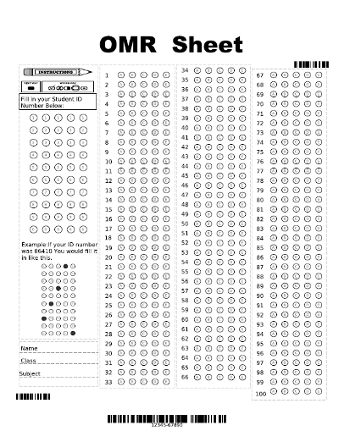
No OMR based Examination
No OMR based Examination in Executive and Professional Programme

Slide 54

Comprehensive Refurbished Study Material
Learning objectives (Paper/Chapter-wise)
If the subject matter involves any Act
  Objects and reasons of the Act, Background/Committee Report
  Jurisprudence of the law
  Act – Rules -Regulations – Notifications – Clarifications – Forms
  Family tree
Principles involved and Relevant Judicial Pronouncements
Flow chart/ Graphical/ Tabular/ Pictorial Representation Practical examples/ exercises/ illustrations/ FAQs
Procedures and practices
Subject knowledge – expert, working, overview, application
Area of work: Advisory, Compliance, Procedural, Audit, Appearance
Glossary
Summary
List of Readings for further study

Slide 55

REVAMPED EXAMINATION AND EVALUATION SYSTEM
Quality question papers in terms of coverage and desired level of knowledge;
Proper combination of theory with practice, analytics, case-laws, case studies and problem solving approach questions;
Effective and efficient evaluation system

Slide 56
Skill directory
Skill Sets
Communication Skills | Legal Skills | Management Skills | IT Skills
Verbal and Written skills Ability to communicate Power to express Ability to listen & understand | Legal drafting; Court Craft Interpretation abilities Pleadings Representative and appearance capabilities Art of Advocacy Knowledge of Applicable Laws, Rules and Regulations Application and implementation of Law Understand Compliances Systems and Procedures | Business skills- Commercial and Business Acumen. Analytical approach, sound business sense Management-Decision making, Team work, analytical skills and creativity. Strategic and corporate planning. Leadership-Board management, Coordination with regulators, stakeholders management, Stress Management, Team Building, Equation Analysis and understand various Push and Pull Factors, Risk assessment and identify action to be taken to mitigate risks. Collaborations Leading Edge- Build and maintain relationships | Info graphic; Social Media;; Digitalization; Filing Procedure Effective use of Technology for enhancement of performance such as PPT, Excel, Word etc. Updation of skill and understanding new technology used by the business

Slide 57
Areas of work
Advisory
Procedure
Compliance
Certification
Audit
Representation/ Appearance
Areas of Work

Slide 58
    Areas of work (Illustrative)
Areas | Company Law | Securities Law | FEMA
Advisory | Group Structure; Mergers and Amalgamations; Transactions; Capital Structure; Financial Structure | Further Allotment; Takeover; Insider Trading; Listing/ Delisting | FDI/ Portfolio Investment; ODI/ Liberalized Remittance Scheme (LRS); ECB; BO/ PO/ LO; NRI; Export-Import
Procedure | Incorporation/ formation of Companies; Alteration in MOA & AOA; Change in Capital Structure; M & A including fast track merger; Closure of Companies | ICDR; LODR; SAST; PIT; Delisting; Buy-back | ------Do------
Compliance | Annual base Compliances; Event base Compliances; Ongoing Compliances | ------Do------ | FCGPR/ FCTRS; Annual Returns (FDI); BO/ PO/ LO- filings; Export-Import Papers; ECB Papers; ODI Forms; Liberalized Remittance Scheme (LRS)

Slide 59
    Areas of work (Illustrative)
Areas | Company Law | Securities Law | FEMA
Certification/ Declaration/ Reports/ Signing | CS in Practice: Annual Return; Certification of Annual Return; Pre-certification of e-forms; Scrutinizer Report; Secretarial Audit Report; Return for change in stake; Declaration at the time of incorporation/ formation of Companies; Filing of statement with ROC at the time of merger CS in Employment: Pre-certification of e-forms as an officer of the Company; Signing of Financial Statement; Annual Return as an officer of the Company; Report on AGM by listed company | CS in Practice: Certification under LODR (Reg. 40, 56 & Sch. V); Compliance Certificate for listing on BSE SME Platform; Certification in case of offer of securities to more than 49 and up to 200 members CS in Employment: Compliance Certificate under Reg. 7 of LODR; Compliance report on Corporate Governance under Reg. 27 of LODR; | CS in Practice: Compliance Certificate in FDI i.e. FCGPR
Audit | Secretarial Audit; Internal Audit; Compliance Audit | Compliance Audit under LODR & ICDR | FEMA Audit; FDI/ PI Audit; ODI Audit; ECB Audit; BO/ PO/ LO Audit; Export/ Import Audit

Slide 60
    Areas of work (Illustrative)
Areas | Company Law | Securities Law | FEMA
Appointment | CS in Practice: Secretarial Auditor; Scrutinizer; Expert; Valuer; Liquidator; Legal Representative; Advisor; Technical member in NCLT; Member of Mediation & Conciliation Panel CS in Employment: KMP | CS in Practice: Legal Representative; Advisor CS in Employment: Compliance Officer; | CS in Practice: Legal Representative; Advisor
Regulatory Approvals/ Appearance | ROC; RD; NCLT; NCLAT; Central Government (MCA) | SEBI; SAT; Adjudicating Authority | RBI; GOI (Concerned Ministry); ED

Slide 61

Thank You

