Slide 1

User Manual for Certificate Courses

Slide 2
Login Information
Website to login https://www.tcsion.com/LX/login#lx
→Login id and password has been sent to your email id shared with ICSI
→ Upon first login you will be shown EXPIRED PASSWORD PAGE where old password is the password shared with you over email. Please set you password using capital letters, small letters, special character and numbers (for example Sky@1234)
→ In case you Forgot password use the "Forgot Password" option
Where Login Id is same as above (for example ABCD45678012020@icsi.edu). Use email option .An email will be sent to your email id registered with ICSI where you can reset the password.

Slide 3
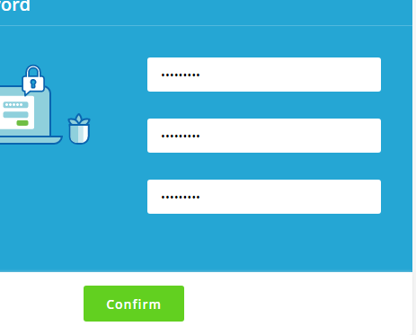
PAGE AFTER FIRST LOGIN
Alphanumerical with minimum One capital , One small, one number and one special character. Example Ace@1234

Slide 4
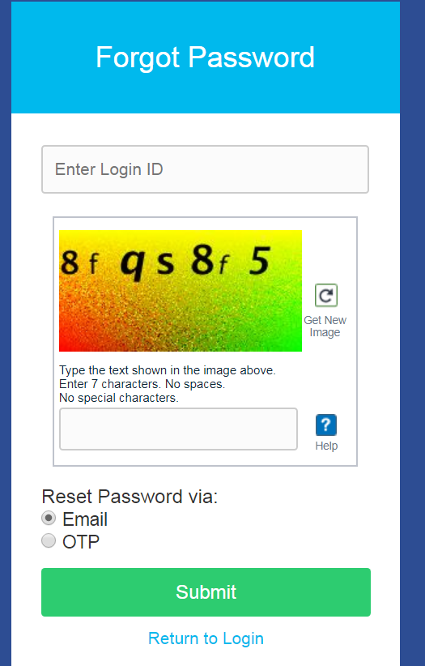

Slide 5
System Requirements
For a better experience on using LMS please ensure the following:
Good Speed internet connection (4MB/s)
2. Updated version of Google Chrome/Mozilla Firefox browsers. We do not recommend Internet Explorer
3. Preferred Screen resolution - 1366 x 768 / 1280 x 720.
4. Regular cleaning of browser cache memory
5.Pop up enabled from LMS website

Slide 6
Thank you

