Slide 1
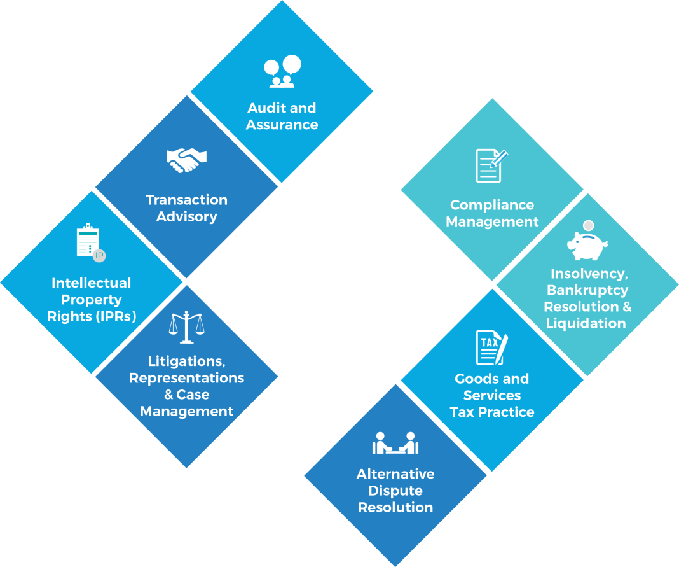

REWARDING IDEAS
RARING STEPS

Slide 2

INDEPENDENCE AND TRANSPARENCY
IN
RELATED PARTY TRANSACTIONS
NATIONAL CONVENTION OF COMPANY SECRETARIES AT BHUBANESWAR
30 August 2018

Slide 3
RPTs – focus perspective
Companies Act, 2013
Compliances
Disclosures
Ease of doing Business
LODR
Governance
Checks and balances – approvals and reviews
Investor Protection
Ind AS
Disclosures in financial statements
Risk Management
Investor Protection
Independent Professional Scrutiny
Information to Regulators

Slide 4
KINDS OF CONFLICT OF INTEREST
ACTUAL INTEREST – Being influenced by conflicting interest
Regulations capture this interest
Eg: Spending CSR funds on an NGO where a ‘distant relative’ is housed or employed
POTENTIAL INTEREST – Might be influenced by conflicting interest
To some extent the regulation capture this interest
Eg: As a director of the bank in order to secure a benefit from the third party for his partner, granting loan to a third party
PERCEIVED INTEREST – Might appear to be influenced by conflicting interest when there might not be any
Not captured by regulations
Eg: Providing employment in a key position to an old friend’s son who is highly qualified at a high pay but without adequate experience as is generally demanded by the job for other candidates. Here though the friend’s son may have true abilities to perform still this may be perceived as a conflict of interest.

Slide 5
Interested Directors (as per S184(2)) – is this sufficient?
“Interested director” means a director who is in any way, whether directly or indirectly, concerned or interested in a contract or arrangement or proposed contract or arrangement entered into or to be entered into—
a) with a body corporate in which such director or such director in association with any other director, holds more than 2% shareholding of that body corporate, or is a promoter, manager, Chief Executive Officer of that body corporate; or
(b) with a firm or other entity in which, such director is a partner, owner or member, as the case may be, shall disclose the nature of his concern or interest at the meeting of the Board in which the contract or arrangement is discussed and shall not participate in such meeting:

Slide 6
What is concerned?
Why does Section 184 say concerned or interested – definitely the word “concerned” is not synonymous of the word “interested”.
A director who is concerned in any contract or arrangement should also disclose and distance.
Certainly an Independent director may not be concerned in the contract or arrangement; but he may be concerned about the interests of the company.
In such a case, he would impartially analyse the need, the terms and conditions and express his approval or dissent.

Slide 7
OCB and Arms Length – Are they suffiicent criteria?
Before availing the benefit of exemption granted by Section 188 to transactions with Related Parties which are arm’s length transactions entered into in the ordinary course of business, the burden is upon the Board of Directors of the company to be satisfied that the transaction concerned meets both the above ingredients.
Audit Committee / Board of Directors owes a duty to study these aspects and decide requirements as to the levels of approvals required before putting through or giving effect to a transaction or contract or arrangement which falls within any of the description of specified related party transactions.
There must be a proper policy to fix repsonsibility upon the senior management to determine (a) materiality; (b) significance (could be on the basis of materiality or criticality; (c ) arm’s length basis; and (d) in the ordinary course of business.

Slide 8
Policy Level high Points
Objectives
Risk / Governance Aspects
Board Process
Focus on right time and complete disclosures
Materiality and Significant Transactions
Promoter Control
Role of KMPs / senior management
OCB / Arm’s length

Slide 9
PENAL ACTIONS THAT MAY RESULT FROM VIOLATIONS
Voidable nature of Transaction
Consequences of breach of contracts
Investigation under Section 213
Action under Section 241 of Companies Act, 2013 for oppression and mismanagement
Action under Section 245 of Companies Act, 2013 for class action suits
Action under Section 447 of Companies Act, 2013 for fraud
Enquiry into transactions under Insolvency and Bankruptcy Code, 2016 or any other law for malfeasance, or entering into undervalued or fraudulent preference transactions

Slide 10
RISK PROFILING FOR COMPLIANCES UNDER RPTs
Arms
Length
Disclosures
GRADIENT III
GRADIENT IV
Disclosures
☒
☒
Arms
Length
☑
☒
RPT
☑
☑
Arms
Length
Disclosures
☑
☒
GRADIENT I
GRADIENT II
Arms
Length
Disclosures

Slide 11
RUSSIAN LAW
Interested party transactions require approval only if such approval is demanded by:
the general director of the company;
a member of the collective executive body or the board of directors; or
a shareholder holding at least 1% of the shares in the company.

Slide 12
Ordinary course of Business – Russian law
Transactions belonging to a company's ordinary course of business (which are exempted from the applicability of the requirements to interested party and material transactions) have been defined “as transactions which belong to the activity of the respective company and other businesses conducting analogous types of activity – regardless of whether the company has executed such transactions previously – provided that the transactions do not lead to the termination, amendment of the type or substantial amendment of the scale of the company's activities”.

Slide 13
Material Transactions under Russian law
A transaction is 'material' if its subject is the acquisition or potential alienation of assets with a value of at least 25% of the balance value of the respective company's assets as of the last accounting period.
The following transactions also qualify as material:
loans, bank credits, pledges and suretyship agreements under which assets with a value of at least 25% of the balance value of the company's assets will be acquired or actually or potentially alienated;
purchases of shares in a public joint stock company which result in the company holding more than 30%, 50% or 75% of the shares in the public joint stock company and therefore becoming obliged to purchase its other shares, provided that the price for the other shares complies with the value of at least 25% of the company's assets; and
obligations to grant the temporary possession or use of assets, or a licence to use an IP right, to a third person if the balance value of the assets or IP right is at least 25% of the company's assets.

Slide 14
Approval requirements under Russian law
Non-interested shareholders of a joint stock company's general meeting must approve a transaction if:
the subject of the transaction is assets with a value equal to or exceeding 10% of the balance value of the company's assets;
the subject of the transaction is 2% of the ordinary shares of the company or of privileged shares forming 2% of all of the company's shares, unless the bylaws provide for a lower number of shares;
the board of directors cannot take a resolution on the consent, as the number of non-interested directors is less than the quorum for conducting a meeting of the board of directors.
Otherwise, approval must be granted by the joint stock company's board of directors.

Slide 15
UK LAW – Interested Transactions
Section 175 – Duty to avoid conflicts of interests
Section 177 - Duty to declare interest in proposed transaction or arrangement
Section 203 - Related arrangements: requirement of members’ approval
A company may not—
(a) take part in an arrangement under which—
(i) another person enters into a transaction that, if it had been entered into by the company, would have required approval under section 197, 198, 200 or 201, and
(ii) that person, in pursuance of the arrangement, obtains a benefit from the company or a body corporate associated with it, or
(b) arrange for the assignment to it, or assumption by it, of any rights, obligations or liabilities under a transaction that, if it had been entered into by the company, would have required such approval,
unless the arrangement in question has been approved by a resolution of the members of the company.
197 Loans to directors: requirement of members’ approval
198 Quasi-loans to directors: requirement of members’ approval
200 Loans or quasi-loans to persons connected with directors: requirement of members’ approval
201 Credit transactions: requirement of members’ approval

Slide 16
Contrasting UK and US Laws
The UK laws focus more on the internal front than the external approvals when compared to USA,
In UK law board approval emerged very quickly in the nineteenth century because the English courts accepted that the ‘no conflict’ principle was a default rule, out of which the shareholders could contract via appropriate provisions in the articles.
In the US board approval emerged more as a result of judicial and legislative development of fiduciary doctrine than through private ordering, though private ordering played a subordinate role in the US as well.
Now that the Companies Act 2006 in the UK has endorsed board approval, the two systems seem even closer in terms of functional result.

Slide 17
Contrasting with UK, US and Indian Laws – development of the fiduciary doctrine!
The significant difference lies in the manner in which the two systems respond to the risks of inadequate scrutiny under a board approval mechanism
In the general UK law, the main mechanism is prior shareholder approval of conflicted transactions. This is done for classes of transaction where the legislature has perceived the risks of inadequate board scrutiny to be substantial.
In India, as well as in UK and USA, Board approval by a disinterested quorum was a default requirement
In UK law for long controlling shareholders fell outside the doctrinal scope of UK law, and so the law developed, rather slowly, a number of piecemeal and incomplete mechanisms for dealing with this category of RPT.
So was the position in India too.
In contrast, in USA on the other hand brought controlling shareholders within the fiduciary fold.

Slide 18
YOU ARE THE BEST JUDGE OF YOUR INTERESTS
IGNORING COMMON INTERESTS FOR SELF INTEREST IS AN OFFENCE
MORALITY IS
JUDGEMENT TO DISTINGUISH RIGHT FROM WRONG
VISION TO SEE THE TRUTH
COURAGE TO ACT UPON IT
DEDICATION TO THAT WHICH IS GOOD
INTEGRITY TO STAND BY THE GOOD AT ANY PRICE

Slide 19


