Slide 1
“PCS – A Value Driven Professional”
CORPORATE GOVERNANCE & COMPLIANCE
Suhas Tuljapurkar, legasis
May 18, 2018
The LaLiT, Mumbai

Slide 2
Origin of Corporate Governance - FIDUCIARY DUTY - 1
Loyalty … Act in the Interest of the Company
Consequential aspects:
Composition of Board
Independent Directors
RPT
Conflict of Interest
Nomination & Remuneration Policy

Slide 3
Origin of Corporate Governance - FIDUCIARY DUTY - 2
Care ….. Duty to pay attention and take due care
The duty of care requires board members to act on a fully informed basis, in good faith, with due diligence and care.
Consequential aspects:
Oversight Duty
Committees
Financial Controls
Compliance
Important Aspect: Best Judgement Rule

Slide 4
Origin of Corporate Governance - FIDUCIARY DUTY - 3
Disclosure ……. Disclose all material information
Consequential Aspect:
Mandated Disclosures v Materiality Thresholds
Integrity in Accounting
QSQT
Stakeholders Committee
Important Aspect: Information Asymmetry

Slide 5
Origin of Corporate Governance - FIDUCIARY DUTY - 4
Extra Care…….. Careful Scrutiny Decision Event Based
Corporate Strategy
Investments
M&A
No clear test …Criminal Liability
Bankruptcy like situation

Slide 6
Governance
Line Item Responsibility of the Board
Governance Structure
Committees
Mandatory
Discretionary
Delegation of Authority
Evaluation of Performance of Board

Slide 7
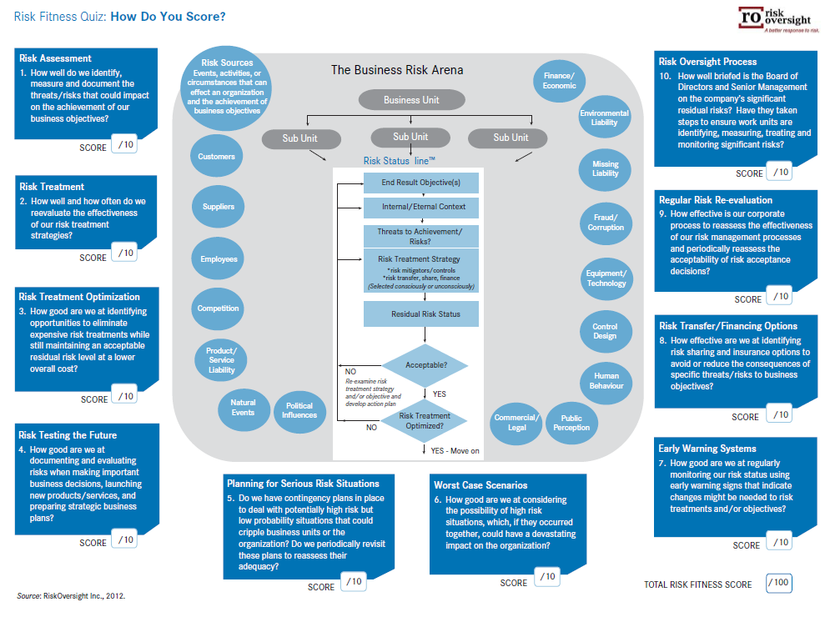
Risk
Risk as an Oversight

Slide 8
Compliance
Compliance with ALL laws
”Proper System….Adequate & Operating Effectively
Non Prosecution
Deferred Prosecution
Risk Based Approach
Business Continuity vs Prosecution
Standards of Systems
ISO 19600 Vs. ISO 37001

Slide 9
OECD Principles
The risk of “analysis paralysis”:
“Requiring directors to be ‘fully-informed’ may be misleading, because it is not possible for directors to undertake all of the analysis that may be possible – this may lead to ‘analysis paralysis.’ It is the role of management to fully analyse information, while the role of the director is to ask questions and seek second and third opinions where required before making a decision. For example, the directors of a company with a chequered history asked so many questions of management on every decision that was brought to the board that the number of agenda items quadrupled and the board became dysfunctional.”

Slide 10
Companies Amendment - 2017
ASSOCIATE, HOLDING AND SUBSIDIARY COMPANIES
ISSUANCE OF SHARES – AT A DISCOUNT; SWEAT WITHIN ONE YEAR
CHANGES SPECIFICALLY IMPACTING LISTED COMPANIES
Liability for Misstatement in the Prospectus
Relaxation in Filing of Returns
DIRECTORS AND KEY MANAGERIAL PERSONNEL– COMPLIANCE AND RESTRICTION ON TRANSACTIONS
Key Managerial Personnel–Definition
Directors
Resident Director
Independent Director – up to 10% income
Number of Directorships
Alternate Director
Disqualifications for Appointment of a Director
Resignation of Director
RELATED PARTY – INVESTING COMPANY OR THE VENTURE OF A COMPANY
PRIVATE PLACEMENT PROCESS
ANNUAL RETURN – SIMPLE FORM FOR COMPANY’S TURNOVER LESS THAN 100 CRORE
DIN - AADHAR

Slide 11
Thank You!

