Slide 1





The Institute of Company Secretaries of India (ICSI) is a premier national professional body constituted under an Act of Parliament (Company Secretaries Act, 1980).
ICSI Functions under the jurisdiction of the Ministry of Corporate Affairs, Govt. of India.
The Institute of Company Secretaries of India has been set up to regulate and develop the profession of Company Secretaries.

Slide 2

About
ICSI has its Headquarters at New Delhi and 4 Regional Councils at Chennai, Kolkata, Mumbai & New Delhi, 72 Chapters, 1 Centre of Excellence and 1 Centre for Corporate Governance Research & Training spread all over India.
The Institute has on its rolls over 65,000 qualified members both in Employment & in practice.
About 3 lakh students are currently enrolled in the Company Secretaries Course.
Conducts Examinations at around 200 Examination Centres across the country and one Overseas Centre at Dubai.
UGC recognizes CS Qualification equivalent to a Post Graduate Degree.

Slide 3
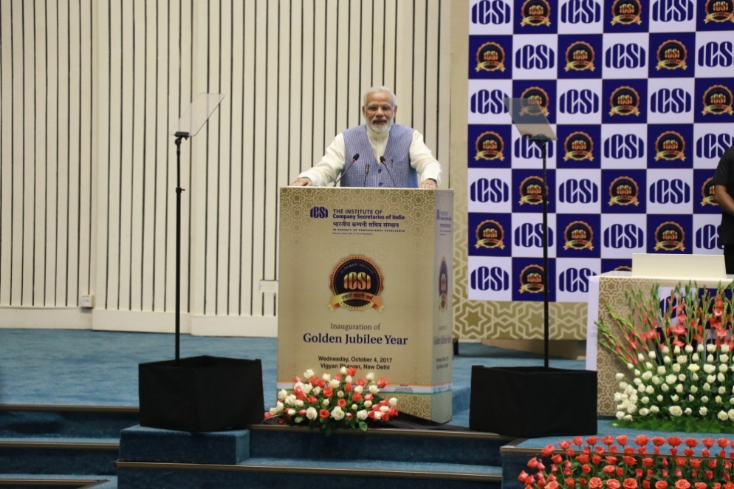
Honourable Prime Minister’s Words
‘I am honored to be with the experts who ensure every Company in the country follows the law of the land, maintain complete transparency. The onus is on you to see to it what should be the corporate culture of the country’.
‘ICSI plays an important role in institutionalizing the transparency and honesty in the country. Let us march ahead for building a New India with renewed vigor, zeal and confidence’.
‘The motto of ICSI is ‘Satyam Vada, Dharmam Chara’. It implies that one should speak the truth and follow rules and regulations. Your advice – right or wrong has an impact on the Corporate Governance of the country’.
‘The importance of a transparent and honest administrations is now understood in the country. The recommendations made by the ICSI played a positive role in formulating the Corporate Governance Framework’.
Prime Minister Narendra Modi at the Inauguration of ICSI Golden Jubilee Celebration on 4th October, 2017 at Vigyan Bhawan, New Delhi

Slide 5
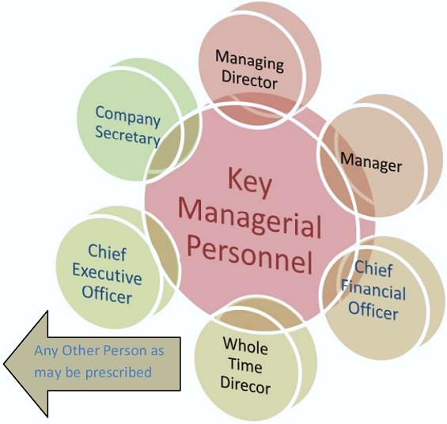
Company Secretary In Employment
Key Managerial Personnel (KMP)
The Companies Act, 2013 Act confers a special status to Company Secretary as the Key Managerial Personnel.
Every listed company and every other public company having a paid-up share capital of ten crore rupees or more has to appoint a whole time Key Managerial Personnel (KMP).
A company other than a company covered above which has a paid-up share capital of ten crore rupees or more shall have a whole-time company secretary.

Slide 6
Company Secretary In Practice
The Companies Act, 2013, has increased the opportunities for Company Secretaries in practice by introducing Secretarial audit.
As per section 204 of the Companies Act, 2013 read with Companies (Appointment and Remuneration of Managerial Personnel) Rules, 2014, following companies are required to obtain Secretarial Audit Report’ from independent practicing company secretary;
Every listed company.
Every public company having a paid-up share capital of Fifty Crore rupees or more; or
Every public company having a turnover of Two Hundred Fifty Crore rupees or more.
Every company having outstanding loans or borrowings from banks or public financial institutions of one hundred crore rupees or more.
Under the SEBI (Listing Obligations and Disclosure Requirements) Regulations, 2014 (Listing Regulations), the Company Secretary has to be mandatorily appointed as Compliance Officer except for units of Mutual Funds listed on Stock Exchanges.

Slide 7

Why Companies Hire a Company Secretary:
A Company Secretary has various roles and responsibilities :
Mobilising Resources from Capital Market through IPOs, FPO’s
Mobilising Global Resources through FDI, ECB, ADR/GDRs
Managing Corporate Restructuring
Project Planning & Execution, Regulatory Interface
Managing Joint Ventures and Foreign Collaborations within and beyond India
Treasury & Financial Management including Loan Syndication, Taxation, Project Finance
Ensuring Due Diligence and Compliances of all the laws applicable to company
Initiating Best Practices in Corporate Governance ,Corporate disclosure and reporting
Corporate Social Responsibility
CS also plays role as an Integrated Corporate Managers and are capable of undertaking wide gamut of work in all the functional areas in addition to their core area of Legal and Corporate Compliance Management.
The Companies Act, 2013, in fact, recognizes Company Secretaries as Advisors to the Board on the affairs of the Company and all matters to ensure good Corporate Governance.

Slide 8
Other Opportunities for Company Secretaries in Higher education Arena
Company Secretaries being Qualified Professionals are now in high demand in Central and State Universities and Higher Education Academic Institutions as expert educationists, in their area of specialisation.
The ICSI has Academic Collaboration with IIMs and various Universities across India for mutual development of Student and Member fraternity through various initiatives.

Slide 9
Admission Process:
How to Register for CS Executive Entrance Test(CSEET)
Eligibility
Students who have passed Senior Secondary Examination (10+2 pattern) or appearing in Senior Secondary Examination (10+2)
Registration & Examination
Register online between 16th December to 15th April
Register online between 16th June to 15th October
Fees
Register online between 16th April to 15th June
Register online between 16th October to 15th December
Registration Fee for CSEET : Rs. 1500/-
Exam in 2nd/3rd week of July
Exam in 2nd /3rd week of November
Exam in 2nd /3rd week of January
Exam in 2nd/3rd week of May
(Fee Particulars: Registration Fee Rs. 1000 /- + CSEET Reference Book (MCQ based sample questions) - Rs. 500/-)

Slide 10
CS Executive Entrance Test (CSEET) Schedule
The CSEET is held on a single day consisting of :
a) Computer Based MCQ Test : Duration: 120 Minutes on the following Subjects:
(i) Business Communication;
(ii) Legal Aptitude & logical Reasoning
(iii) Economic and Business Environment &
(iv) Current Affairs

Slide 11
Categories eligible to get exemption from CSEET Effective from 20.6.2021:
• CS Foundation Programme Passed Students (Exemption Fee : Nil)
• ICAI (The Institute of Chartered Accountants of India) Final Course passed Students (Exemption Fee : Rs.5000/-)
• ICMAI (The Institute of Cost Accountants of India) Final Course passed Students (Exemption Fee : Rs.5000/-)
• Graduates (having minimum 50% marks) or Post Graduates (without any criteria of minimum % of marks) in any discipline of any recognised University or any other Institution in India or abroad recognized as equivalent thereto by the Council (Exemption Fee : Rs.5000/-)

Slide 12
Initiative by ICSI during COVID -19 Pandemic
• 100% Concession in fees payable at the time of registration in CS Executive Program to the students who lost their parents/legal guardian/adoptive parents due to any reason, including Covid19 pandemic.
ICSI in alignment with various social initiatives of Govt. of India has come up with fee waiver initiative for the students who lost their parents/legal guardian/adoptive parents due to any reason, including Covid19 pandemic. Fees of such students payable at the time of registration in CS Executive Program shall be waived off.

Slide 13
Cut-off Dates for Registration in Executive Programme & Professional Programme
CS Executive Programme
CS Professional Programme
CSEET Passed students with +2 passed certificate / Mark sheet
CS Executive Pass
31st May (both modules of Executive)
in December Same Year
31st July (one module of Executive)
in December same Year
31st May (both modules of Professional)
in December Same Year
31st July (any one module of Professional)
in December Same Year
30th November (both modules of Executive)
in June Next Year
31st January (one module of Executive)
in June same Year
30th November (both modules of Professional)
in June Next Year
31st January (any one module of Professional)
in June same Year

Slide 14
Company Secretaries Course Details
CS EXECUTIVE PROGRAMME
Module- 1 Jurisprudence, Interpretation & General Laws Company Law Setting up of Business Entities and Closure Tax Laws |  | Module – 2 Corporate & Management Accounting Securities Laws & Capital Markets Economic, Business and Commercial Laws Financial and Strategic Management
CS PROFESSIONAL PROGRAMME
Module- 1 1. Governance, Risk Management, Compliances and Ethics 2. Advanced Tax Laws 3. Drafting, Pleadings and Appearances | Module – 2 4. Secretarial Audit, Compliance Management and Due Diligence 5. Corporate Restructuring, Insolvency, Liquidation & Winding-up 6. Resolution of Corporate Disputes, Non-Compliances & Remedies |  | Module – 3 7.Corporate Funding & Listings in Stock Exchanges 8. Multidisciplinary Case Studies (The examination for this paper will be open book examination) 9. Electives 1 paper out of below 8 papers 9.1 Banking – Law & Practice 9.2 Insurance– Law & Practice 9.3 Intellectual Property Rights– Laws and Practices 9.4 Labour Laws & Practice 9.5 Insolvency – Law and Practice (The examination for this paper will be open book examination)

Slide 15
Fulltime Integrated Company Secretary Course (Executive Programme)
Key Highlights of the Course
Limited Batch Size (Maximum 50)
Full day classroom teaching with detailed coverage of CS Syllabus
Experts from Industry and Academia as faculty
Special personality development sessions to groom students
Industry and regulatory body visits (Like BSE, NSE, SEBI, NCLT, Factory Visit, etc)
Special sessions on Mock Board Meetings, Mock AGM and Moot Court to give corporate flavour
Reading room and Library Access with free Wi-Fi access for beyond classroom learning
State of the art infrastructure facilities
Dedicated Academic Officer to guide you through out the Course
Complementary attendance of in-house workshops of ICSI-CCGRT on non-residential basis
Special coffee sessions with lead Company Secretaries from big corporate houses
Assistance for long term training and placement by ICSI-CCGRT
Residential Course. Stay within CCGRT Campus. Air-conditioned Hostel Rooms
Eligibility Criteria
Any of the following
  Company Secretary Executive Entrance Test (CSEET) Cleared
  Any graduate with 50% or Any Post Graduate#
#Need to take exemption from CSEET
Selection Process
Students who fulfils above criteria needs to undergo following as may be adopted by CCGRT:
Written Test
Group Discussion and
Personal Interview
Visit www.icsi.edu for further information.

Slide 16

One Day Mandatory Orientation Programme
The Institute has introduced one day mandatory orientation programme for executive and foundation students’ w.e.f. 1st June, 2019.
The students getting registered in CS Course on or after 1st June, 2019 are required to undergo One Day Orientation Programme before their enrolment in the Examination.
The objective of the Orientation Programme is to apprise the newly admitted students to know about their Institute, role & responsibility of a Company Secretary, scheme of studies, course curriculum, duration of the programme, examination pattern, modalities of practical training, skills and aptitude required to be a CS, how to be a successful professional etc.

Slide 17
Placement Support to CS Professionals
ICSI has a dedicated Placement Cell for:
Collaboration with PSUs, Government offices for special placement drives for the ICSI Rank holders
Representation to Department of Personal and Training for considering CS qualifications for Legal and Administrative positions
Leveraging the intellectual and emotional bandwidth of the institute, essential to spawn tomorrow's global leaders today.
Meet Employers / Recruiters and understand the industry expectations, jobs profile, salary packages and future assignments
Organising HR conclaves for building industry relations
Collaboration with Corporates for better job oppournities

Slide 18

Placement & Pay Package
• In recent campus interviews, the meritorious students, having become fresh Company Secretaries, were picked up by regulators and reputed companies at very attractive starting salaries.
• In the large corporate and multi-national companies, they are attracting huge pay packages ranging between Rs. 25 lacs and Rs. 1 crore per annum.
• Salary packages, of course, depend upon the capabilities and capacities of a person and vary from sector to sector.

Slide 19


Pre-Membership Training
1 month Executive Development Programme
(15 days online mode 15 days classroom mode)
21 month practical training with Industry/ PCS **
(after completing Executive Programme)
1 month Residential Corporate Leadership Development Programme
(after completing Professional Programme)
**Exemption is granted if the candidates
possess practical experience

Slide 20
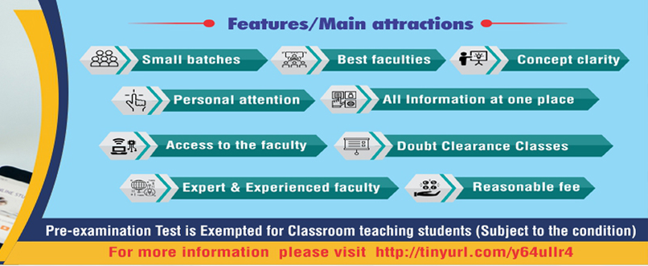
ICSI Classroom Teaching Centres
at Regional Councils/Chapters and
ONLINE CLASSES
Pre-examination Test is Exempted for Classroom teaching Students(Subject to the condition)
For more information please visit http://tinyurl.com/y64ullr4)

Slide 21
Optimal fee in comparison to Private Coaching Centres.
Library facility with latest books
Distinguished Faculties and a blend of academicians from premier institutions, Professions and industry experts.
Learning through practical approach
100% coverage of Syllabus
Special programme/ special Guest Lectures
Exemption from Pre-exam test subject to the clearance of respective subject/Module
Demo lectures, Mock Tests, Crash Courses
After Taking Admission in CS Executive Programme Students can join Classes ,
at ICSI Regional / Chapter Offices of the Institute at the following link:
https://www.icsi.edu/media/webmodules/websiteClassroom.pdf

Slide 22
Register Online for CSEET Now
Visit www.icsi.edu or Click on Link
https://smash.icsi.in/Scripts/CSEET/Instructions_CSEET.aspx

