Slide 1
CHALLENGES FACED BY COMPANY SECRETARIES DURING CORONAVIRUS & LOCKDOWN PERIOD

Slide 2
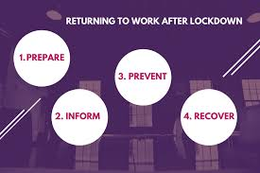
Strategy or plan of action DURING/AFTER LOCKDOWN
What need to be reviewed and improved
What will be the ‘new normal’ look like
How to prepare for the change arisen due to Pandemic
How to convert challenges into opportunity

Slide 3
Challenges faced DURING LOCKDOWN
Change/Alteration of Articles by passing Resolution for Hybrid & Fully Virtual AGM’s.
Virtual AGM was unacceptable to many Proxy Advisors & Shareholders of some Big-sized Companies worldwide.
Digitizing processes and bringing in new technology under cost-cutting measures.
Bridging the communication gap between company & all its stakeholders and redressal of their grievances.
Ensuring right security controls & procedures are in place as company’s sensitive information being talked about from homes.
Preparation of various Documents, Filing Of Forms, taking approvals from Directors/Shareholders/Regulatory Authorities.
Additional pressures of Home Life, Mental & Physical Health issues,etc.
Compliance of Corporate Governance Practices keeping in view the restrictions on travel & social distancing measures.
Not having access to certain Hardware like Printers,Scanners,etc.

Slide 4
Areas of governance need to be addressed
Company Secretaries should keep in mind the above core areas, while advising their company’s management, in particular over the next few months as we return to a semblance of normality :
DIRECTORS:
The companies have been taking tough decisions during the Pandemic & will continue to take in months ahead. So, he/she need to focus on the essentials and keep good records in board papers and minutes of the reasoning behind the board's thinking.
STAKEHOLDERS:
While making decisions Directors/CS need to "have regard to" their stakeholders, particularly their employees, customers and suppliers, creditors together with the community and the environment to achieve their targeted goals.
REMUNERATION:
Director and senior executive remuneration is usually under the spotlight during this Pandemic. For this an appropriate Remuneration Policy must be designed keeping in view the current scenario.

Slide 5
Areas of governance need to be addressed (contd.)
AGM(s)/BOARD & COMMITTEE MEETINGS:
Some companies have postponed their meetings or held off sending out a notice during the lockdown & still facing the issues to hold meeting within prescribed time frame & some Companies are also able to convene meetings in a flexible way using a range of technologies. Articles should also be reviewed to ensure they give maximum flexibility in postponing and adjourning an AGM and holding hybrid/potentially fully virtual meetings. Therefore, adequate measures must be taken to ensure viability & tranquility of the meetings.
DIVIDENDS:
Many companies have either cancelled or reduced a planned final dividend at their 2020 AGM & in lieu of that declared Interim Dividend, as there is no need of shareholders approval Board can alone declare that, to help release payment earlier to the shareholders(e.g. Castrol India). Thus, a review of dividend policy should be an item for the board agenda and large shareholders may expect to be consulted.
CORPORATE REPORTING:
As various reporting deadlines were extended by Regulatory Authorities, early planning & engagement must be made with various Committees of company to ensure smooth functioning.

Slide 6
EFFECTs OF LOCK DOWN DUE TO COVID-19
Layoffs/Furloughing of many Company Secretaries & other Employees, who were in employment or close to their retirement period .
Complete Salary cuts or Percentage-wise reduction in Salary was made to deal with Revenue Reduction due to the Pandemic.
Some Companies have put recruitment on hold/halted their hiring process until the situation improves.
Challenging situation for fresher in competitive hiring market.

Slide 7
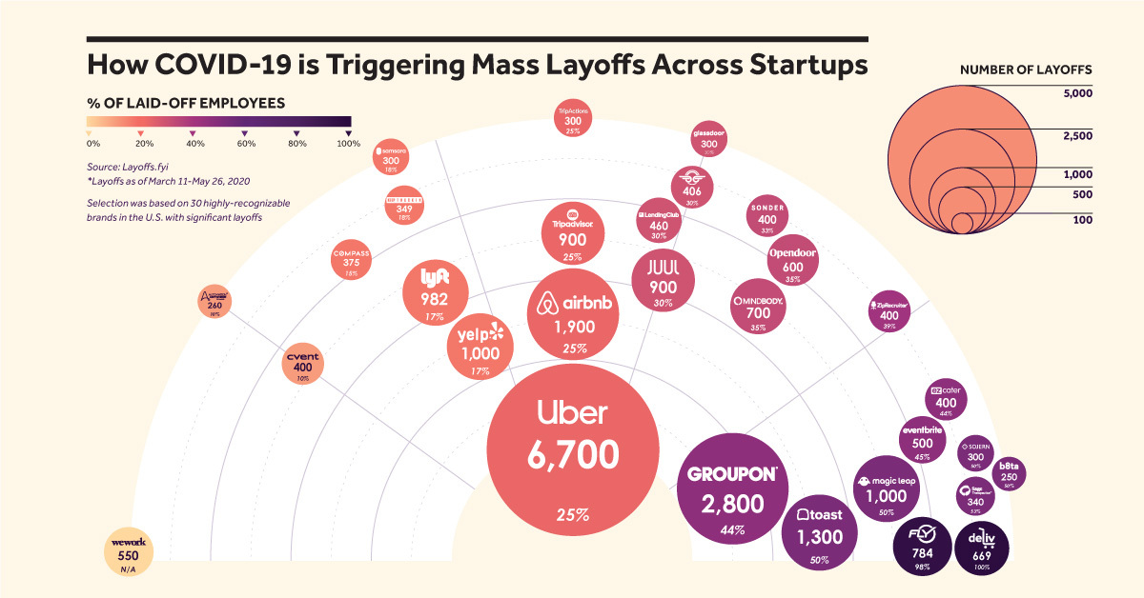
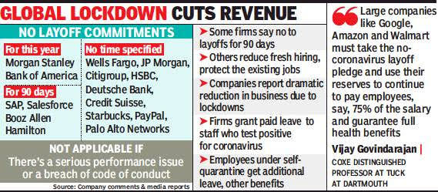
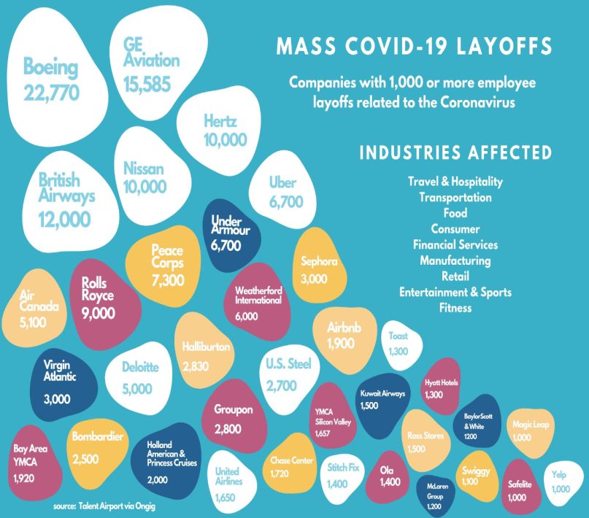
Statistical Analysis

Slide 8
Tools used to conduct affairs in a smooth manner
Microsoft Teams
Zoom Cloud Meetings
Cisco WebEx Meetings
Blue Jeans App
Google Meet
Skype
WhatsApp
DocuSign
Microsoft Lens
CamScanner

Slide 9
Tasks accomplished amidst lockdown
Board Agenda, Strategy Processes & Controls were Re-designed keeping in view Covid-19 Scenario.
Board Meetings & Annual General Meetings & Committee Meetings of Companies convened/conducted in smooth manner.
Meeting the Compliance Deadlines within stipulated time.
Communication Gap between Company’s Professionals & other Stakeholders eased out despite of Technical Glitches through Virtual Means.

Slide 11
PRESENTATION BY:
RUCHI MATHUR
STAGE :
(CS Professional Programme)
REGISTRATION NO. : 221069751/02/2011
E-MAIL ID :
ruchimathurjai@yahoo.in

