Slide 1
Creativity
Mind Openers

Slide 2
Mind Sets
There is nothing in that idea
Can’t See how that can be done
There is only one way to look at it
My judgement, based on experience says it wont work
It simply don’t work
It is just impossible

Slide 3
Assumptions
Ass – U – Me

Slide 4

Find Napolean

Slide 5

Candle Sticks

Slide 6
Candle Sticks

Slide 7
Mind Openers
A man goes to a cool drink shop and says :” Can I get a cup of water ?
At this point the shopkeeper suddenly pulls out a gun and points out straight at the man’s forehead.
After a few seconds, the man says : “Thank you” and walks out.
Explain the man’s behaviour.

Slide 8
Mind Openers
Can two persons stand on the corners of a small handkerchief in such a way that they don’t touch each other?

Slide 9
Mind Openers
A man was found by the police in his study ,dead on the floor with a gun by his side .On the desk was a tape recorder.Pushing the play button brought a message:’I can’t go on,I have nothing let to live for,’ followed by the sound of a shot”
Is this a murder or suicide ? Give justification.

Slide 10
Mind Openers
Six coins are arranged as follows .Move only one coin so that the two arms will have four coins each.

Slide 11
Mind Openers
Five match sticks are placed as below : Use one more matchstick to make four Triangles of equal size.

Slide 12
Mind Openers
There is an apple inside the cup as given below : Move just two matchsticks to bring the apple out of the cup.

Slide 13
Mind Openers
A cake is given to you. With just three cuts of knife ,make it into 8 parts.

Slide 14
Mind Openers
The width of a lake is 100 feet. There are two trees , one at the middle of the lake and other at the shore.there is a small island in the middle.
A person want to reach the island in the middle of the lake.He does not know swimming but has a rope which is longer than 100 feet. How can he achieve his aim?

Slide 15
Mind Openers
A man is standing by a full-length window seven floors up in a block of flats .The window is fully open. Suddenly ,on an impulse, he jumps straight through the window .
He lands safely on his feet ,unhurt There were no rivers, Swimming pools or any other water for him to land in ,no trampolines or suchlike to bounce on and he had no parachute or similar device
How did this happen?

Slide 16
Mind Openers
A farmer had to get a wolf, a goat and a sack of carrots safely over a river in a boat. But he only had room for one of these in his boat at a time .
The problem was he couldn’t leave the wolf and the goat together because the wolf would eat the goat . He couldn’t leave the goat and carrots together, because the goat would eat the carrots. How did he get them across?

Slide 17
Mind Openers
You are asked to hold a corner of a handkerchief in one hand, the opposite corner in the other and make a knot in the handkerchief without letting go of the corners.

Slide 18
Mind Openers
A large sheet of paper is only 0.1 mm thick. You are folding it half , half again , half again and so on for 50 times.
How thick will be resultant paper pack ? Would it be 6 inches , 1 feet or more than 6 feet.

Slide 19


The Juicy Glass

Slide 20


Swimming Pool

Slide 21

Old Man or young Girl ?

Slide 22
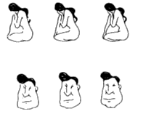

Old Man or Young Girl ?

Slide 23
Count the F’s
FIVE OF OUR FACTORY STAFF HAVE OFFERED SOME OF THEIR TIME FOR THE DEVELOPMENT OF THE AFFIRMATIVE ACTION PLAN
12 F’s

Slide 24

Cylinders
A
B
4.87
4.87
4.87
3.81

Slide 25
Triangle Puzzle
.

Slide 26
Patterns
A
B
C

Slide 27
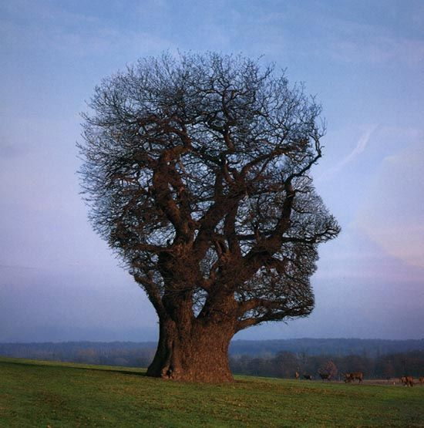
Give a Title

Slide 28
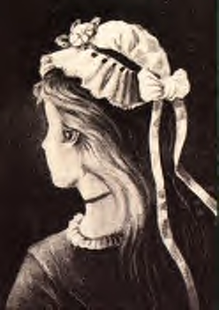
Young Girl ?
Or Old Woman?

Slide 29

Find out your Girlfriend

Slide 30
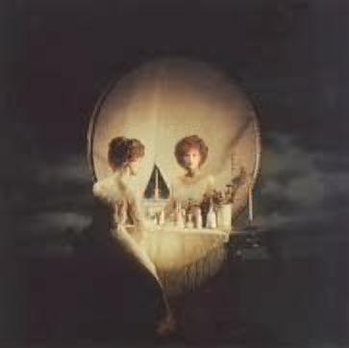
Young Girls ?
Or a Skull

Slide 31
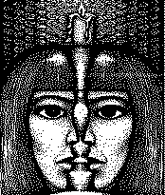
How many Girls ?

Slide 32
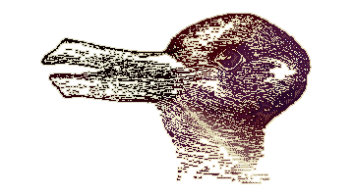
See both side of the picture

Slide 33
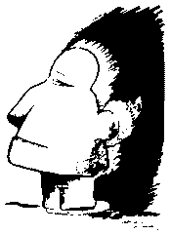
Red Indian or Eskimo ?

Slide 34

Inward or Outward

Slide 35
1+5
2+4
3+3
4+2

Slide 36
QUICK!!! THINK OF A
VEGETABLE

Slide 37


Slide 38
A Quiz
A farmer has got three sons.
He leaves 7 cows with a will that each elder brother
should get twice of what his immediate younger
brother gets.
How will you distribute ?

