Slide 1
CS Nagendra D. Rao, Practising Company Secretary
UNIQUE DOCUMENT IDENTIFICATION NUMBER

Slide 2

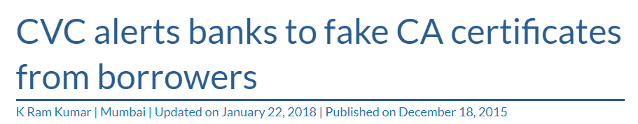

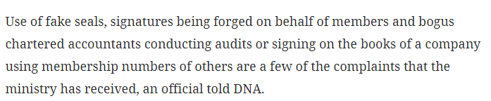
NEED OF UDIN
Source: moneycontrol.com & thehindubusinessline.com

Slide 3
UDIN GUIDELINES
[Unique Document Identification Number]
Approved by the council in its 261st (Special) Meeting held on June 27, 2019.
This is in accordance with the powers conferred by clause (1) of Part II of the Second Schedule to the Company Secretaries Act, 1980.
These guidelines may be called the Unique Document Identification Number (UDIN) Guidelines, 2019.

Slide 4
OBJECTIVE OF THESE GUIDELINES
To verify the authenticity of various documents certified by PCS.
To prevent counterfeiting.
For ease of maintaining the Register of Attestation.
To ensure compliance of the Guidelines.
To enable auto-prefill details of Certification / Attestation services in of the form for renewal of Certificate of Practice.

Slide 5
Applicability of UDIN of Professional Bodies
Name of the Body | Council Decision on | Applicable from
ICAI | 17-18th of December, 2018 | All Certificates with effect from 1st February, 2019. GST and Income Tax Audit with effect from 1st April, 2019. All Audit and Assurance Functions with effect from 1st July, 2019
ICSI | 27th June, 2019 | 1st of October, 2019
ICAI (Cost) | 5th of July, 2019 | 5th of July, 2019

Slide 6
APPLICABILITY
Certificates
Reports
Others

Slide 7
CERTIFICATES
Annual Return - MGT-8.
Share Transfer Certification – Reg 40(9) – SEBI (LODR), 2015.
Director Disqualification Certificate – SEBI (LODR), 2015.
Reconciliation of Share Capital Audit
Foreign Investment (As per notification under FEMA)

Slide 8
REPORTS
Secretarial Audit – Sec 204 of Companies Act, 2013.
Secretarial Audit of materially unlisted Companies – Reg 24A of SEBI (LODR) Regulations, 2015.
Annual Secretarial Compliance Report – Reg 24A of SEBI (LODR) Regulations, 2015
Internal Audit of Depository Participants & Stock Brokers.
Third party Certification of Labour Law.
Diligence Report for Banks.

Slide 9
OTHERS
PCS may generate the UDIN for any other eForm and document(s) which is not listed above and not mandatory as per these guidelines on voluntary basis.

Slide 10
Quoting of UDIN and timelines
Shall be generated at the time of signing the Certificate/ Report and mandatorily be mentioned in the Certificate, Report and documents along with the CoP number.
Quoting UDIN shall be mandatory w.e.f. 1st October, 2019
Quoting UDIN recommendatory from 5th July, 2019
During filing of Form for Renewal of CoP, the data for the certificates issued from 1st of October, 2019 will be auto-filled & the data for the certification made from 1st of April, 2019 to 30th of September, 2019 will have to be manually filled.

Slide 11
Common Queries Regarding UDIN
Who can register with the UDIN portal?
Only Members with a valid CoP can register.
Who can generate UDIN?
Only the certifying member can generate UDIN.
Will the members who generated the UDIN be notified?
Yes, UDIN shall be shared on the registered e-mail ID of the member.
Is there a provision to revoke the UDIN that has already been generated?
Yes, it may be surrendered / cancelled by the PCS within 7 days of such generation if it is NOT Utilized.

Slide 12
Common Queries Regarding UDIN
Whether new UDIN is required for duplicate certificate?
UDIN is to be generated only once for original certificate, same UDIN can be used for issue of duplicate certificates.
Any restriction on generation of UDIN?
No, there are no restrictions & limits on the generation of UDIN.
Whether UDIN should be generated before issuing the certificate?
No, UDIN shall be generated at the time of signing the certificate & cannot be generated in advance.

Slide 13
Common Queries Regarding UDIN
Any fees that have to be paid for generating UDIN?
No fees are to be paid for registering with the portal or for generating UDIN.
Can other parties verify the UDIN generated?
Yes, other parties such as regulatory bodies and other interested parties may be able to verify the authenticity of documents certified by PCS on the UDIN portal.
In case of a Partnership firm / LLP, who can generate UDIN?
Only the signing partner can generate UDIN.
Do online forms require UDIN?
UDIN is applicable not only to normally signed certificates, but even digitally signed documents.

Slide 14
Common Queries Regarding UDIN
Whether any documents are to be uploaded for obtaining UDIN?
No
Is UDIN secure?
UDIN is totally secure as it can be viewed only by the members or the regulators & shall remain confidential & not to be construed as information under the Right to Information Act, 2005.
Whether name of the Client needs to be mentioned?
Yes, at the time of generation of UDIN, name of the company, CIN required.
Consequences of Violation
Member is liable for action as Professional Misconduct under Company Secretaries Act, 1980 r/w First and Second Schedule to the CS Act, 1980.

Slide 15
UDIN MODULE FLOW

Slide 16
PROCESS OF REGISTERATION AND GENERATION OF UDIN
icsi.edu
PCS Portal
UDIN
Members Registration (After successful registration, we will receive Login ID and Password)
Members Login
Generate UDIN

Slide 17
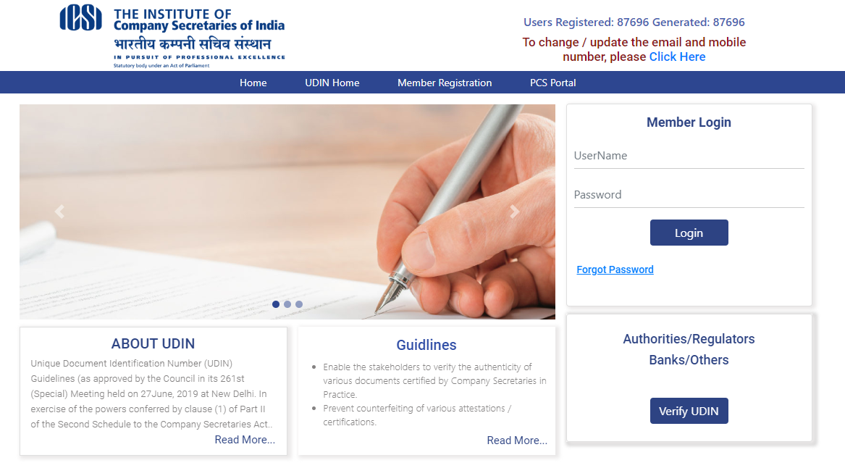

Slide 18
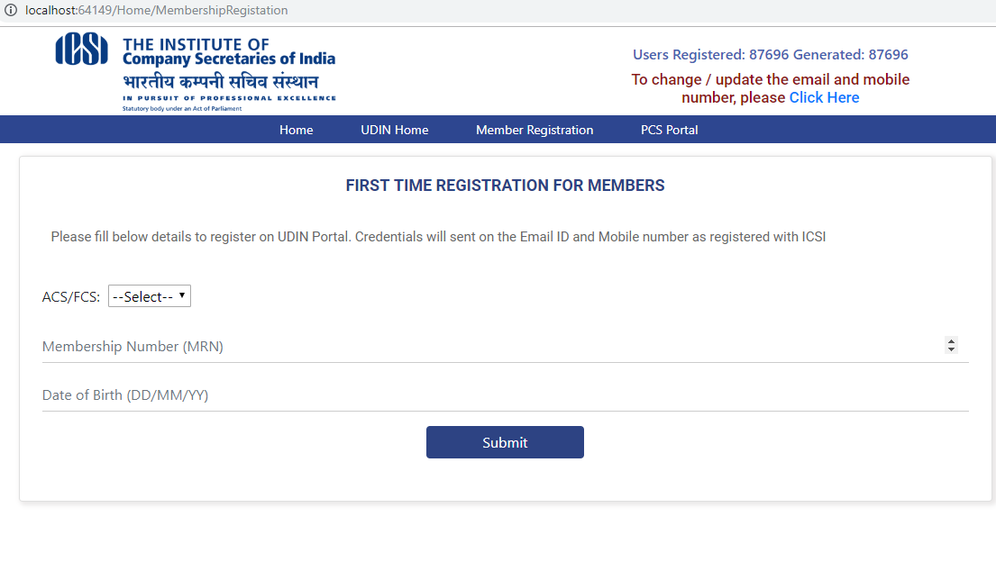

Slide 19
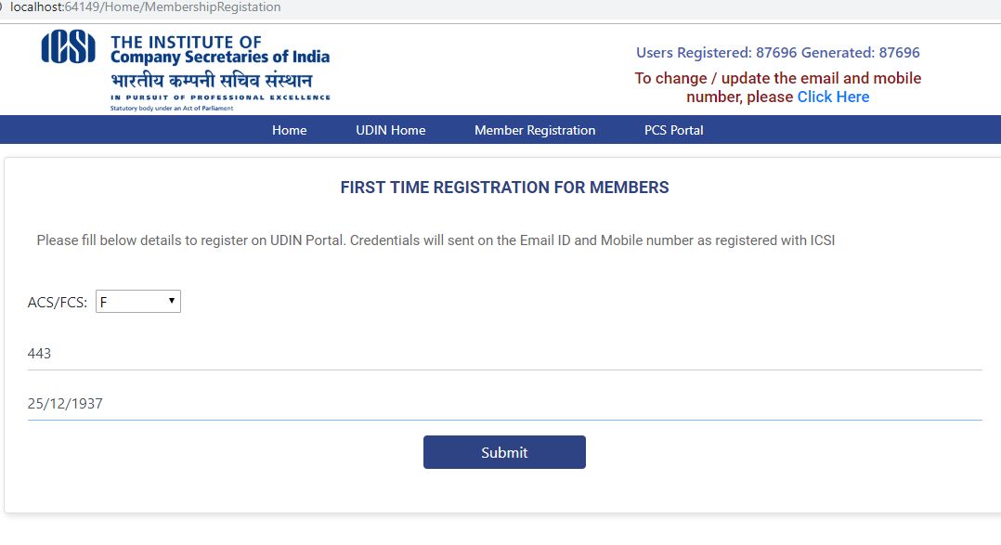

Slide 20
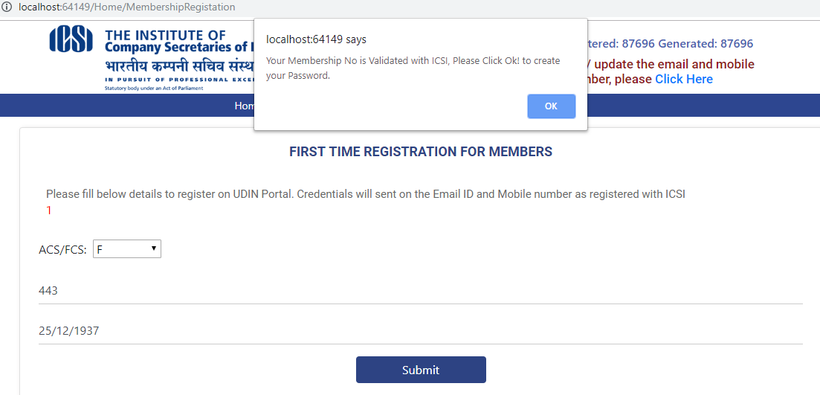

Slide 21
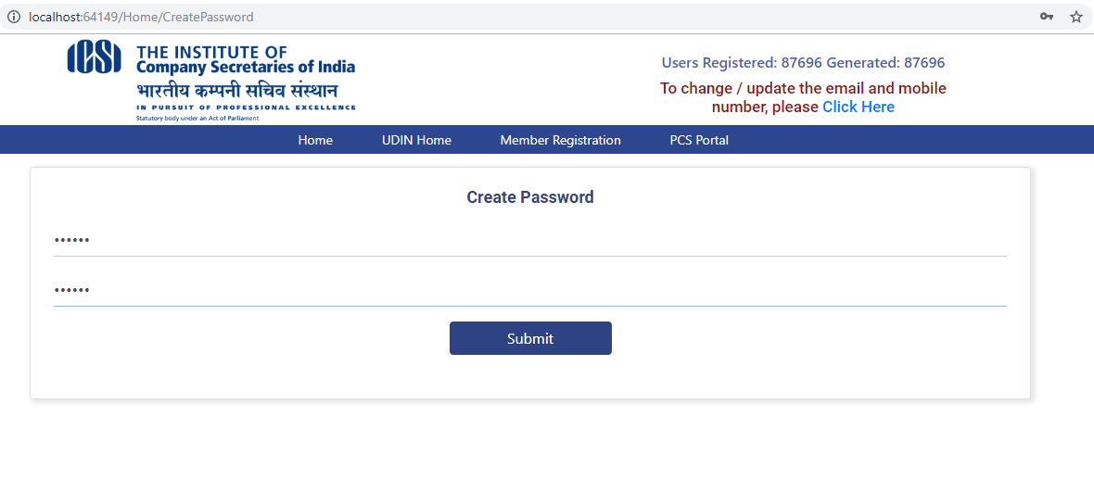

Slide 22
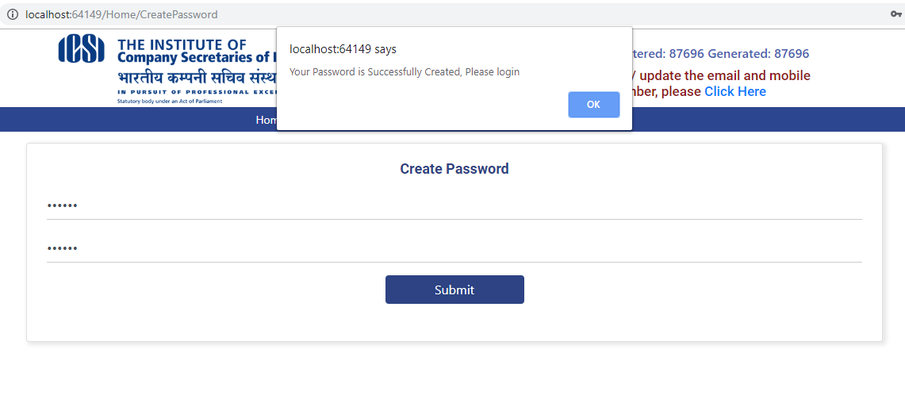

Slide 23
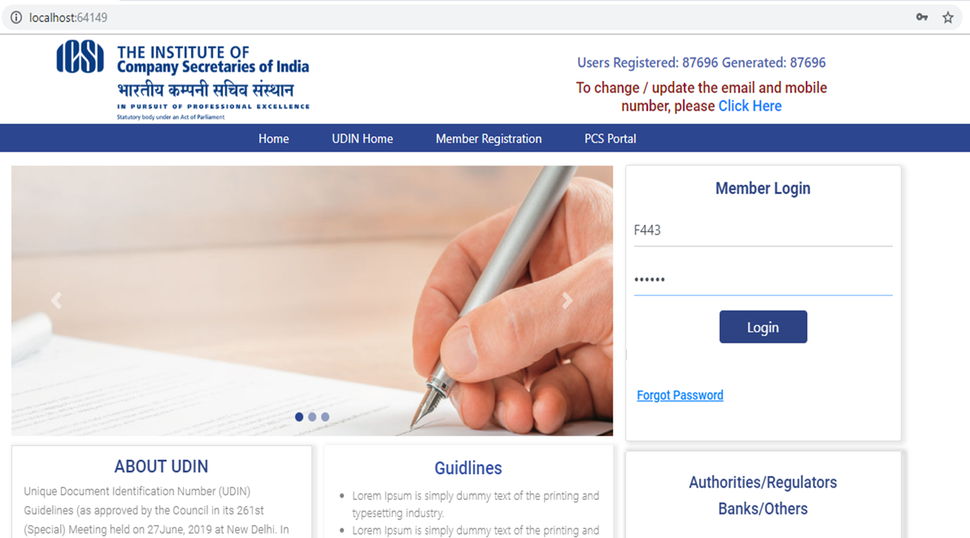

Slide 24
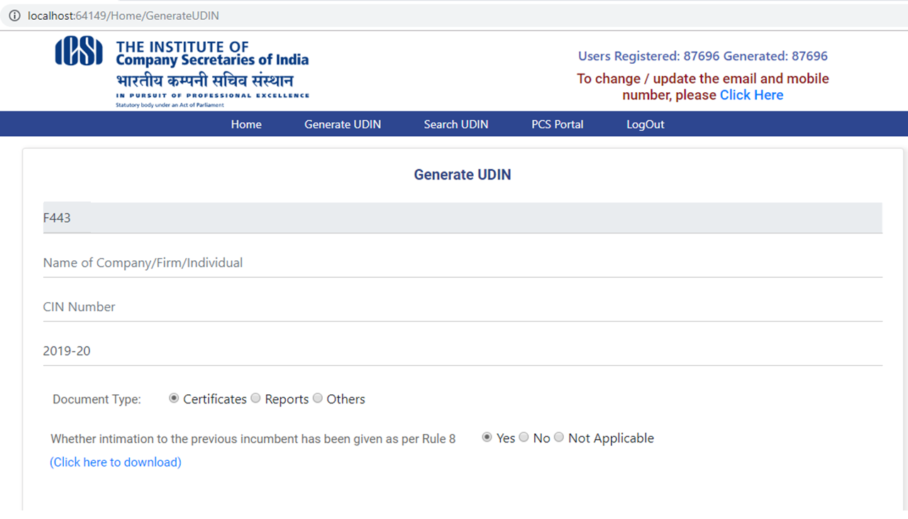

Slide 25
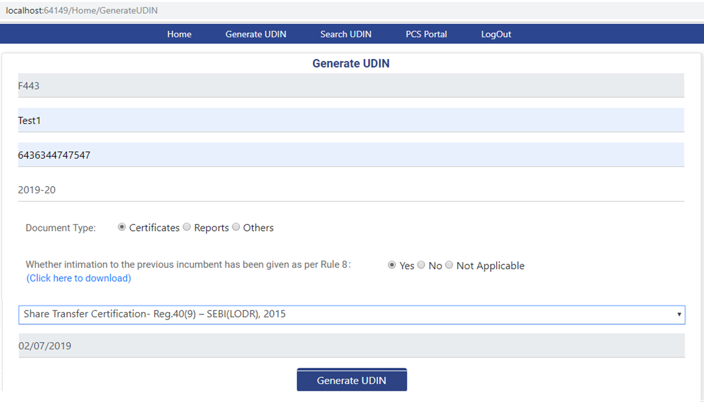

Slide 26
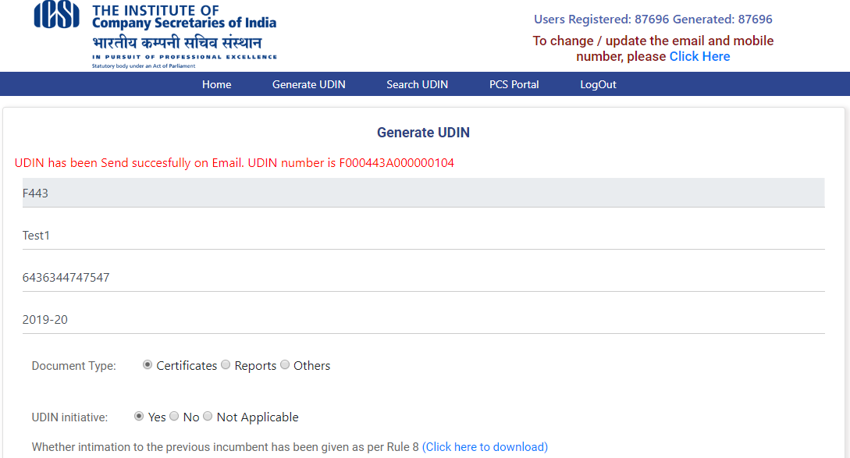

Slide 27
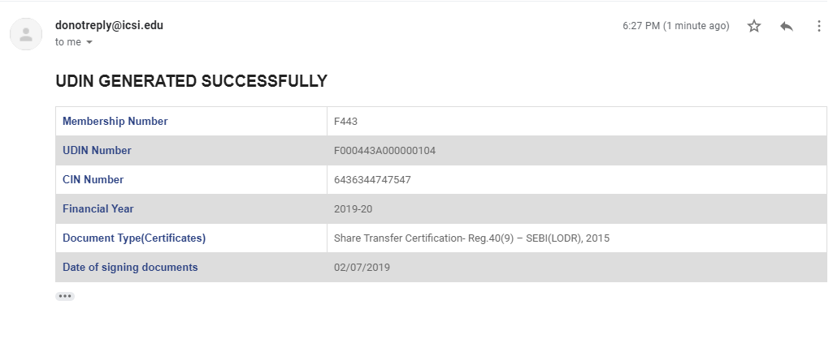

Slide 28
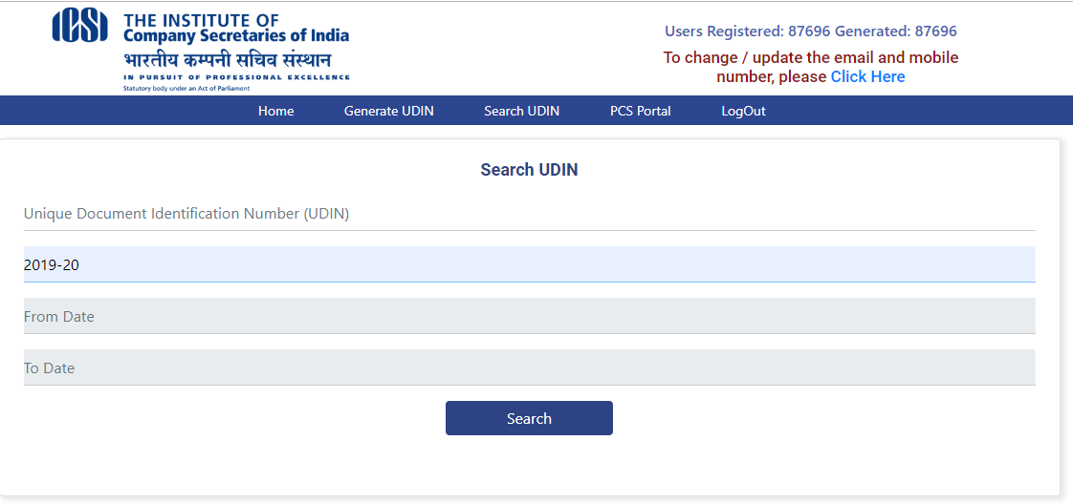

Slide 29
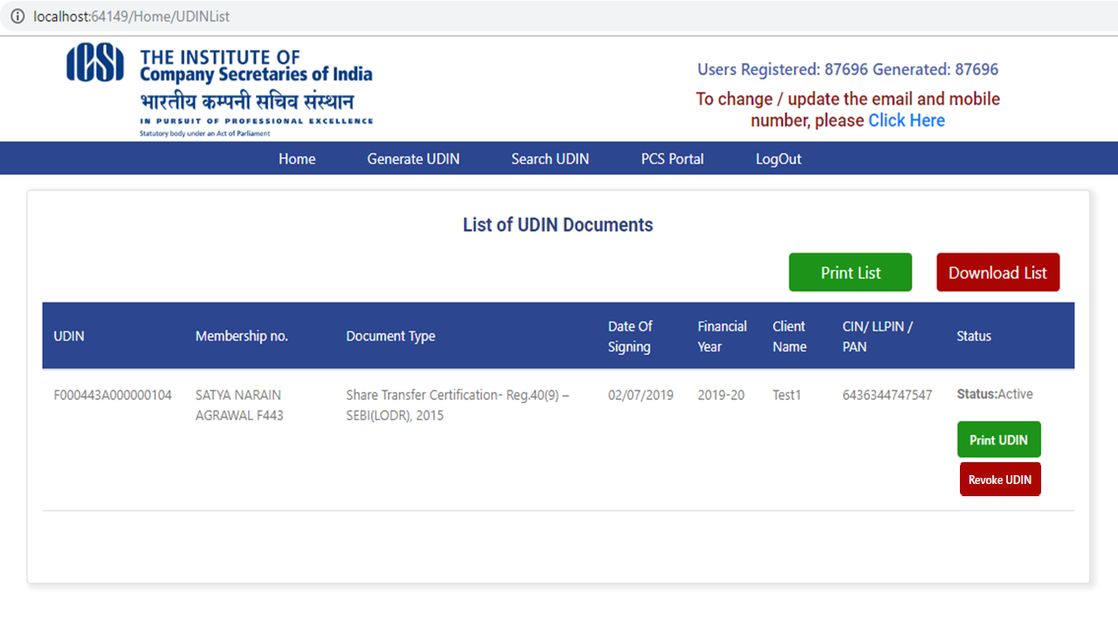

Slide 30
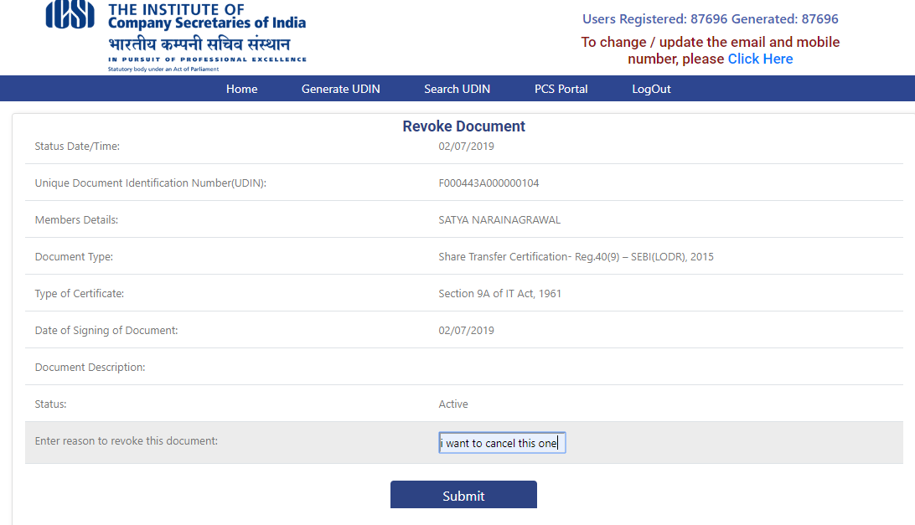

Slide 31
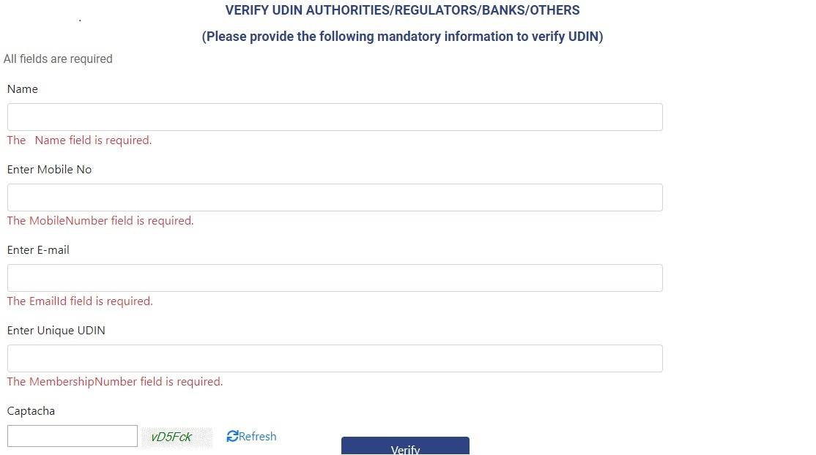

Slide 32
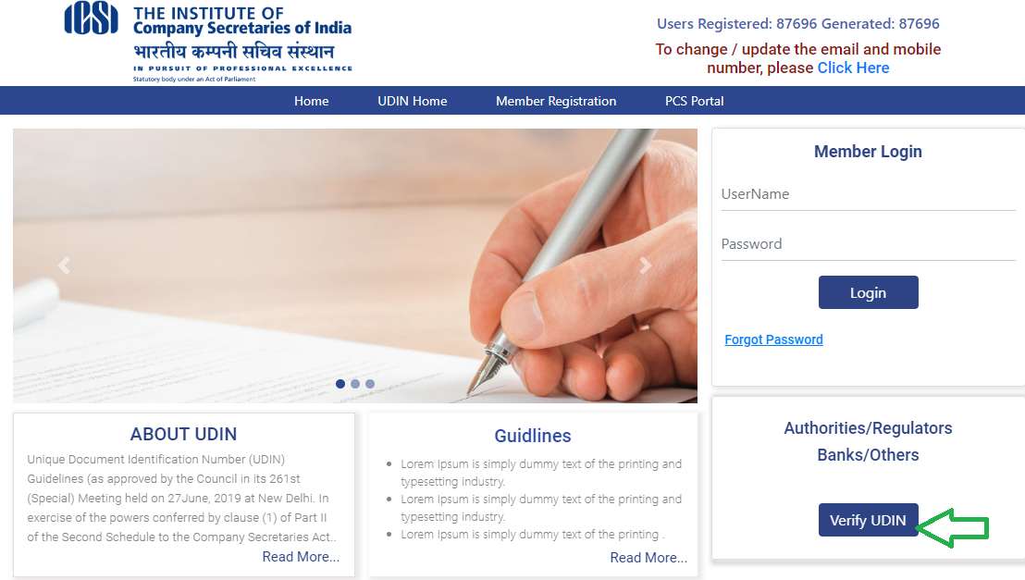

Slide 33
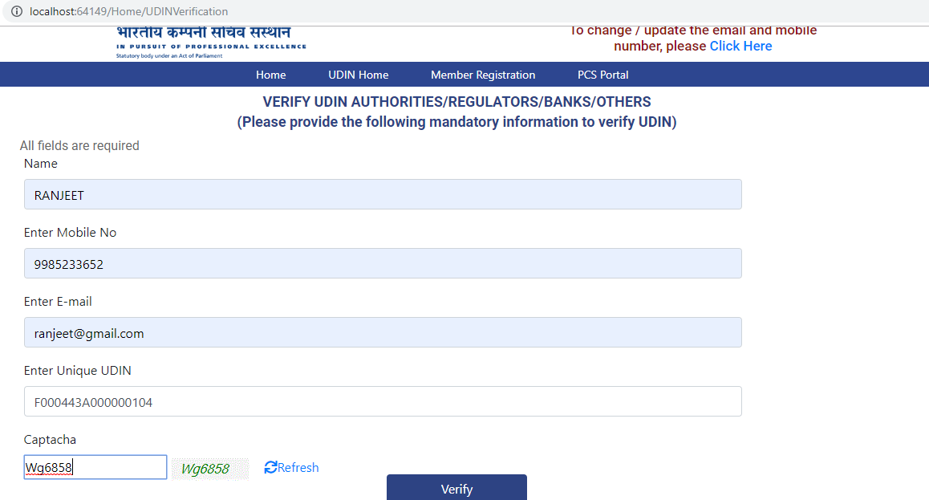

Slide 34
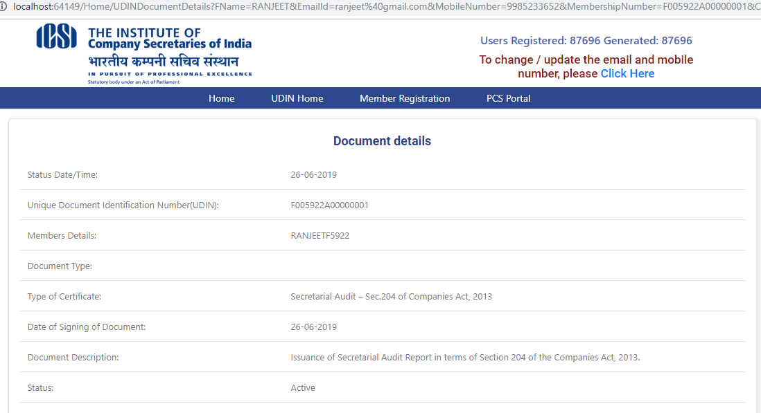

Slide 35
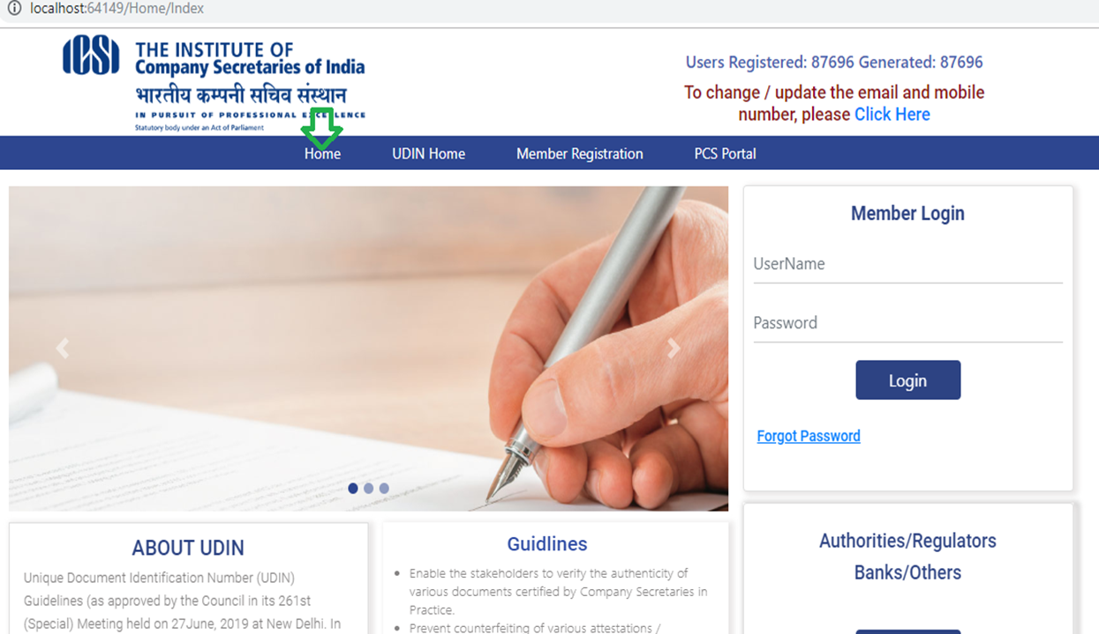

Slide 36
THANK YOU

