Slide 1
Cross-border M&A Valuation – Issues
Jayasimha P
Director – Investment Banking
JPR Capital (P) Ltd.
SEBI registered category -1 Merchant Banker

Slide 2
Agenda
M&A Valuation – what is it all about?
Building blocks of M&A Valuation
Important Issues to consider
Methods of valuations
Case Study: Flipkart acquired by Walmart

Slide 3
M&A Valuation- What is it all about ?
Synergies are the basic reason why M&A activity is conducted.
Synergy is defined as follows in International valuation standards 2017(IVS 104- Bases, 190)
  “Synergies” refer to the benefits associated with combining assets.
They refer to the incremental cash flows associated with resultant structure.
Generally the post-integration process must be completed within 6-9 months from the date of completion of the deal.
Type of synergies also play a role in realization and valuation – Revenue or cost or real options
A nice cup of coffee – would you prefer it cold?
It is from synergies we pay the premiums to target’s shareholder.

Slide 4
Building blocks in M&A Valuation
Value to Acquirer Shareholder
Synergies
Acquisition Premium
Over valuation
Fair Value (FV)
Under valuation

Slide 5
Cross-border M&A important issues
Strategic reasons
Asset Acquisition
Financial Reasons
Acquiring new technology and capability
Attractive raw material and labour costs
Accelerating growth
Leveraging on the intangible asset base
Diversification in new markets (Market expansion)
Reducing the cost of capital
Significant cash balances and underutilised borrowing capacity
Minimizing tax liabilities
Cash vs. Stock – Which is better choice
M&A deals generally include the part cash and part share deals to increase the synergies that get ploughed back into the company.
However, most cross-border M&A involve paying 100% cash to avoid the lengthy process of registering the shares with the authority e.g. SEC, United States of America
This generally crystallises the target management’s responsibility in future merged entity
However, FEMA regulations have to be adhered to when an Inbound merger or an outbound merger is being made.

Slide 6
Valuation
Income Approach
Cost Approach
Market Approach
Excess earnings method
Discounted Cash Flow Analysis
Option Valuation methodology
Guideline publicly traded comparable method
Comparable Transaction Method
Replacement cost method
Reproduction method
Summation Method

Slide 7
Valuation requirements
Law | Incidence | Method | Who can do
Companies Act | Preferential Issue - Unlisted Co-Sec 62 & Sec 42 | Indian Valuation Standards | Registered Valuer
 | S/230 – Arrangement S/232 – Merger / Demerger | Indian Valuation Standards | Registered Valuer Expert
 | Section 247 | Indian Valuation Standards | Registered Valuer
RBI / FEMA | Inbound / Outbound | Listed Shares – SEBI Guidelines Unlisted Co – International Accepted Valuation Methodology (IAVM) | MB / CA
SEBI | Takeover Regulation | Direct Acquisition – Highest of – negotiated price / 52 weeks VWAP / highest acquisition price in 26 weeks / 60 days VWAP Indirect Acquisition | Acquirer / Manager to offer (MB)
 | Preferential Issue (ICDR) | Frequently traded – Higher of 26 / 2 weeks VWAP Infrequently traded – All valuation parameters have to be taken care of | MB / CA (10 Years)
Income Tax | Unquoted Shares – Sec 50CA & 56(2)(x) r.w. Rule 11 UA | Co in which public are not substantially interested Issue of unquoted equity – NAV or DCF Certificate All other valuation Quoted Equity – traded / floor price Unquoted Equity – Adjusted NAV Unquoted Pref Shares – certificate | MB MB/CA
IBC | Asset Valuation – Regulation 35 | Fair Value & Liquidation Value – IAVM | Registered Valuer
SEBI takeover code requires the fairness opinion of a SEBI registered Merchant Banker

Slide 8
Different methods of M&A Valuation
Arriving at the fair value of the target company generally kicks-off the M&A process
Method | Description
Discounted Cash Flow | Relies on lot of assumptions, which might be completely different from actual metrics. Reasonable and consistent valuation can always defend the digressions.
Relative Valuation | The most difficult of the lot. Finding a true comparable in the start-up environment is difficult but provides for a benchmark price/value before the negotiations. However, comparing to Apples to Apples is not enough.
Precedent Transaction Analysis | This method provides a gauge about the PRICE paid about the recent transactions paid to similar targets. However, this includes the premium paid by the acquirers in the recent past giving a clouded image and could lead to more higher valuations.
FEMA regulation provides that the valuation can be done using any internationally accepted methodology.
Following the International Valuation Standards make sure the valuation report is complying with international valuation methodologies
Both Acquirer and Target have to be valued if deal includes a share swap to determine the exchange ratio. FEMA requires the valuation to be done by SEBI registered category-1 Merchant Banker.

Slide 9
Issues encountered in valuation
Fair value lies in the eye of beholder but how to get the right fair value of business?
Estimating the right cost of equity or cost of capital and growth rate
  Cost of capital is the hurdle rate that the business should deliver to its shareholders.
  Harvey (2005) 12 ways of calculating the International cost of capital
  India has a huge data gap in terms of valuation specific academic literature.
Choosing the right tax rate
  Place of effective management (POEM)
  Base Erosion Profit Shifting (BEPS)
  Tax incentives in host country and domestic country
  DTAA tax treaties should also be considered while assessing the appropriate tax rate.
Cross-border currency issues – exchange rate fluctuations
Getting the SPA right
Choosing the right value drivers
  Estimating the wrong value drivers in valuation can lead to disastrous results
  Cosmetic changes can harm the acquirer company. Choose a valuer who has in-depth valuation knowledge and industry-specific knowledge.
Notes:
Campbell R Havey
Duke University
Foreign companies having POEM in India placed at a disadvantage as compared to domestic Indian companies.
A foreign company shall continue to be treated as a foreign company even if it is said to be resident in India as per the POEM test.
Tax rate for a foreign company to remain the same, i.e. 40% (exclusive of surcharge and cess) even where it is deemed to be an Indian resident company.
Transactions of foreign companies to remain unaltered on the basis of such companies becoming India resident on account of the POEM test.
BEPS Action 6 focuses on treaty abuse by examining the purpose of a transaction (i.e. principal purpose test (PPT) and/or limitation of benefits (LOB) test) and specific treaty abuse rules covering certain dividend transfer transactions, dual-resident entities, etc. The majority of Asia-Pacific countries have chosen not to apply the LOB test in addition to the PPT, with the exceptions of India and Indonesia.
BEPS Action 6 focuses on treaty abuse by examining the purpose of a transaction (i.e. principal purpose test (PPT) and/or limitation of benefits (LOB) test) and specific treaty abuse rules covering certain dividend transfer transactions, dual-resident entities, etc. The majority of Asia-Pacific countries have chosen not to apply the LOB test in addition to the PPT, with the exceptions of India and Indonesia

Slide 10
Flipkart acquired by Walmart
Flipkart was acquired by Walmart to the tune of 77% for $16 billion kicking the company valuations to $21 billion.
Total revenue of e-commerce industry in India in 2017 was $21 billion !
One of the largest deals in e-commerce industry in India.
Flipkart acquired 10 start-ups since its inception – all horizontal mergers- before being acquired by Walmart.
Threshold case for proving that value received is in the eyes of the beholder.
Walmart attempts to reappear as a young company in an aging world.
Flipkart has already burned $1 billion cash after the deal was made.
Regulatory hiccups- FEMA, IT, Competition act.

Slide 11
Be careful of what you wish for ! – Holding structure discounts (regulatory)
Flipkart Digital Media Pvt. Ltd.
Flipkart Payments Pte. Ltd.
Flipkart payment gateway Pvt. Ltd.
99.76%
100%
100%
0.24%
Flipkart Singapore
(Ultimate Holding company)
Flipkart Logistics Pte. Ltd.
Flipkart Internet Pvt. Ltd. (Owner of flipkart.com)
100%
0.61%
100%
99.9%
99.39%
Flipkart Market Place Pte. Ltd.
Flipkart India Pvt. Ltd. (Cash and Carry wholesale entity)
0.1%
Source: Live Mint, 2019

Slide 12
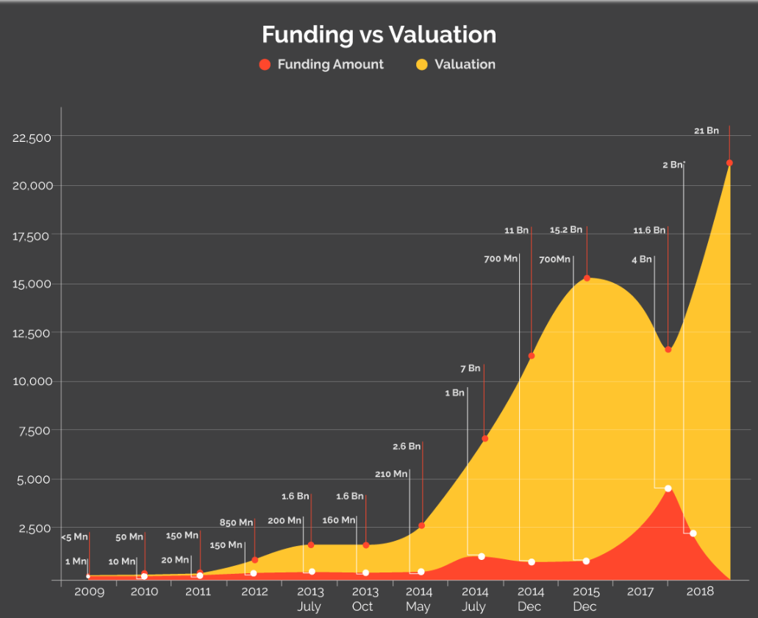
Flipkart acquired by Walmart

Slide 13
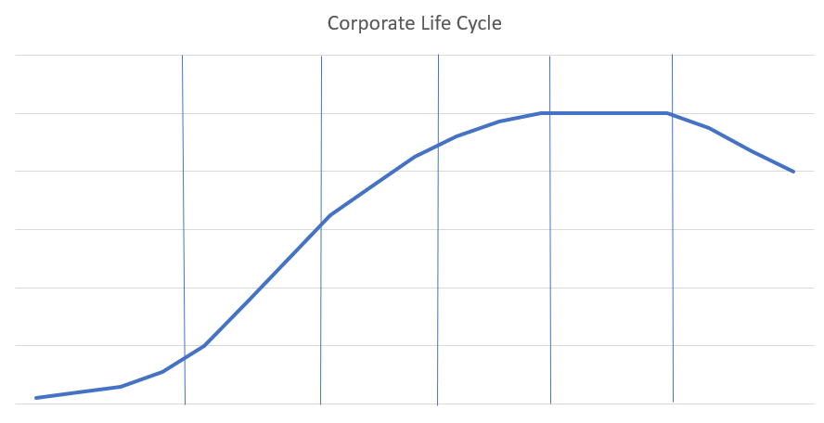
Where do I exist on the corporate life cycle?
Revenue growth
High-growth
Mature Growth
Mature stable
Decline
Start-up
Young
Time
Stage | Start-up | Young growth | High-growth | Mature – growth | Mature – Stable | Decline
Valuation metrics and drivers | Market potential, cash burn ratio. | Number of users, value per user | Repeat revenues, EV/sales, DCF etc | Revenue growth, PEG ratio etc. | Earnings growth, P/E, EV/EBITDA | Liquid assets, Price to book, Return on capital.

Slide 14
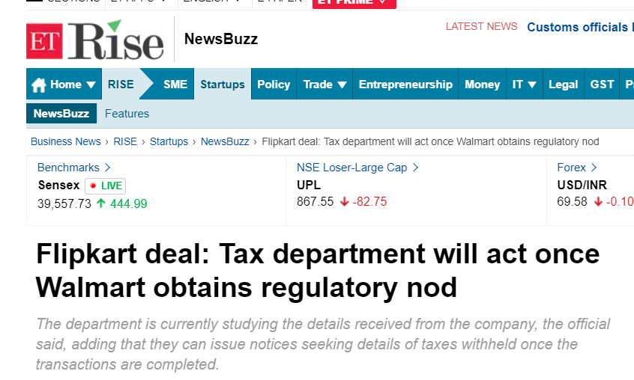
Thank you !

Slide 15
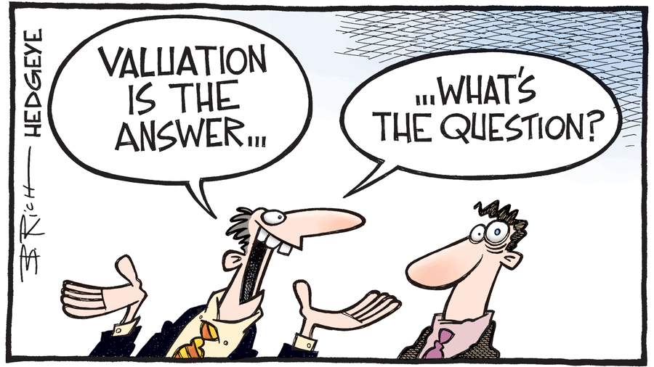

Slide 16
Q&A
Jayasimha P
JPR Capital
Email: jay@jprcapital.in
Phone: +91 7330962581

Slide 17







12 Methods of calculating international cost of capital
Method | Formula | Method | Formula
World Capital Asset Pricing model | E (Ri,t )Z(t−1) = β i,w,(t−1)E *Rw,t Zt−1 | Damodaran Model
The World Multifactor Capital Asset Pricing Model |  | The Ibbotson Bayesian Model | CAPM + intercept
Bekaert and Harvey Mixture Model |  | The Implied Cost of Capital Model | Gordon growth model
The Sovereign Spread Model (Goldman Model) |  | The CSFB Model
The Implied Sovereign Spread Model |  | Expected Returns are the Same Globally | Same rates adjusted for inflation
The Sovereign Spread Volatility Ratio Model |  | The Erb-Harvey-Viskanta Model

