Slide 1

WIRC-CONFERENCE – INDORE- 13-14-MAY-2022
Recognition accorded
by SEBI
to
Company Secretaries in Practice
CS B Narasimhan

Slide 2
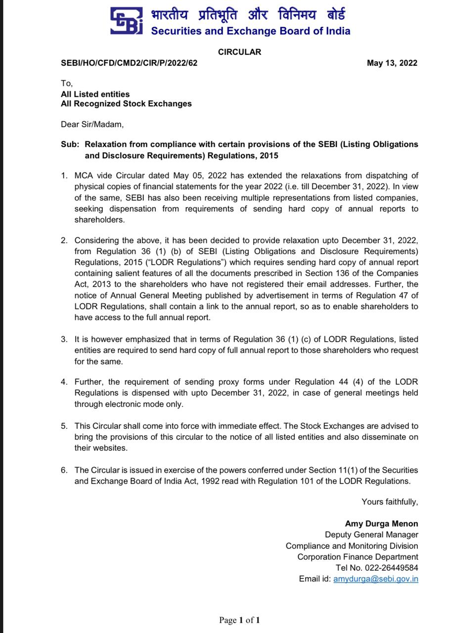
Recognition ..…...
Not a routine level of knowledge..
An edge of expertise…
A factor of reliability
Accountability

Slide 3
SEBI …
Recognition ..
Achievement over a period …

Slide 4
SEBI (ICDR) Regulations, 2018 [Regulation 163 (2)]
To issue a Certificate of Compliance from a PCS , to be placed before the general meeting of the shareholders considering the proposed preferential issue, certifying that the proposed preferential issue is being made in accordance with the SEBI (ICDR) Regulations, 2018……

Slide 5
Circular -SEBI/HO/MIRSD/MIRSD_ RTAMB/P/CIR/2021/687 of 14-12-21
By a PCS
To provide Certificate of Compliance to Registrars to an Issue and Share Transfer Agents (RTA).

Slide 6
SEBI (Share Based Employee Benefits and Sweat Equity) Regulations, 2021
(a) [Regulation 13] by Secretarial Auditor
To certify that the scheme(s) has been implemented in accordance with the SEBI (Share Based Employee Benefits and Sweat Equity) Regulations, 2021 and in accordance with the resolution of the company in the general meeting.

Slide 7
SEBI (Share Based Employee Benefits and Sweat Equity) Regulations, 2021
(a) [Regulation 26 (3)] by Secretarial Auditor
To certify compliance with Regulation 26 (2) at the time of adoption of latest Balance Sheet by the company.( in relation to GEBS- General Employees Benefits Scheme )

Slide 8
SEBI (Share Based Employee Benefits and Sweat Equity) Regulations, 2021
(a) [Regulation 27 (4)] by Secretarial Auditor – to certify
at the time of adoption of latest Balance Sheet by the company Regarding shares holding appearing in (in respect of RBS- Retirement Scheme )

Slide 9
SEBI (Share Based Employee Benefits and Sweat Equity) Regulations, 2021
Regulation 36 by Secretarial Auditor – to certify
that the issue of sweat equity shares has been made in accordance with SEBI (Share Based Employee Benefits and Sweat Equity) Regulations, 2021 and in accordance with the resolution passed by the company authorizing the issue of such sweat equity shares.

Slide 10
SEBI (Delisting of Equity Shares) Regulations, 2021
(a) [Regulation 10 (3)]:
By a Peer Reviewed Company Secretary
To conduct due diligence and certify that the buying, selling and dealing in equity shares of the company carried out by the acquirer or its related entities and top twenty five shareholders is in compliance with the applicable provisions of securities laws including compliance with sub-regulation (5) of regulation 4 of the SEBI (Delisting) Regulations, 2021.

Slide 11
SEBI (Delisting of Equity Shares) Regulations, 2021
(b)Contents of the Report: as per Regulation 12 (2)
(c) Proviso to Regulation 21 (a): By a Peer Reviewed Company Secretary
To certify the shares held by inactive shareholders.

Slide 12
SEBI (LODR) Regulations, 2015
Regulation 24A(2)*:By PCS
To provide Annual Secretarial Compliance Report to all the listed entities on compliance of all applicable SEBI Regulations and Circulars/ Guidelines issued thereunder.
*From FYE - 31-03-2019

Slide 13
SEBI (LODR) Regulations, 2015
Regulation 24A(1)*:By Secretarial Auditor
To conduct Secretarial Audit of every listed entity and its material unlisted subsidiaries incorporated in India.
*From FYE - 31-03-2019

Slide 14
SEBI (LODR) Regulations, 2015
Regulation 40(9):By Peer Reviewed PCS (on Annual Basis)
To certify that all certificates have been issued within thirty days of the date of lodgement for transfer, sub-division, consolidation, renewal, exchange or endorsement of calls /allotment services.

Slide 15
SEBI (LODR) Regulations, 2015
Schedule V, Part C of Clause (10)(i): By PCS
To certify that none of the directors on the board of the company have been debarred or disqualified from being appointed or continuing as directors of companies by SEBI/Ministry of Corporate Affairs or any such statutory authority.

Slide 16
SEBI (LODR) Regulations, 2015
Schedule V, Clause E: By Peer Reviewed PCS
To issue Compliance Certificate regarding compliance of conditions of Corporate Governance.

Slide 17
SEBI (Depositories Participants) Regulations, 2018
Regulation 76: By Peer Review PCS
To issue quarterly certificate with regard to reconciliation of the total issued capital, listed capital and capital held by depositories in dematerialized form, details of changes in share capital during the quarter, and in-principle approval obtained by the issuer from all the Stock Exchanges where it is listed in respect of such further issued capital.

Slide 18
SEBI Circular SEBI/HO/MIRSD/IR/P/2018/73 dated April 20, 2018
By PCS :
To conduct Internal Audit of Registrar and Share Transfer Agent (RTA).

Slide 19
SEBI (Research Analysts) Regulations, 2014
Regulation 25(3): By a PCS
To conduct annual audit of Research Analyst or research entity in respect of compliance with these regulations.

Slide 20
SEBI (Investment Advisers) Regulations, 2013
Regulation 19(3): By a PCS
To conduct Compliance Audit of an Investment Adviser.

Slide 21
SEBI Circular SEBI/ MIRSD/CRA/Cir-01/2010 dated 06 January, 2010
For - Regulation 22 of SEBI (CRA) Regulations, 1999: By a PCS (On Half Yearly Basis)
To conduct Internal Audit for Credit Rating Agencies (CRAs).

Slide 22
OTHER RECOGNITIONS FROM SEBI
SEBI ( Stock Brokers ) Regulations, 1992:
By a PCS (Half Yearly Basis) SEBI Circular MRD/ DMS/CIR-29/2008 dated 21-10-2008
To conduct Internal Audit of Stock Brokers / Trading Members / Clearing Members.
Section 15V, SEBI ACT 1992 Explanation (b): By a PCS
To appear as Authorised Representative before the Securities Appellate Tribunal.

Slide 23
OTHER RECOGNITIONS FROM SEBI
Section 22C: By a PCS SECURITIES Contract Regulations
To appear as Authorised Representative before the Securities Appellate Tribunal.
Section 23C, Explanation (b): By a PCS under Depositories Act 1996
To appear as Authorised Representative before the Securities Appellate Tribunal.

Slide 24
OTHER RECOGNITIONS FROM SEBI
Guideline No :F1/8/SE/82 dated 20-08-1982: By a PCS . The Securities Contracts Regulation Rules, 1957
To appear as an Authorised representative before SAT.

Slide 25
WHAT IS BHAKTI FOR A PROFESSIONAL IN HIS WORK? CAN WE CALL IT PASSION.. CAN WE CALL IT INVOLVEMENT.. CAN WE CALL IT KNOWLEDGE… CAN WE CALL IT EYE FOR DETAILS…. CAN WE CALL IT HARDWORK…. OR IS IT ALL COMBINED……
IN ORDER TO SUCCEED YOUR DESIRE FOR SUCCESS SHOULD BE FAR GREATER THAN YOUR FEAR OF FAILURE………..Albert Einstein

Slide 26

Welcoming ideas

Slide 27

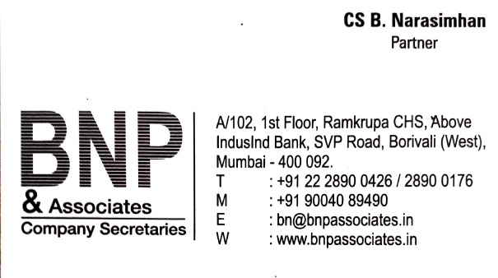
THANK YOU

