Slide 1
Welcome you all to this Informative Webinar on the topic ‘Role of depository in Making Capital markets investor friendly’
Presented By
CDSL Ventures Limited (CVL)
CDSL Insurance Repository Limited (CDSL IR)

Slide 2
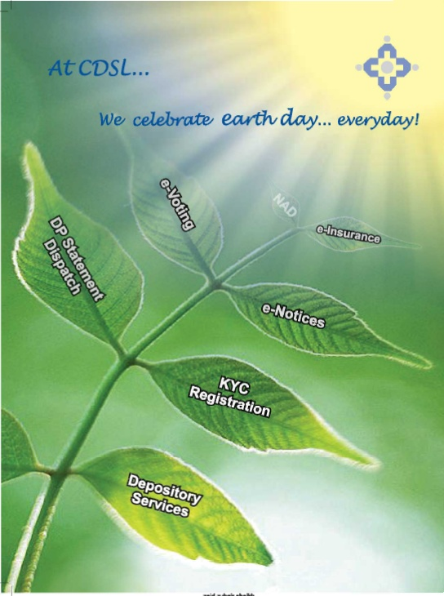
About CDSL
Incorporated in December 1997
Shareholders – BSE and leading Indian and Foreign Banks like HDFC Bank Ltd, Standard Chartered Bank, Canara Bank, LIC of India etc.
First and only listed depository in Asia-Pacific
First and only depository to operate in IFSC
Certifications
ISO 27001:2013 - IT systems & processes
ISO 22301:2012 - Business Continuity Management Systems
ISO 9001:2015 - eVoting process
STQC – eVoting process

Slide 3
CDSL Today
CDSL Today !
BO Accounts
2.63 crores
Situated in over 94% pin-codes
DPs Registered
Issuer Companies
14,891 Unique companies
14,122 - Equity ISINs, 33,561 other ISINs.
Operating from over 20,500 touch points
595
CDSL – Largest growing Depository
2.31 Million Demat Accounts
55 % Cumulative Market Share - BOIDs
70 % Incremental Market Share - BOIDs
Notes:
Updated on monthly basis

Slide 4
Depositories ACT of 1996 Boon or Bane to capital markets?
Holding of shares prior to Act
Transfer of Securities
Settlement through stock exchange platform
Transmission and nomination
Market lot and Liquidity

Slide 5
After Depositories ACT
Holding of securities in Demat form
Transfer of Securities
T+2 settlement cycle
Market lot of 1 shares
Multiple nomination facility

Slide 6
Other Important developments
Single KYC through KRA
Instant Account opening using EKYC
OTP based confirmation for transfer of securities
Margin pledge facility
Unlisted Public and private companies in Demat form.
Foreign Investment Monitoring through Depositories.
Evoting facilities

Slide 7
Services offered by Depositories
Dematerialization (Demat): converting physical certificates to electronic form.
Rematerialisation (Remat): Reverse of Demat, i.e. converting electronic securities into physical certificates.
Transfer of securities
Change of beneficial ownership
31

Slide 8
Services offered by Depositories
Settlement of trades done on exchange connected to the Depository
Investor can avail of these services through Depository Participant (DP)
Many Stock Brokers and Banks function as DPs and investors can open a new DP account with them.
Demat securities in depositories - 100% safe and secure.
32

Slide 9
Transmission of Securities
Transfer of securities balances in a demat account due to death, bankruptcy, lunacy etc. of the account holder.
Not a voluntary act of the account holder.
This transfer is brought about by operation of law i.e. a person cannot ask for transmission of shares from his/her own Demat account.
The transmission process through the depository is simple and fast.
33

Slide 10
Transmission of Securities - Process
Steps for Transmission:
The surviving joint holder/s, nominee or legal heirs of the deceased account holder need to approach the Depository Participant (DP)
However, if shares were held in physical form, one would have to approach each Company and their respective RTAs.
34

Slide 11
What is a Pledge ?
Pledge: Deposit of some personal property as collateral for a debt.
Investor wants to Borrow Funds to pay margin
He may pledge his owned securities (shares, bonds, etc.) to borrow funds.
Pledged securities act as collateral for the loan. Pledgee/ Creditor only has possession of pledged securities and not ownership/ title to the pledged securities.
If borrower of funds(pledger) defaults on repayment → lender of funds (pledgee) can sell the securities and recover his money
Securities are provisionally moved from pledger’s/ debtor’s securities account to pledgee’s/ creditor’s securities account.
35

Slide 12
Basic Services Demat Account (BSDA)
Facility for small investors
Eg: Debt securities = Rs.90,000/- & Equity Shares = Rs.40,000/- → NO AMC Charge.
Eg: Equity shares = Rs.1 lakh & Value of those shares increases to Rs 2.5 lakhs → Investor is not eligible for BSDA.
EQUITY SHARES |  | DEBT SECURITIES
Holding | AMC Charges | Holding | AMC Charges
<Rs.50,000 | NIL | <Rs.1,00,000 | NIL
Between Rs.50,000 – Rs.2,00,000 | Rs.100/- per year | Between Rs.1,00,000 – Rs.2,00,000 | Rs.100/- per year
>Rs.2,00,000 | Charges as applicable to regular (non-BSDA) accounts | >Rs.2,00,000 | Charges as applicable to regular (non-BSDA) accounts
37

Slide 13
Consolidated Account Statement
Summary of Investments
Holding Statement:
Equity
Debt Securities
Mutual Funds
Statement of Transactions:
Debit of securities
Credit of securities
Pledge of securities
Margin Pledge / Re-pledge for trading
38

Slide 14
Investor Grievance Redressal
Online system :
CDSL : https://www.cdslindia.com/Footer/grievances.aspx
Via email :
CDSL: complaints@cdslindia.com
Toll Free Number:
CDSL : 1800-22-5533
39

Slide 15
CDSL DIGITAL SERVICES
Easi (electronic access to securities information)
Easiest (to enter secured transactions)
Myeasi (Mobile App)
Smart (SMS alerts)
e-Voting / m-Voting (to caste your valuable vote)
CDSL – Convenient, Dependable, Secure
CVL-Exploring new horizons
CDSL IR - Aaj Digital toh Kal Befikar

Slide 16
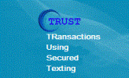
Take Away for Investors…
Update your contact details with your member / DP.
Update your bank details in your demat account.
Register your Nominee details in demat account. (Up to 3)
Keep the instruction slip book in your safe custody.
Register & track your demat account through CDSL (easi) & SMS facility.
Verify your transactions regularly.
Power of Attorney (Optional document)
CDSL Mobile App

Slide 17
Thank You
Website: www.cdslindia.com
40

