Slide 1

PCS – A value driven professional
Golden Jubilee Year National Conference of Practicing Company Secretaries 18th May 2018
www.ConsultIFRS.Com
1

Slide 2
Emerging areas in CS practice
Exploring key facets of Valuation with special emphasis on valuation of tangible and intangible assets
www.ConsultIFRS.Com
2

Slide 3





Faculty Rammohan N. Bhave
Address: 10, Sundersringar, Gulmohar Road,
Chunabhatti (East), Mumbai- 400 022
Google map ConsultIFRS.com
Contact & Whatsapp: +(91) 9167446744
Email: mohanbhave2@gmail.com
mohanbhave@ConsultIFRS.com
Enquiries: +(91) 8108557000
Facebook: 32000 friends
mohanbhave2@gmail.com
send friend request to Rammohan Bhave
LinkedIn: Rammohan Bhave 40000
contacts send connection request

Slide 4





Rammohan N. Bhave
Collegian
B Com – 1976
LL.B. (G) – 1981
Professional
CA – 1980
CMA – 1984
CS - 1987
Strategic
IIM (A) – M & A – 2005
SAP - 2000
Global
IFRS London – 2009
Six Sigma – 2009
Certified Intl. Valuer – 2018
and on way to Guinness book Record

Slide 5
My Journey – Laxmi (M) follows Saraswati
Reliance InfoComm
2002- 2004 – Business Controller
Crompton Greaves, Nasik -
1980 to 1990 Started career
Blue Star & Blue Star InfoTech – 1997 – 1999 Mumbai – CFO
Mittal Europe
2006-09
MD & Chief Finance Director, Europe
30 Years of
Industry experience;
and 8 years of
IFRS Consulting / training
Mafatlal –
1991 – 1994 (Surat) 1995- 1996 (Mumbai)
Foundation software – USA 2000,
Singapore 2001,
Australia 2002
Gammon India –
2004-06
Last 8 years - IFRS/Ind AS - Consultant & Faculty, Valuation,
M&A, ECB, FDI, Listings on Foreign Stock Exchange

Slide 6
JOURNEY FROM - TO
From compliance
To Value add

Slide 7
Move from - to
Institute of Company secretaries of India
Institute of Growth & Governance of India

Slide 8
From ICSI to IGGI – Why?
Secretary word is outdated & misleading, Chartered is also Outdated
Every entity (not just Companies) needs Governance
Many areas of Governance are Growth oriented – like M & A, Valuation
Banks, Cooperatives, Education Institutes – need Governance based growth
Company secretary should be GROWTH GOVERNOR or else VIKAS GOVERNOR

Slide 9
Already emerged
Insolvency professional
Closing shell companies

Slide 10

Now
Valuation
IFRS/INDAS
FDI/ECB
LISTING ON FOREIGN STOCK EXCHANGE
BLOCK CHAIN TECHNOLOGY

Slide 11
Valuation via Stories
At DROP of Hat
1
2
Huge disclaimers
Bank loan driven
3
4
unreasonable assumption
Full of errors
5
6
Nobody responsible

Slide 12

Who is be authority
MCA - IBBI
IVS – Ind VS?
VALUATION STANDARDS BOARD

Slide 13
Objectives for latest draft valuer’s rules
IFRS / Ind AS
GST, Income tax, wealth tax
RERA, customs, excise
BANK NPAs
Benami properties
Insolvency, bankcruptcy code
Black money & demonetisation
PSU at disvestment value
Aggregators - FDI

Slide 14




METHOD
COST
  Historical cost
  depreciations
MARKET
  Market quotes
  Directly observable
INCOME
  Returns on assets
  Best use/ highest use
MIX
  weightage
  relevance

Slide 15
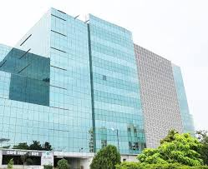

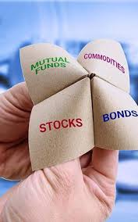
IBBI – CLASS OF ASSETS
LAND AND BUILDING
PLANT AND EQUIPMENT
FINANCIAL ASSETS

Slide 16

President, VP & council members
Being First RVO among …..
All 3 Land & Building AND P & M AND Financial assets

Slide 17

WHAT IS NEEDED FURTHER?
Intangible assets need separation
AND ABOVE ALL
Business valuations and goodwill
Financial liabilities
Employee Stock options
Insolvent companies
Inventory
Actuarial

Slide 18



LEVELs of INPUTS
LEVEL 1
  WHERE
  AND
  WHAT??
LEVEL 2
LEVEL 3

Slide 19
Valuation where?
Business valuation
1
2
Fixed assets, Inventory
Intangibles
3
4
Shares & debentures, Options
Financial assets & liabilities
5
6
Actuarial

Slide 20
Valuation purpose
M & A
1
2
Direct and indirect taxes
Co Act – B/s. IPO
3
4
Bank Loan
IBBI - Insolvency
5
6
ESOP

Slide 21
Non-Monetary Assets and Liabilities
Assets & Liabilities
TANGIBLE ←-----------------------Non Monetary Assets-----INTANGIBLE –
Non Monetary Liabilities
Held for use in business
Purpose
Office, Factory, Branch, Warehouse, mfg, material handling
Warranties
Guarantees
Onerous contracts
Pension liabilities
Held for trading
purpose
Inventory
Held for appreciation & renting
purpose
Investment Property
Held for Sale
purpose
Surplus

Slide 22
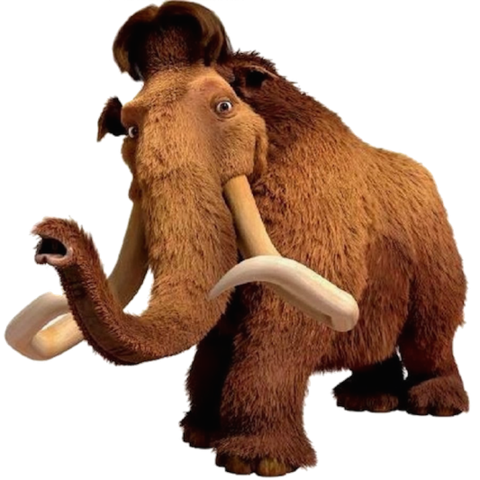





Valuation where you start & where you should reach
If it acts like a duck
& quacks like a duck
But it is actually a rat
& management wants to call it an elephant
DUCK
As per IVS call it a

Slide 23
Tangibles & intangibles
A
B
Tangibles
Intangibles
model
  Cost model
  Income model
  Market model

Slide 24

Intangibles - Practical examples -1
Flying rights international – Kingfisher To Air Deccan
Landing rights – same
Adidas impairment goodwill 1200 Crores
Spectrum – Unitech
Irrigation rights – scam in Maharashtra
FSI – Adarsh
Mining rights – Bellari mines Karnataka
Right to sell tickets stadium – Commonwealth games scam
Liquor licenses –Sula wines
Wine manufacturing license – United Spirits

Slide 25
Intangibles - Practical examples -2
R & D expenses capitalised by sale of undertaking –Biocon
Ferrying rights – Marine engineering
License to put Windmill energy tower – Suzlon, Enercon, Versa, Inox, Gamesa,
Regeneral power, Sembcor
Fix in building roofs - Mobile towers – Reliance is selling
LMDS (local multi-point distribution system/service) technology right – gateway
systems
Brand – 400cr loan by banks to Mallya
Gammon – toll collection rights

Slide 26
Intangibles - Practical examples -3
Solar energy equipment manufacturing rights – Axiom Energy Hyderabad
Publishing rights – CNBC TV 18, TAXMANN, Navneet Publications
LOGO – Google
Banking License – GPP bank, BBK, Airtel bank
Right to cut trees- MP Power
Website – Byjus
Carbon credits – Naveen Fluorine, SRF, GFL, Tanfac
Air India – RBSA valuer – MOST GLOBAL AIRPORTS Landing right (32?)

Slide 27
Intangibles - Practical examples -4
ISO certification – CG 1st company to take ISO for accounts department
Six sigma
CMM level V – Wipro, TCS, Infosys
TDR
Non-compete rights – Ambani brothers division
Patents – Bilcare & ACG
RIL – 139 brands published in mar 2017 financial statements

Slide 28
Intangibles - Practical examples -5
Film distribution rights – Balaji Telefilms
Media rights – Group M
TRP – Abp TV
Cricketers contracts – IPL teams (Yusuf Pathan impaired to 75 Lakhs due to dope test)
Software – Ola cabs, TFS
SAP, MS office, bancs24, Finnacle, Finmin, CBS
Stock brokers card – BSE members –
Commodity exchange start up right – Jignesh – FT
MP Power – power distribution/ generation/transmission license as enacted

Slide 29
Intangibles - Practical examples -6
Customer Relationship – TFS
Customer Loyalty - TFS
Branding – Patanjali – Star Bharat (TV Channel)
Defense Rights – Mechvac
Mytas – Construction Rights
DLF – Urban Development Rights
National Herald – Debt Recovery Rights
Suppliers Relationship - TFS

Slide 30
Humble suggestions to ICSI -high time to start quickly
1. Include in syllabus full paper immediately
2. Start certificate courses for current professionals
3. Hold Webinars, Seminars

Slide 31
High time to start quickly
1. Committee to analyse comments on Valuation standards by ICSI
2. Make Mandatory legal due diligence for every valuation, to be certified by Company secretary – A BIG OPPORTUNITY
3. Currently every valuer puts disclaimer for legal due diligence

Slide 32
High time to start quickly
1. Keep goal of at least few thousand valuers quickly as regd. valuers
2. Valuation for M & A – is biggest need in value terms
3. Currently every valuer puts disclaimer for legal due diligence

Slide 33
Learn new concepts
New models
Level of inputs
GMV Model
1. Market price
Startup valuations
2. Observable Inputs
3. Unobservable inputs

Slide 34

I offer my services on Valuation and IFRS
To ICSI

Slide 35




Further scope for Valuations
IFRS/ Ind AS
BANKING
INSURANCE
NBFC

Slide 36
Expected to add
All bank borrowing companies
A
SME and MSME
B
Cooperative sector
C
Trusts
D
THEN IPSAS and GASB
E

Slide 37
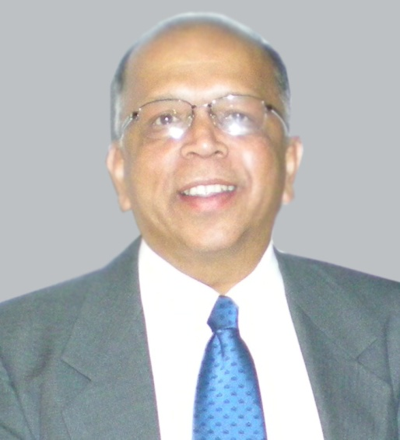



Rammohan N. Bhave
Limca Record Holder on IFRS
FCA, FCMA, ACS, LL.B. (G.),
IFRS – ICAI, Six sigma green belt.
Diploma in IFRS, ACCA, London
+91 9167446744
mohanbhave2@gmail.com
mohanbhave@consultIFRS.com

Slide 38
Thank You!

