Slide 1
Ease of Doing Business- A Myth or Reality
Nesar Ahmad
Nesar & Associates
csnesar367@gmail.com
Mob No: 9810044367

Slide 2
Plan for Ease of Doing Business
To resolve insolvency & bankruptcy issues
To polish public contracts dispute resolution bill
Removing administrative bottlenecks
To create favourable environment for investors
Liberalized procedures for MSMEs

Slide 3
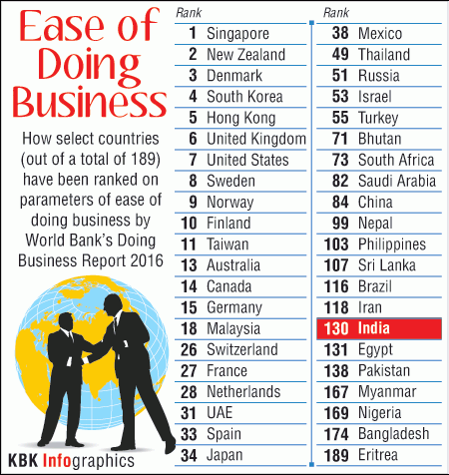
Ranking as per World Bank’s Doing Business Report 2016

Slide 4
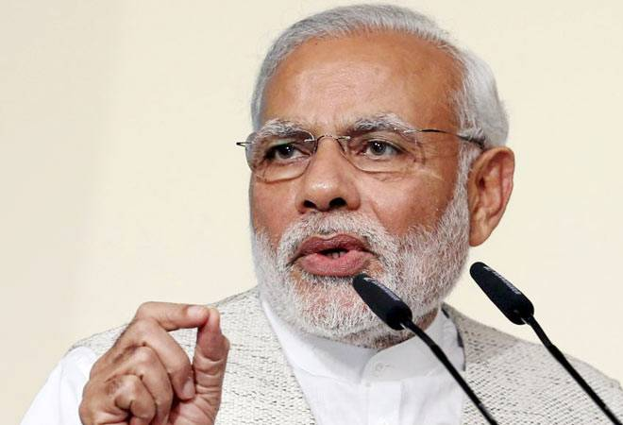
PM MODI JI’S Views on Ease of Doing Business
World Bank has placed India on 12th position in the list of countries that had ensured ease of doing business.
Today, the world is facing a very deep economic crisis and in this situation, India is a beacon of hope.
Whether it is World Bank, IMF or Credit Rating Agencies, all of them consider India one of the fastest growing economies,

Slide 5
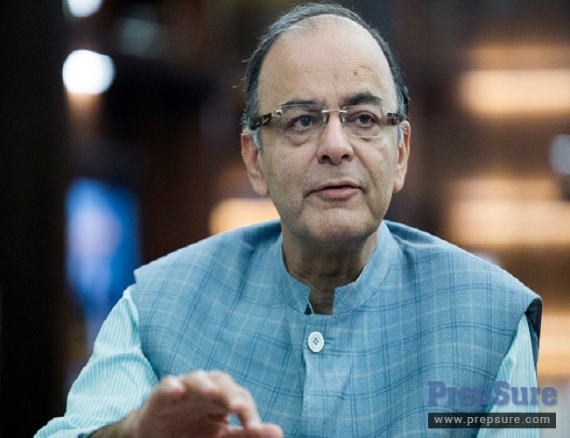
ARUN JI at World Economic Forum, DAVOS (Jan, 2016)
One main reform which is still work in progress is Ease of Doing Business in India.
We did not have a great track record on that, but our rankings have improved there also.
Still, it remains a work in progress and we will continue to take steps on that front.

Slide 6
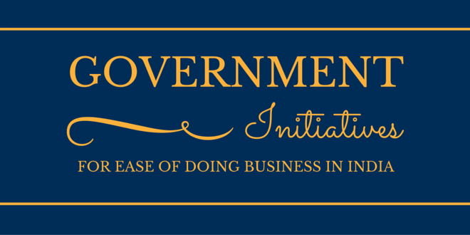

Slide 7
GOVERNMENT INITIATIVES FOR ‘EASE OF DOING BUSINESS ’
Online process for applying Industrial License (IL) and Industrial Entrepreneur Memorandum (IEM)
Ministry of Corporate Affairs has introduced an integrated process of incorporation of a company
To remove requirements of minimum paid-up capital and Common Seal for companies.
20 services are integrated.
-contd.

Slide 8
GOVERNMENT INITIATIVES FOR ‘EASE OF DOING BUSINESS ’
5. Initial validity period of Industrial License has been increased to three years from two years.
A checklist has been developed for processing all applications filed by foreign investors relating to foreign investments.
An Investor Facilitation Cell has been created.
Registration process of VAT and Professional Tax has been merged into a single process.
…contd.

Slide 9
GOVERNMENT INITIATIVES FOR ‘EASE OF DOING BUSINESS ’
Registration for VAT in Delhi has been made online
TIN allotment is done real-time
business can start immediately on receipt of TIN number.
DIPP requested all Secretaries of Government of India and Chief Secretaries of the States/UTs to simplify and rationalize the regulatory environment
…contd.

Slide 10
GOVERNMENT INITIATIVES FOR ‘EASE OF DOING BUSINESS ’
Notification has been issued on 12-03-2015 by DGFT to limit number of documents required for export and import to three.
Defence products’ list for industrial licensing has been issued.
To facilitate investors and to reply to their queries, Frequently Asked Questions (FAQs) by applicants.
…contd.

Slide 11
GOVERNMENT INITIATIVES FOR ‘EASE OF DOING BUSINESS ’
NIC Code- 2008 has been adopted.
17.Security Manual for Licensed Defence Industry’ has been issued.
…contd.

Slide 12
GOVERNMENT INITIATIVES FOR ‘EASE OF DOING BUSINESS ’
SEZ Units allowed removing goods for repair, replacement, testing, calibration, quality testing and research and development on self-attestation.
Process of applying for Environment and Forests clearances has been made online
Ministry of Labour is working for rationalization of Labour laws.
…contd.

Slide 13
GOVERNMENT INITIATIVES FOR ‘EASE OF DOING BUSINESS ’
Facilitating revival and rehabilitation of MSMEs.
22.Unified portal for registration of Units for reporting of inspection, submission of returns and grievance redressal.
23. Passing of Insolvency & Bankruptcy Code.

Slide 14
India Moves Up in World Bank's Ease of Doing Business
India now ranks 130 out of 189 countries, moving up 12 places from last year.
China is ranked 84 and Pakistan is at 138th place.

Slide 15
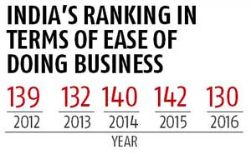
INDIA’S RANKING

Slide 16
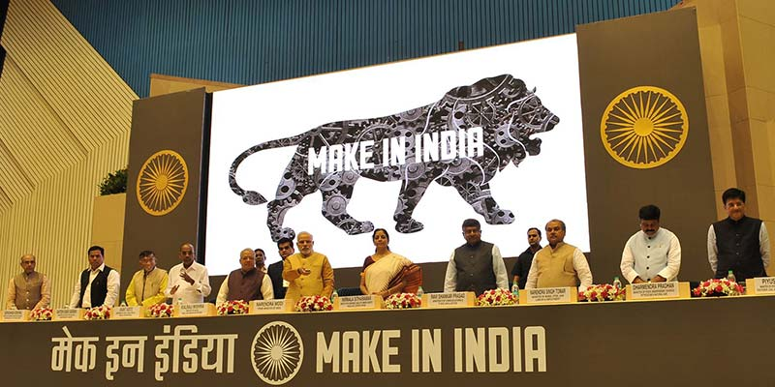

Slide 17
Pranab Mukherjee on February 23, 2016
India is a heaven of stability in an increasingly turbulent global economy
Fiscal deficit and current account deficit have all come down
The government has taken a number of measures to put in place a simplified, progressive and non-adversarial tax regime

Slide 18
EASE OF DOING BUSINESS

Slide 19
Implementation of the outcome of Committee of Secretaries constituted by PM
GST rollout
Clear Taxation Policy
Easy/Clear Labour Policy (Exit Policy)
(Rajasthan & Maharashtra model)
Less Regulatory burden on MSMEs
…contd.

Slide 20
‘Make in India’, ‘Start up India’, ‘Stand up India’
Ease of accessing- Land, Labour, Capital and Technology
More and more Free Trade Agreements (FTAs) on bilateral and multilateral level
Insolvency and bankruptcy Law
…contd.

Slide 21
Public Sector Reform
Predictable legal environment for manufacturing and trade
Public interface at Regulatory Bodies- SEBI, IRDA, FSSAI, CBDT, CBEC and other Ministries/Regulators.
…contd.

Slide 22
13.Financial Reforms for tackling NPAs.
14.Unique ID No. for Corporates to do business
15.Co-ordination between MCA, CBDT, CBEC and other regulators for use of common unique ID for Corporates.

Slide 24
CONCLUSION
Need to work on implementation of “Ease of doing business”
This reform will bring the sudden change in Corporate and Consumer world.
Overcome of Economic Crisis

Slide 25
Nesar Ahmad csnesar367@gmail.com Nesar & Associates 9810044367

