Slide 1


Real Estate (Regulation and Development) Act, 2016
CS SUBHASH SETIA

Slide 2
Presentation Outline
A
Real Estate
Market
B
Government Initiatives
C
Challenges
D
RERA- Highlights/Issues
E
Role of CS
F
Suggestions

Slide 3
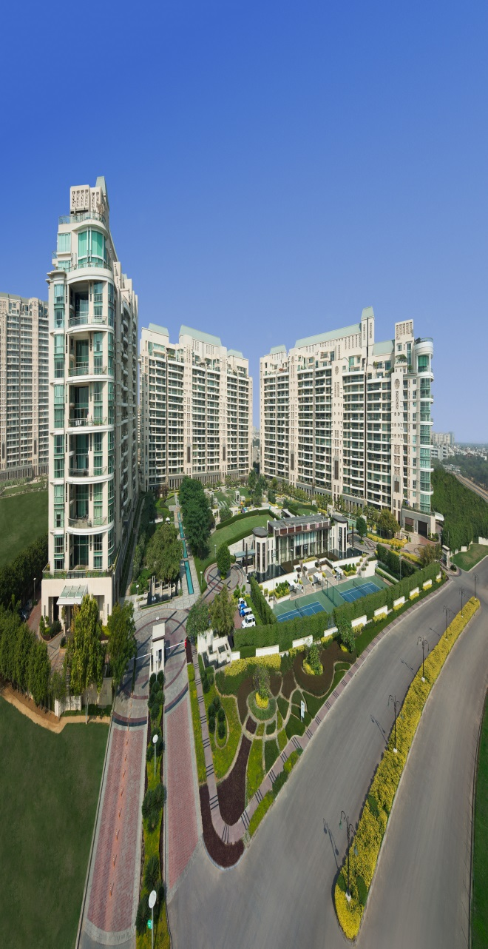
Real Estate Market
Includes Housing, Retail, Hospitality, Commercial & SEZ.
One of the most globally recognised sectors.
Second largest employer after Agriculture (In India).
Contributes 5%-6% of India’s GDP and is estimated to increase to approx..13% by 2028.
In the period FY08-20, the market size is expected to increase at a CAGR of 11.2%.

Slide 4

Real Estate Market
PE investments increased at CAGR of 33% to US$2,220 million upto Dec’15.
Reasonable market - 4/5 times of annual earnings.
Real Estate growth is coupled with economic conditions, growth of the corporate environment, demand for office/commercial space as well as urban and semi-urban accommodations..

Slide 5

Recent Govt. Initiatives
Promulgation of RERA to create an institutional infrastructure for protecting the interests of consumers and promoting growth of the real estate sector in efficient and transparent manner.
Launch of ‘Smart Cities’.
Launch of ‘Housing for All’ by 2022.
Introduction of REITs Regulations and resolving incidental challenges.
‘Make in India’ & Start-up to accelerate leasing business.
Single-window clearance for approval for construction by BMC.
Kerala has decided to make the online process of securing permits from local bodies for construction of houses with the launch of 'Sanketham'.

Slide 6

Challenges…. Developer
Land acquisition
Funding and cost
Highly regulated
Approval timelines
Multiple compliances
Skilled Labour and quality issues
Pricing escalation .. .. inflation
Lack of infrastructure

Slide 7


Challenges…. Customers
No visibility for Developer track
Late Delivery
Non transparency about area and facilities
One side Agreement
Exorbitant price
Usage of funds in other projects
Change in lay-out
Quality issues
Defective land titles – large litigations

Slide 8

Initiation of New Generation of Developers

Slide 9

RERA …..Key highlights…..
Regulator
Registration
Disclosures
Definition
Project receivables
Warranties
Promoter obligations
Model Agreement
Defect liability
Functions and duties of promoter
Consequences of revocation of registration
Penalties

Slide 10
Key highlights…..contd…
Regulator
setting-up of Real Estate Regulatory Authority(ies).
setting-up of Real Estate Appellate Tribunals in all states and Union territories (except Jammu & Kashmir) within 1 year of its notification.
Registration
Mandatory registration - total area of land exceeds 500 Sq.mt. (approx. 598 sq. yds.) or 8 apartments (inclusive of all phases).
Every phase of a project to be registered separately.

Slide 11
Key highlights…..contd…
Registration
Projects cannot be advertised, booked or sold in any form prior to registration and approvals.
Grant or reject registration applications within 30 days.
Registration of real estate agents.
Disclosures
Publicly accessible disclosures of the project and promoter details etc. are compulsory.
Online disclosure / updation of project on quarterly basis.

Slide 12
Key highlights…..contd…
Definitions
Promoter
Allottee
Apartment
Carpet area
Common areas
Interest
Real estate agent
External development works

Slide 13
Key highlights…..contd…
Project Receivables
70% of all project receivables in a separate account.
Drawdown from such account is permitted for land and construction costs only, in line with the PCM (to be certified).
Accept only up to 10% of the apartment cost prior to entering into a written agreement for sale.
Warranties
Declaration as to legal title to the land title, if such land is owned by another person.
Obtain insurance for title and buildings along with construction insurance.

Slide 14
Key highlights…..contd…
Promoters obligations
Not to alter plans, structural designs and specifications of the land, apartment or building without prior consent of 2/3rd of the allottees.
The promoter is also not permitted to transfer or assign majority of its rights and liabilities in a project without such consent, along with the RERA's prior written approval.
Model agreement
Specified form of agreement for sale may be prescribed, which will prevent inclusion of biased provisions in it. Consumers have also been granted the right to seek relief for unilateral termination of such agreements by promoters without cause.

Slide 15
Key highlights…..contd…
Revocation of registration
Promoter makes default in compliance of provisions of RERA.
Promoters violates T&C of approval granted.
Promoters involved in an kind of unfair practice or irregularities.
Consequences of revocation of registration
Debar the Promoters from accessing the website
Specify the Promoters name in defaulter and display photographs on its website.
Inform all other RERA in other states and UTs

Slide 16
Key highlights…..contd…
Consequences of revocation of registration
Facilitate the remaining development works by competent authority/association of allottees.
Bank will hold project account to freeze/defreeze the account.
Functions & duties of Promoter
Comply with all obligations, responsibilities and functions under the RERA.
Obtain completion certificate or the OC or both.
Provide and maintain the essential services on reasonable charges

Slide 17
Key highlights…..contd…
Functions & duties of Promoter
Execute conveyance deed.
Pay all outgoings until the transfer of physical possession.
Not to create encumbrance after execution of agreement for sale.
Defects liability
The promoter is responsible for structural defects or other deficiencies for a period of 5 years from the date of delivery of possession.

Slide 18

Penalties…
Promoter
Upto 10% of the estimated cost of the Project or imprisonment upto 3 years for failing to register the Project.
Upto 5% of the estimated cost of the Project for providing false information or other non-compliance of the provisions of the Act.
Imprisonment upto 3 years and/or fine for every day upto 5%-10% of the estimated cost of the Project for not complying with decision of Appellate Tribunal.

Slide 19
Penalties…
Real Estate Agent
Penalty of Rs. 10K for every day of default which may cumulatively extend to 5% of the cost of the apartment for not complying with order of RERA.
Imprisonment upto 1 year or fine for every day upto 5% of the cost of apartment for not complying with decision of Appellate Tribunal.
Customer
Upto 5% of the cost of the apartment bought for not complying with order of RERA.
Imprisonment upto 1 year or fine for every day upto 10% of the cost of apartment for not complying with decision of Appellate Tribunal.

Slide 20

Key Issues out of RERA…
No clarity between Occupancy certificate & Completion certificate
Filing of Income Tax Returns- classified documents
Sanctioned plans to be put up on the website- IPR and Security issues
Land Rate should be as per Book of Accounts- all costs prior to starting projects to be added
Title Insurance – No such product available from Insurance Companies
Increased reliance on external capital to achieve high growth
Possible impact on joint venture arrangements

Slide 21
Key Issues out of RERA…
Potential delay in cash-flow realizations from projects
Adoption by State Governments and draft State law
Drafting and finalizing of Rules
No single window for approval
Timelines for approvals
Increase cost of project
Change in mindset of customer - cost escalation
Rationalization of stamp duty

Slide 22

Merits of RERA…
Developer
Elimination of fly by night operators.
Minimum standards of governance, accountability & professionalism.
Greater visibility into the developers’ delivery performances.
Higher investment and a possible reduction in the cost of funds.
Customers
Timely completion of projects and delivery.
Safeguarding of investment, as 70% of the sales receipt locked.
An increase in the quality of construction due to a defect liability.
Balanced builder-buyer agreements.
Sale on the carpet area.
Greater visibility into developer’s delivery track record.

Slide 23

Brunt of RERA…
Developer
Additional layer of approvals.
No provision for a single window mechanism.
Increased reliance on external capital to achieve high growth.
Possible impact on joint-venture.
Potential delay in cash-flow realizations.
Customers
The timelines of approvals not defined.
higher prices due to the reduced competition.
New project launches might be limited as approvals could take time.

Slide 24

Role of Company Secretary
Advisory /Planning
Drafting of applications/agreement/ other documents
Obtaining approvals/registration
Compliance management
Co-ordination
Limitation of liability
Representation at legal forums

Slide 25

Suggestions
NAREDCO
CREDAI
Ministry
Drafting of Rules
MOU
SOPs for new generation of promoters
Certification on compliance management

Slide 26

Q & A

Slide 27


