Slide 1
1

Slide 2
PSESSION -I
Panel Discussion : Start up India
Professional Opportunities
for
Practicing Company Secretaries
in
Goods and Services Tax
Dr. Sanjiv Agarwal
12-13th August, 2016
FCA, FCS,ACIS ( UK )
@ Kasauli (HP)22 Jaipur / New Delhi
© Dr. Sanjiv Agarwal
2

Slide 3
This presentation covers :
Overview of Economy / Tax structure
Goods and Services Tax – at a glance
Challenges in Implementation of GST
GST-Way forward
Professional opportunities in GST
3

Slide 4
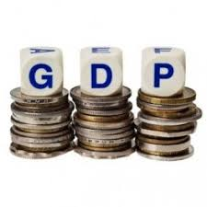
GDP COMPOSITION
4

Slide 5
TAXATION IN INDIA - POWER TO TAX
Taxation governed by Schedule VII of Constitution of India
India has a three- tier federal structure to levy and collect taxes –
the Union Government,
the State Governments including urban/rural local bodies
Concurrent List
Presently goods are liable to VAT/ Excise / Customs duty while taxable services attract service tax.
Certain transactions subject to both - VAT and Service tax
Efforts being made to revamp the direct tax structure - (Wealth Tax Act, 1957 scrapped, Committee working on the same)
Efforts to bring in a single indirect tax – GST proposed
5

Slide 6
TAXONOMY OF INDIAN TAXATION
TAXATION POWERS OF UNION
Income Tax (1961) – on income, except agricultural income
Excise Duty (1944) – on goods manufactured
Custom Duty (1962) – on imports
Service Tax(1994) – on specified services
Central Sales Tax(1956) – on inter-state sale of goods
Stamp Duty – on 10 specified instruments
Specified Cesses - on specified items
6

Slide 7
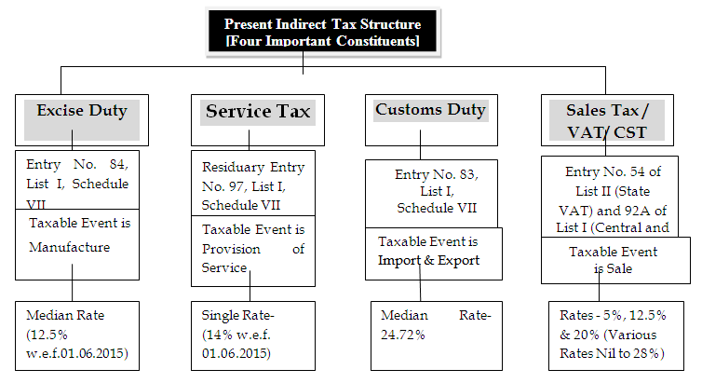
PRESENT INDIRECT TAX STRUCTURE IN INDIA
7

Slide 8
DRAWBACKS OF CURRENT TAXATION SYSTEM
Confusion / lack of clarity / interpretational issues
Lack of trust between assessee and revenue – Valuation/ Classification/ Exemption
Complexity and lack of consistency in provisions
Hidden tax on exports, no state tax on imports
Cascading effect
Narrow assessee base
High transaction costs
High compliance costs
Too much of litigation and disputes
Lack of harmony and varying inter-statepractices : Turnover/Exemption
8

Slide 9
RECENT IMPROVEMENTS IN TAX STRUCTURE
Replacement of the single-point State sales taxes by the VAT in all of the States and Union Territories.
Gradual reduction in the Central Sales Tax rate (will be scrapped in GST regime)
Introduction of service tax by the Centre and substantial expansion of its base over the years.
Rationalization of the Cenvat credit system
Electronic platform
Self regulatory tax regime-Self Assessment
Dispute resolution measures (VCES,2013; IDRS,2016)
9

Slide 10
CONCEPT OF TAXABILITY OF SERVICE
SERVICE FOR A CONSIDERATION
10 DECLARED SERVICES
E: Employee
M: Money
A: Actionable claim
G: Goods
I: Immovable property
C: Court Fee
E - MAGIC TEST
2. Negative list (15)
3. Exemptions (63)
Taxable
1. Non -Taxable territory (POPS)
10

Slide 11
GOODS AND SERVICES TAX
Goods What ?
Services Why ?
Tax When ?
11

Slide 12
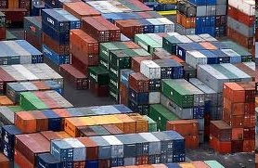
WHAT IS GST ?
A common tax
on
Goods Services
12

Slide 13
GOODS AND SERVICES TAX
G ONE NATION ONE MARKET ONE TAX
S MIGRATION FROM ORIGIN BASED TAX TO CONSUMPTION (DESTINATION) BASED TAX
T TRANSACTION BASED TAX (SHIFT FROM ACTIVITY BASED TAX)
13

Slide 14
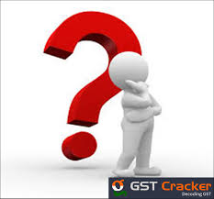
WHAT IS GST ?
‘G’ – Goods
‘S’ – Services
‘T’ – Tax
Goods and Service Tax (GST) is a comprehensive tax.
GST will be a national level value added tax applicable on goods and services.
GST is an indirect tax in lieu of tax on goods (excise) , tax on service (service tax) and VAT / CST.
GST is just like State level VAT which is levied as tax on sale of goods.
GST is a tax on goods and services with value addition at each stage having comprehensive and continuous chain of set-of benefits from the origin (producer’s/ service provider’s) point up to the destination (retailer’s level )where only the final consumer should bear the tax.”
14

Slide 15
WHY DOES INDIA NEED GST
To have ease of doing business
Making exports competitive
Protection from cheaper imports
No free Inter- state trade & commerce
Suffers from discriminatory taxes , undue preferences , trade and non - trade barriers , entry tax , octroi and check posts .
A complex tax structure with multiple rates of taxes and multiple taxes across the supply chain
As a developing country, India needs a transparent & progressive tax policy / tax structure
15

Slide 16
WHY DOES INDIA NEED GST
Fewer and lower taxes to yield more revenue rather than having stiff taxes
Broadening of tax base
GST will operate on a negative list i.e. all goods and services will be subject to GST unless specifically exempted (to have few exemptions)
GST encourages an unbiased tax structure that is neutral to business processes, business models, organization structure, product substitutes and geographical locations
High transaction cost in the hands of the tax payers
Increased tax collections due to wider tax base , better compliance and reduced tax evasion
Improvement in international cost competitiveness of indigenous goods and services.
Enhancement in efficiency in manufacture and distribution due to economies of scale
contd. . .
16

Slide 17
WHY DOES INDIA NEED GST
Cascading Effect
Multiple taxes
No inter-tax set off
Even no set-off in some taxes
Tax on Tax
Increased cost of products / services
Higher compliance costs
In GST, many taxes will get subsumed and tax cascading will be eliminated on credit of inward / input taxes
17

Slide 18
WHY DOES INDIA NEED GST
Cascading Effect
Central Sales Tax (CST) on inter-state sales, collected by the origin state for which no credit is allowed by any level of Government – will be phased out now
Real estate transactions kept outside the scope of both VAT and CENVAT
Exempt sectors are not allowed to claim any credit for the CENVAT or the service tax paid on their inputs
18

Slide 19
Objectives of GST
Elimination of tax cascading
Improve cost competitiveness
Common market , Common tax
Streamlining indirect tax regime
Operational and functional efficiencies
19

Slide 20
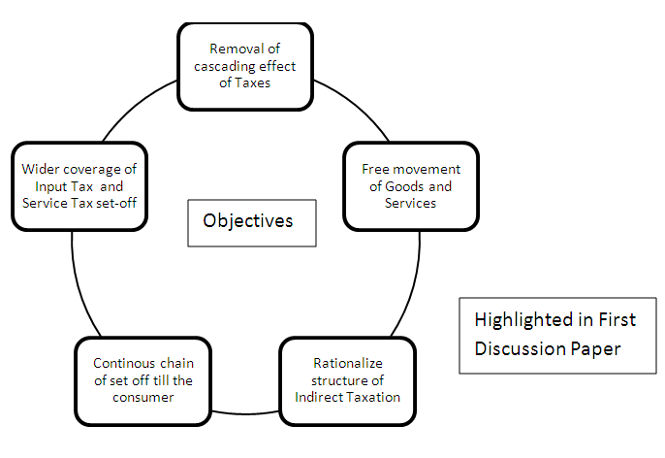
Objectives of GST
20

Slide 21
Objectives of GST
Common market - common tax
Borderless market – no inter-state barriers
Uniformity of tax rates
Fully automated
Easy compliances
No tax cascading across chain
Seamless input credit
Transparency to eliminate corruption
Improved competitiveness –
ease of doing business
reduced transaction costs
21

Slide 22
22

Slide 23
ILLUSTRATION OF GST
23

Slide 24
24

Slide 25
THE CONSTITUTIONAL AMENDMENT BILL, 2014
Enables introduction of GST
GST defined
Goods / Service defined
Integrated GST
Import of goods / services
Alcohol for human consumption
Petroleum products and tobacco
Role of GST Council
Compensation to States
25

Slide 26
THE CONSTITUTIONAL AMENDMENT BILL, 2014
NEW DEFINITIONS
“Goods and services tax” means any tax on supply of goods, or services or both except taxes on the supply of the alcoholic liquor for human consumption. [Proposed Article 366(12A)]
To be extended to crude, diesel, petrol, natural gas and ATF from a date to be notified on recommendation of the GST Council
“Goods” includes all materials, commodities, and articles. [Existing Article 366(12)]….inclusive definition
(Concept of ‘excisable goods’ to go )
“Services” means anything other than goods. [Proposed Article 366(26A)]…depends upon definition of goods
Supply defined in Section 3 of Model GST Law
26

Slide 27
THE CONSTITUTIONAL AMENDMENT BILL, 2014
Goods and Services Tax Council (GSTC) - proposed Article 279A
To be constituted by the President within 60 days from the coming into force of the Constitutional Amendments
Consists of Union FM and Union MOS (Rev)
Consists of all State Ministers of Finance
Quorum is 50% of total members
Decisions by majority of 75% of weighted votes of members present and voting
1/3rd weighted votes for Centre and 2/3rd for all States together
Contd…..
27

Slide 28
THE CONSTITUTIONAL AMENDMENT BILL, 2014
Goods and Services Tax Council (GSTC)
Council to make recommendations on
Taxes, etc. to be subsumed in GST
Exemptions & thresholds
GST rates
Band of GST rates
Model GST Law & procedures
Date from which GST would be levied on petroleum products
Changes in entries in List – I & II
Compensation for loss of revenue to States for five years
Council to determine the procedure in performance of its functions
Council to decide modalities for dispute resolution arising out of its recommendations
28

Slide 29
Further Amendments in Constitution (122nd Amendment) Bill
Compensation to states for revenue ('may' replaced by 'shall') loss for 5 years on account of introduction of GST
1 percent additional inter-state tax withdrawn
Dispute resolution forum to adjudicate disputes between
Centre and states
Two or more states
Centre + states and other states
Taxes collected by Union shall be distributed between Union and States
29

Slide 30
THE GENESIS OF GST
Tax on Goods
GST
Tax on Services
Central GST (CGST)
Inter State GST (IGST)
State GST (SGST)
30

Slide 31
INDIRECT TAXES PROPOSED TO BE SUBSUMED IN GST
Local body taxes not being subsumed (eg. EntertainmentTax )
31

Slide 32
TAXES WHICH MAY NOT BE SUBSUMED IN GST
Central Taxes/Levies | State Taxes/Levies
Basic Customs Duty | Taxes on Liquors
Excise Duty on Tobacco products | Toll Tax/ Road Tax
Export Duty | Environment Tax
Specific Central Cesses (eg, Oil Cess) | Property Tax
Taxes on petroleum products | Tax on Consumption or Sale of Electricity - Not certain
Stamp Duties | Stamp Duty - Not certain
 | Purchase tax on food grains
 | Taxes on motor spirit & high speed diesel
32

Slide 33
NEW CONCEPTS IN GST
Proposed Indirect Tax Structure
Intra State Taxable Supply
Excise and Service Tax will be known as CGST
Local VAT & other taxes will be known as SGST
Inter State Taxable Supply
CST will be replaced by Integrated GST (IGST)
Import From Outside India
Custom Duty
Approx. Sum total of CGST and SGST
In place of CVD and SAD, IGST will be charged
33

Slide 34
CENTRAL GST (CGST)
CGST on both , goods and services
To be levied , controlled and administered by Union .
Levied by the Centre through a separate statute on all transactions of goods and services made for a consideration.
Exceptions would be exempted goods and services, goods kept out of GST and transactions below prescribed threshold limits.
CGST would be levied across the value chain.
Rates for CGST would be prescribed appropriately reflecting revenue considerations and acceptability.
Two Governments will combine their various levies into single GST.
Proceeds to be shared between Centre and States .
34

Slide 35
STATE GST (SGST)
Levied by the States through a statute on all transactions of goods and services made for a consideration.
State GST would be paid to the accounts of the respective State.
Exceptions would be exempted goods and services, goods kept out of GST and transactions below prescribed threshold limits.
Basic features of law such as chargeability, taxable event, measure, valuation, classification would be uniform across these Statutes / States as far as practicable.
35

Slide 36
INTEGRATED GST ( IGST )
On inter-state supply of goods and services
Includes Cross border transactions (only imports)
Centre would levy and collect IGST in lieu of CGST and SGST.
To be shared between Centre / States
Single IGST rate
IGST would be levied on all inter-State transactions of taxable goods and services with appropriate provision for consignment or stock transfer of goods and services.
Inter-State dealer will pay IGST after adjusting available, input IGST, CGST and SGST on purchases.
Contd….
36

Slide 37
IGST – ILLUSTRATION
Maharashtra seller selling to Rajasthan buyer for Rs.1,00,000/-.
IGST payable assuming an 8% rate is Rs.8,000/-.
Rs.8,000/- can be paid by adjusting
Inter-State purchases (IGST) Rs.3,000/-
Local purchases (CGST) Rs.1,500/-
Local purchases (SGST) Rs.1,500/-
Since dealer has used SGST of Maharashtra to the extent of Rs.1,500/-, Centre has to transfer Rs.1,500/- to Maharashtra Government.
IGST of Rs.8,000/- is availed as credit by Rajasthan buyer.
Rajasthan dealer sells the goods at Rs.2,00,000/- attracting CGST of say Rs.16,000/- and SGST of Rs.16,000/-.
If IGST of Rs.8,000/- is used to pay the SGST then Rajasthan Government has to transfer Rs.8,000/- to the Centre.
37

Slide 38
GST DRAFT LAW – THINGS YOU MUST KNOW
GST applicable on ‘supply’
GST payable as per time of supply
Determining Place of Supply could be the key
Valuation in GST
Input tax credit in GST
Inter-State supply of goods for consideration not to attract additional tax
There would be 33 GST laws in India
Rate of GST is not yet specified in the draft GST law
38

Slide 39
CREDIT CHAIN UNDER GST
TO BE OFFSET IN SAME ORDER | CENTRAL GST CREDIT | STATE GST CREDIT | INTEGRATED GST CREDIT
1 | Central GST Liability | State GST Liability | Integrated GST Liability
2 | Integrated GST Liability | Integrated GST Liability | Central GST Liability
3 | - | _ | State GST Liability
Entities may need to maintain Separate IGST Credit Chain for each State individually
39

Slide 40
CENVAT CREDIT MATRIX
TAX TYPE (INPUT) | TAX TYPE (OUTPUT) | WHETHER POSSIBLE | RANKING
CGST | CGST | YES | 1
CGST | SGST | NO | N.A
CGST | IGST | YES | 2
SGST | CGST | NO | N.A
SGST | SGST | YES | 1
SGST | IGST | YES | 2
IGST | IGST | YES | 1
IGST | CGST | YES | 2
IGST | SGST | YES | 3
40

Slide 41
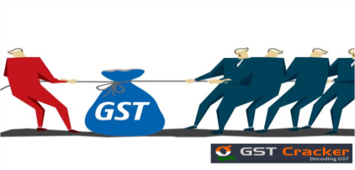
Complexities in Implementation of GST
Lack of harmony between tax laws / accounting practices / accounting standards.
Not using the correct accounting method.
Incorrectly claiming GST credits on Government charges - such as land / property tax .
For stamp duty which is not subject to GST, a GST credit may be claimed on this portion of the payment.
Not remitting GST on Government grants and incentives which are received inclusive of GST
Some states may be reluctant to implement GST and Co-operation among the states
To allocate revenue to the respective States
41
Contd…..

Slide 42
Complexities in Implementation of GST
Incorrectly claiming GST credits
Claiming a GST credit when the business does not have a valid tax invoice – matching issues .
Issues in deciding destination of service (POP).
Handling rapid increase in Assessee base
Clearance of pending cases of assessment & others under Cenvat/ Sales Tax/VAT /Service Tax/ Excise
Challenges in IT infrastructure
Improvement in Banking System
Perception of trade and industry
42

Slide 43
GST WAY FORWARD : WHEN GST WILL COME ???
Passage of Constitution (122nd Amendment) Bill
Rajya Sabha 3 August, 2016
Lok Sabha 8 August, 2016
Ratification of Bill by atleast 50% states by two - third majority (16 states)
President's assent
Constitution of GST Council
Decisions on critical issues by GST Council
Draft of Final GST Bills – CGST / IGST / SGST
Bills to be legislated – CGST / IGST by Parliament , SGST- by State Legislatures
GST rules to be drafted / approved / notified
IT software – development / testing
GST awareness / training
Date of implementation of GST in India (common date)
43

Slide 44
GST WAY FORWARD
GST : Immediate Challenges ahead
Ratification by states
Rate of GST
Exemptions / Negative list
Threshold limits
Finalization of GST laws
Composition limit
Dual control by state / centre
44

Slide 45
PROFESSIONAL OPPORTUNITIES IN GST
Professional Practice Areas(planning, compliances)
Advance Ruling
Representation
Employment with Corporates- dealing with Indirect taxes
Advisory Services
Professional Opportunities in GST
Representation in Tribunals / Courts
Client Retainerships for Compliances
GST awareness
Knowledge Management & Training
45

Slide 46
ROLE OF PROFESSIONALS
For Tax planning
Internal Audit of books of Accounts/Compliance / Due diligence Audit
Tracking GST development
Review of draft legislation and impact analysis
Industry Consultation for improvement in business process
Interpretation of legal provisions and procedures
Implementation assistance and Post implementation support
Developing systems and procedures/MIS
Advisory and consulting services
Certification Works
Procedural Compliances
Record Keeping
Return verification/filing of returns
Negotiations with Suppliers
Representations before Authorities
Appellate Work
Providing opinions / clarifications
Advance Ruling
46

Slide 47
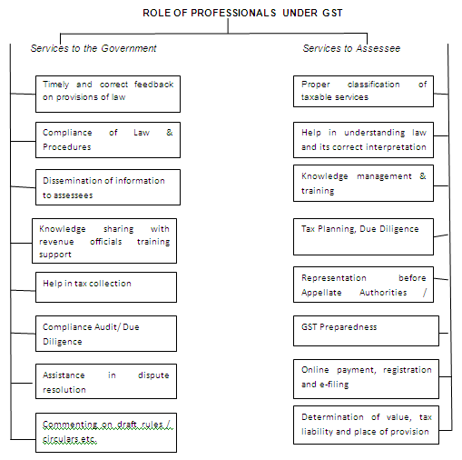
ROLE OF PROFESSIONALS
108
47

Slide 48
ROLE OF PROFESSIONALS
Why CS can explore GST practice
Professionally qualified and equipped to be so
Interpretational skills
Use of IT for business processes provides an edge to offer value added services (MCA compliances under Companies Act)
Makes sense as already providing IT support services for MCA - cost effective, value additive
Industrial exposure & experience
New law, new practice area
No competition exists (internally / externally).
GST will emerge as an area of specialization
Will aid secretarial audit / internal audit functions
GST compliances will become a management and governance issue – GST compliance rating
Add GST to the basket
48

Slide 49
LIKELY PROFESSIONAL OPPORTUNITIES UNDER GST REGIME
Tax Return Preparer (TRPs) under Section 2(99) / 34
Authentication for certification with regard to return , refund , registration and payment
Appearance before Appellate authorities under Section 86
Audit under Section 42(4)
Special Audit under Section 50
49

Slide 50
RECENT ICSI INITIATIVES ON GST
Background material / literature on GST
Specialized course on Indirect Tax / GST
Series of webinars in May / June / August / September , 2016
Core Group constituted on GST
GST Corner feature started in chartered secretary journal
August issue of journal dedicated to GST
GST being emphasized in all major programmes
August 2016 being observed as GST awareness month
Capacity building initiatives
Meetings with Ministers / Government officials
50

Slide 51
51

Slide 52
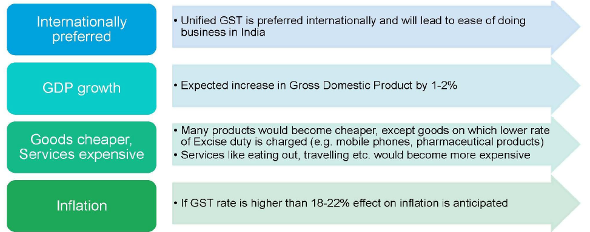
IMPACT OF GST ON INDIAN ECONOMY
52

Slide 53
GST - CHALLENGES
GST : Game changer or name changer
Everyone agrees that GST is necessary but cannot agree on scope form and content of GST
No one tries to understand enormity of GST – from financial accounting to tax impact to supply chain to business models IT infra (ERP) etc.
Should subsume all taxes, surcharges, cesses, levies and royalties
Confusion on what taxes would continue alongside GST
GST ought to apply to all goods and services with nil or very few exemption / exceptions
Legislative challenges
New taxes by States to be addressed
Political matrix
53

Slide 54
GST - CHALLENGES
What happen to all check posts / entry barriers / staff ? Will these be dismantled / relocated ?
IT Infrastructure - Is IT backbone fully ready and in place
Treatment of accumulated fiscal benefits
Additional tax of upto 1 percent for inter state trade for manufacturing states will create distortions
Dispute resolution mechanism still fragile – Council to decide
GST may create inflationary pressure in first few quarters as costs to be passed on to customers
Rapid increase in assessees vis a vis infrastructure
Place of supply to hold the key to success of GST
Effective credit mechanism
54

Slide 55
INDUSTRY’S PERSPECTIVES & CONCERNS
All declaration forms (Form F, C) should be abolished
Monitoring through system based controls
Full set-off of Input tax credit to the assessee / entity, based on principle of business cost and expenditure
Immediate credit of stock transfers, without one-to-one co-relation.
Refunds, if any, should be automatic through system based controls. Full set-off : a question mark
Any change post implementation should be uniform by all states not piecemeal.
Bar on increase in rates, imposition of new taxes by states
Uniform legislation, forms, rules, rates, compliance requirements.
Set-off should be on entity / concern basis.
Building of IT backbone
Multiple state jurisdictions.
55

Slide 56
TRADER’S PERSPECTIVES & CONCERNS
Dialogue with Trade & Industry and all other stake holders
Creating awareness and training to all stakeholders
Industrial inputs, Capital goods to be at lower rate
List of exempted goods – specific/common across states
Stock transfers should be exempted
Cenvat credit issues
Over emphasis on audits
Monitoring through system based controls
Lesser paper work/compliances
Harsh penalties , prosecution and arrest provisions
56

Slide 57
GST & COMMON MAN
Will it reduce the price of products?
Will it reduce the cost of services?
Will it increase Government revenue ?
Ease of doing business ?
Employment opportunities !
Economic developments !
Global business competitiveness !
57

Slide 58
What the government should do
Ensure that the CAB is approved by at least 50% of the states.
Obtain presidential assent once the above is accomplished.
Form GST Council within 2 months of that.
GST Council should decide on various aspects, including rates and dispute resolution, and come up with a draft GST legislation.
Central and state governments should pass respective GST legislation and announce go live date.
58

Slide 59
What businesses should do
Constitute cross functional teams to evaluate various aspects of GST.
Evaluate broad level impact on each function and put forth issues through advocacy forums.
Depending on the availability of further information on rates etc, prepare impact analysis.
Make changes to existing functions/policies, based on the analysis in order to derive benefits from GST and prepare for transition.
Be prepared for go live date and ensure adherence to new compliance framework.
59

Slide 60
ACTION POINTS FOR SMOOTH GST IMPLEMENTATION
60

Slide 61
ACTION POINTS FOR SMOOTH GST IMPLEMENTATION
61

Slide 62
ACTION POINTS FOR SMOOTH GST IMPLEMENTATION
62

Slide 63
“Absorb what is useful ,
discard what is not ,
add what is uniquely your own .”
-Bruce Lee
63

Slide 64
THANK YOU
FOR
YOUR
PRECIOUS TIME
AND
ATTENTION
Dr. Sanjiv Agarwal
FCA, FCS, Jaipur
asandco@gmail.com
sanjivservicetax@gmail.com
64

