Slide 1
Ease of Doing Business in India Facilitations and Obstructions

Slide 2
INDIA IS THE SEVENTH LARGEST COUNTRY BY AREA AND THE SECOND-MOST POPULOUS COUNTRY IN THE WORLD
economy of India is the seventh largest in the world by nominal Gross Domestic Product
third largest by purchasing power parity
a developing economy with an average growth rate of approximately 7% over the last 2 decades

Slide 3
We have a million problems, but at the same time we have over a BILLION minds.
Mr. Narendra Modi
Prime Minister of India

Slide 4
BILLION minds
Unemployment rate in India
9.0%

Slide 5
How to boost employment rate of India ?

Slide 6
Ease of Doing Business

Slide 7
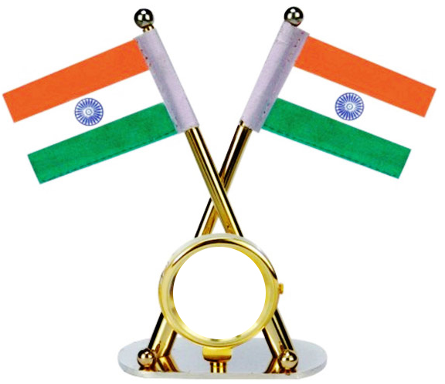
Equation of a Ease of Doing Business
Starting a business
Getting electricity
Registering property
Dealing
with construction permits
Getting credit
Protecting minority investors
Trading across borders
Resolving insolvency
Paying
taxes
Enforcing contracts
Labor market regulation
130

Slide 8
Internal
External
Importance of Ease of Doing Business in India
Job Seeker
Job Provider
Business Setup
Investments
Standup and Startup India
3 C Model
Government
Provide Employment
Attract Investment
Bring Technology
Innovation
Solutions to Problems
Develop Economy
Raises standard of living
Compliances
Capital
Private
Contract Enforcement

Slide 9
WAYS TO IMPROVE EASE OF DOING BUSINESS
System & Process
Technology
Mindset

Slide 10
EASE OF DOING BUSINESS THROUGH
System & Process

Slide 11
Compliances
Unnecessary compliances have been removed and a lot of permissions can be obtained online

Slide 12
COMPANIES (AMENDMENT) BILL 2016
Proposed around 100 amendments on 16th March, 2016, some are highlighted below:
Change in definition of small companies - Many more companies will get into the ambit of ‘small company’ and get benefits
Deletion of provisions regarding the restrictions on layers of investment companies - This eases the structuring of group companies and inter-co investments
Simplification of private placement - This will be a big relief for many startups. The Offer Letter was like a shorter version of public offer documents (DRHP)

Slide 13
COMPANIES (AMENDMENT) BILL 2016 (CONT.)
Issue of sweat equity shares by a newly incorporated company - With a view to encourage the emerging startups and entrepreneurs the company may now issue sweat equity shares after its incorporation without waiting for one year
Annual Return - This reduces paperwork and makes for easier compliances
Meeting through video conferencing or other means - This is certainly ease of doing business

Slide 14
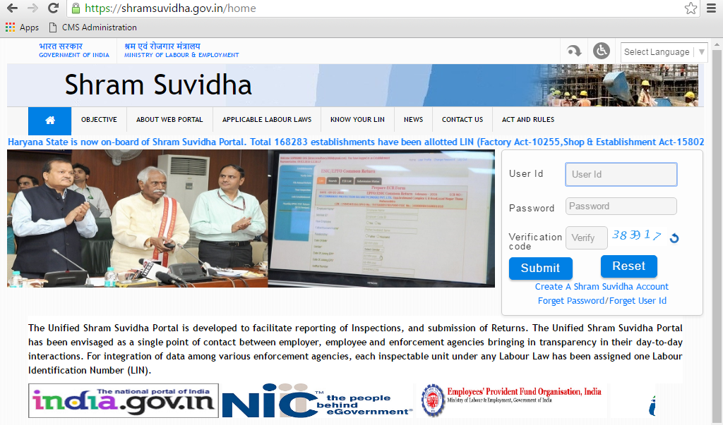
SIMPLIFICATION IN ADMINISTRATION OF LABOUR LAWS
Government launched an online portal shram Suvidha with focus:
Ease of reporting at one place for various labour laws
Consolidated information of labour inspection and its enforcement
Allotment of Labour Identification number to units to facilitate online registration and filing of returns
Real time registration with Employee State Insurance Corporation (ESIC) and Employee Provident Fund Organization (EPFO)

Slide 15
SIMPLIFYING OPERATION OF BUSINESS IN INDIA
Curbing the need of consent to establish / NOC letter letter for new electricity connections
Online application and monitoring for environmental and forest clearances
Simplification in obtaining Industrial Licenses
Reduction in the mandatory documents required for import and export of goods from 7 to 3

Slide 16
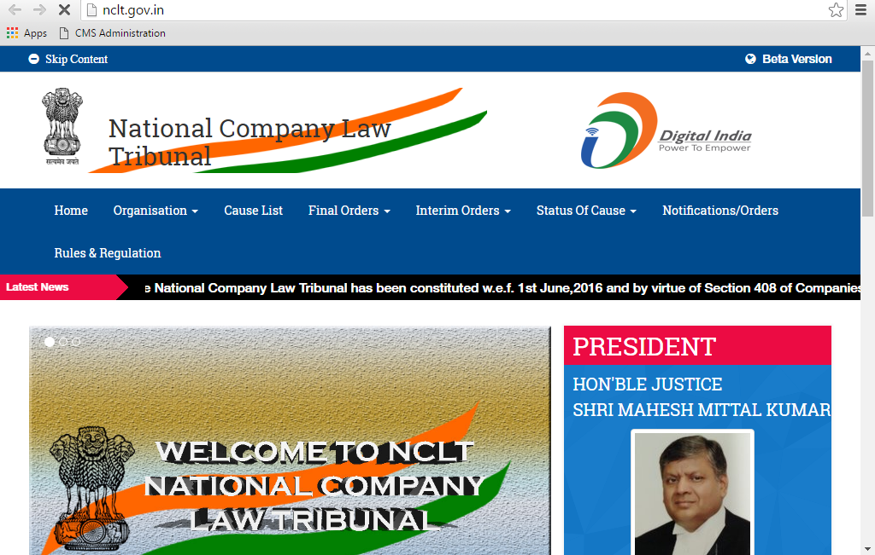
NATIONAL COMPANY LAW TRIBUNAL (NCLT)
The setting up of the NCLT and NCLAT are part of the efforts to move to a regime of faster resolution of corporate disputes, thus improving the ease of doing business in India
NCLT and NCLAT will also pave the way for the faster implementation of the bankruptcy code
It is expected to reduce the burden on courts

Slide 17
GST
GST will ensure one tax in the entire country.
It will result in seamless transfer of goods and services in the country
Taxes and inflation will remain low
People will spend less in buying essential goods
Eliminate the cascading effect of taxes on customers which will bring efficiency in product costs

Slide 18
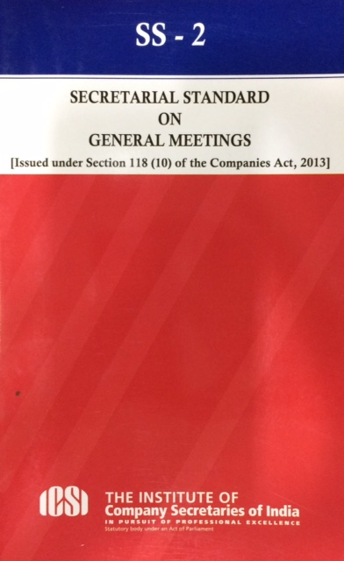
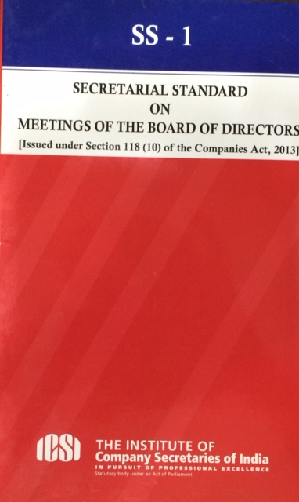
SECRETARIAL STANDARD BOARD INITIATIVE
Giving democratic and transparent consultative process paves the way for effective implementation of legal mandate
14 Lakhs Companies in India
1 Lakhs Professionals
10 Lakhs Professional Opinions

Slide 19
BENEFITS SECRETARIAL STANDARD BOARD
Strengthening the Board Processes
Reduces ambiguity
Increase in Confidence of Investors
Corporate Governance
Transparency
Reduction of non-compliances
To resolve the issues where the law is subject to multiple interpretations

Slide 20
capital
Non Corporate Enterprise in India | 58 Million
Provide employment | 128 Million
Non corporate enterprise in Rural area | 60%
Contribution to Indian GDP | 45%
The most employment-intensive sector of the economy gets the least credit

Slide 21
PRADHAN MANTRI MUDRA YOJANA AND THE MUDRA BANK
GOI indicated that all banks are required to lend to micro enterprises engaged in manufacturing, processing, trading and service sector activities, for a loan upto INR 10 lakh. Further, it was also advised that the loan may be given in three categories, i.e. Loan upto INR 50,000 under Shishu; INR 50,000 to INR 5 lakh under Kishor; and INR 5 lakh to INR 10 lakh under Tarun
Source: http://www.mudra.org.in/

Slide 22
FACILITATING INVESTMENTS THROUGH
FIRST DEVELOP INDIA
Investor facilitation cell established to provide support for all investment queries and for providing handholding and liasioning services to investors
Dedicated Japan Plus Cell established to facilitate and speed up investment proposals and augment economic ties between India and Japan
Dedicated desk established to facilitate and speed up investment proposals and augment economic ties between India and Korea, China, Canada, the US
E biz portal
Checklist with specific time-lines has been developed for processing all application filed by foreign investors in case relating to Retail / NRI / EOU.
Investments in LLP opened up to foreign investors in specific sectors

Slide 23
Contract enforcement

Slide 24
INSOLVENCY AND BANKRUPTCY CODE, 2016
Company in India typically takes four years, or twice as long as in China and Russia, with an average recovery of 25.7 cents on the dollar, one of the worst rates in emerging markets
This law seeks to cut down the time to less than a year. This will not only improve the ease of doing business in India, but also facilitate a better and faster debt recovery mechanism in the country
This Law promises to make it easier to wind up a failing business and recover debts

Slide 25
ENFORCING CONTRACTS INITIATIVE
The Arbitration and Conciliation Act has been amended to reduce the time taken in arbitration proceedings and grounds on which an award may be challenged
Commercial Appellate Division Bench and Commercial Division Benches are functioning in Bombay High Court and Delhi High Court

Slide 26
Other initiatives

Slide 27
MAKE IN INDIA
Launched in September 2014, the “Make in India” initiative aims is to build best-in-class manufacturing infrastructure by enabling investments, boosting innovation, encouraging skill development and strengthening intellectual property protection
Achievements till Date:
In first half of 2015, FDI inflows to the manufacturing sector were more than three times those recorded in first half of 2014

Slide 28
FOCUS ON URBANIZATION THROUGH CREATION OF SMART CITIES
Launched in September 2014, This initiative is expected to boost the real estate, technology, media and telecom (TMT) and construction sectors. In the construction sector, the Government has allowed 100% FDI under the automatic route and reduced the minimum capital requirement to US$5m from US$10m

Slide 29
DIGITAL INDIA INITIATIVE
Under the “Digital India” initiative, also known as “e-Kranti,” the Government aims to provide digital access to all citizens in both urban and rural areas. The initiative is expected to add US$1t to the economy by 2025
Achievements till Date:
Technology giant, CISCO, has announced plans to invest US$1.7b in 2015 in areas such as R&D and innovation with a keen focus on collaborating with the leading cap in its “Digital India” initiative
US based technology company, EMC, also plans to invest heavily in India, as it eyes new opportunities arising due to the initiative in areas such as software development

Slide 30
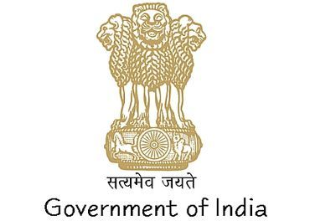
START-UP & STAND-UP INDIA

Slide 31
What startups means

Slide 32
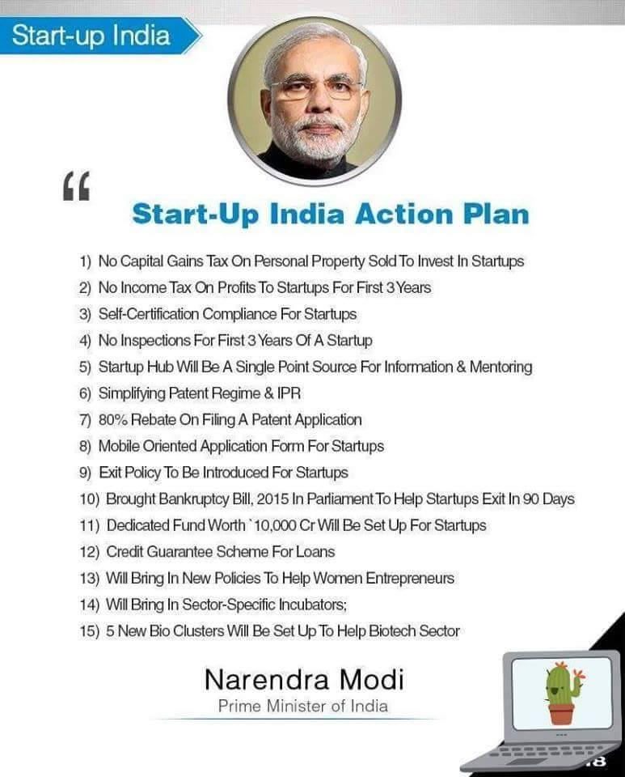
Startup india action plan

Slide 33
PRADHAN MANTRI JAN DHAN YOJANA INITIATIVE
To provide banking and financial services to all sections of the society in an affordable manner.
Achievements till Date:
According to the Guinness Book of World Records, this campaign is the world’s largest financial inclusion mission
Within a period of 15 months, as of December 2015, the Government has opened more than 195m bank accounts

Slide 34
SWACHH BHARAT ABHIYAN INITIATIVE
Focused on building and improving sanitation facilities, clean and adequate water supply and waste disposal facilities in India
Achievements till Date:
The objective is to create a clean India by 2 October 2019
The programs could add between US$26b to US$35b to the economy by 2019 through involvement of many private players

Slide 35
EASE OF DOING BUSINESS THROUGH
Technology

Slide 36
Will Technology take away our work?

Slide 37
TECHNOLOGY TRANSFORMATION will not be WORK DESTROYER rather will be a WORK CREATOR

Slide 38
Transformation from
Stock Market – Out-Cry-System

Slide 39
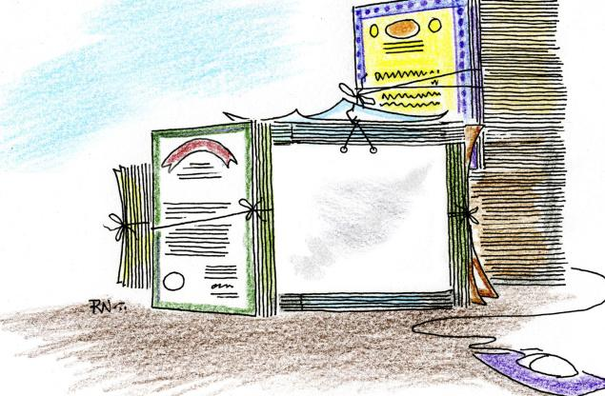
Transformation from
Physical Share Certificates to Demated shares

Slide 40
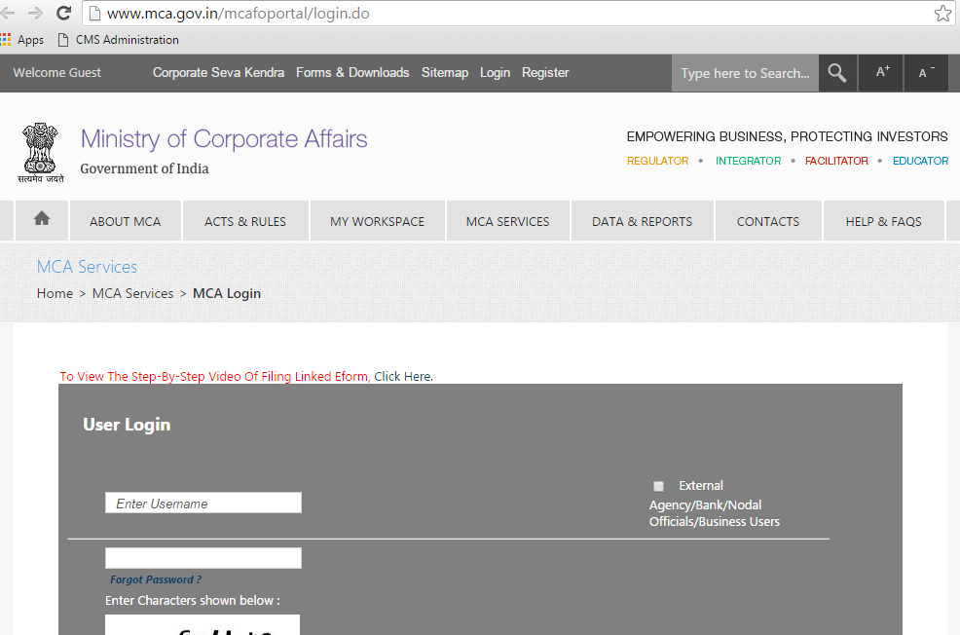
MCA21 : Paper based operations to paper less environment

Slide 41
over 100 Years and 8 Years
Time Period | No. of Companies Incorporated in India
Over 100 Years till 2006 | 795527
Last 10 Years (Approx) | 600000
Out of Total 14 Lacs Companies incorporated in India, near to 6 Lacs Companies incorporated in last 8 years

Slide 42
EASE OF DOING BUSINESS THROUGH
How you can create your own business ?
Mindset

Slide 43
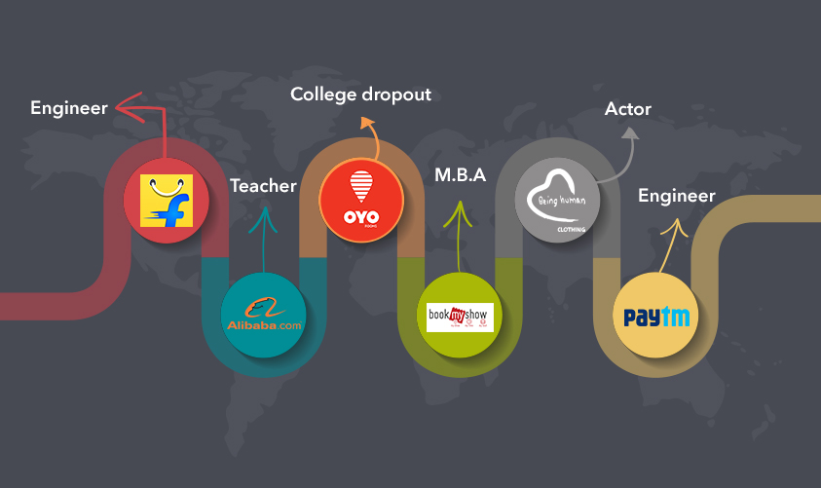
Some took the initiative to work outside their domain
SOME TOOK THE INITIATIVE TO WORK OUTSIDE THEIR DOMAIN

Slide 44
Case Study : India Filings
Founder : CHARLES LIONEL
Who founded Indiafilings.com?
CA
CS
Advocate
Holds Master Degree in Airline Management

Slide 45
EASY START AND GROW YOUR BIZ

Slide 46
WHY NOT YOU ?
If they can

Slide 47
Lost in Life?
Lost about where you should Head for nurturing an IDEA?

Slide 48
Pretty Confused where
to go next ?

Slide 49
5 Essential elements of success

Slide 50
Before you Start
Your
Startup
Target Audience
Size of Users
Business Size
B2B OR B2C
Competitor Analysis

Slide 51
Choose the right NEED

Slide 52
All it takes is an Innovation that makes you an odd out of all the evens in the market.

Slide 53
Accelerate the growth of CS Ecosystem
More CS with the right skills
Workplace need to be your second home
Think Entrepreneur & Be Entrepreneur

Slide 54
ICSI Acceleration Center
To encourage budding practicing company secretaries to set up with Government of India Start-up, Standup India ventures, ICSI has setup its launched CS Acceleration Centre in Kolkota.

Slide 55
Obstructions in doing business in India

Slide 56
Higher transactions cost
Procedural bottlenecks
Complex Taxation system
Non availability of finance
Interface with Bureaucracy

Slide 57
Change is important

Slide 58
Success Mantra - 1
“You need three things to create a successful startup:
to start with good people,
to make something customers actually want,
and to spend as little money as possible.”
By: Paul Graham

Slide 59
Success Mantra - 2
Whether Professionals can grasp such changes??
Have PRIDE in How Far YOU
Have Come
Have FAITH in How Far YOU
Can Go

Slide 60
Success Mantra - 3
Don’t be Afraid
of
CHANGE
It is Leading you to
NEW BEGINNING

Slide 61
Success Mantra - 4
"It is not the strongest or the most intelligent who will survive but those who can best manage change."
--Charles Darwin

Slide 62
Success Mantra - 5
Dear Past,
Thanks for all the lessons.
Dear Future,
I’m ready……

Slide 63
The Impact: A modern tomorrow A better nation

Slide 64
To new India
2016
Welcomes you

Slide 65
Connect with me
Thank You
PAVAN KUMAR VIJAY
/pkvijay
/pkvijay
/pkvijay

