Slide 1
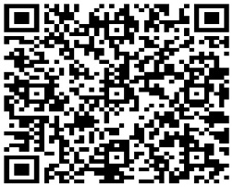
Siliguri Chapter of EIRC of ICSI
Date- Saturday
11th Nov, 2023
{4:30 Pm-06:30 Pm}
Organising
Study Circle Meet & Diwali Milan
CPE-01
[Structured]
Topics | Speaker
Know CSBF | Group Discussion
Fees* (Inclusive of GST) | Rs. 150/-
Venue- Chapter Office, Siliguri
Bank detail for Online payment:
Bank Name | SB Account No. | A/c. Name | IFSC
Canara Bank | 6396101000370 | The Institute of Company Secretaries of India-Siliguri | CNRB0006396
Scan &Pay
After making the payment please forward details (Name, Membership No. & transaction id) at siliguri@icsi.edu
For details please contact: 0353 2432780; Email- siliguri@icsi.edu
Kindly make it convenient to attend the programme.
With warm Regards,
CS Nitin Gupta CS (Dr) Pintu Prasad Jaiswal
Chairman Secretary
*N.B-CSBF Members discount of Rs. 50/- on above fees.

