Slide 1
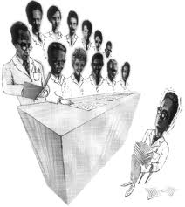
Office Administration and Systems in office of PCS
Notes:
1

Slide 2
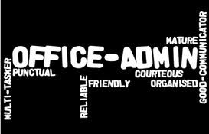
Office Administration
It is an essential feature to any organisation, irrespective of its size & nature as well as the area of operations.
No activity could be organized without systems, procedures and rules.
It is a set of day-to-day activities
within an organization.
2

Slide 3
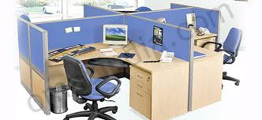
Office Administration FOCUS
3
Management of employees
Ensure adequate resources needed for continuous productive results
Overseeing the day to day operations
In a PCS office specifically focuses
- to ensure providing quality services to the satisfaction of the clients
- to ensure technical standards achieved in compliance of law
- to keep abreast the latest amendments and changes of law with constant knowledge updation as a tool.

Slide 4
Office Administration- Resources
4
Work Area- appropriate infrastructure
Information Technology – hardware, software, website etc.
Communication facility
Proper furniture, lighting, ventilation, a/c etc.
Toilet, dining and refreshment facility
Library (e-library) – required books
and reference materials
Compliance checklists, templates,
specimens
Manpower

Slide 5
System
“System” is doing the things methodically by following certain procedures laid down with clearly defined roles and responsibilities for smooth and effective functioning of the office directly related to the volume and size of the Practice Unit.
5

Slide 6
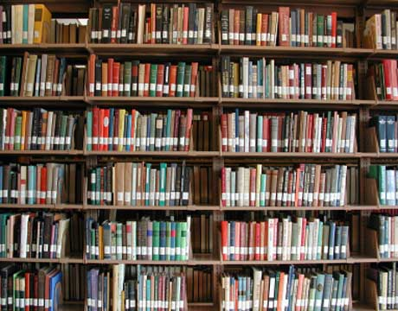
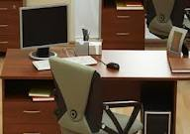
Objectives
6
Periodical Review: Improved work methods ensure better performance with a minimum usage of time, effort, money and materials.
Facilitation: Usage of appropriate Office machines and equipments as well as facilities, adequate working conditions and good LIBRARY for reference.

Slide 7
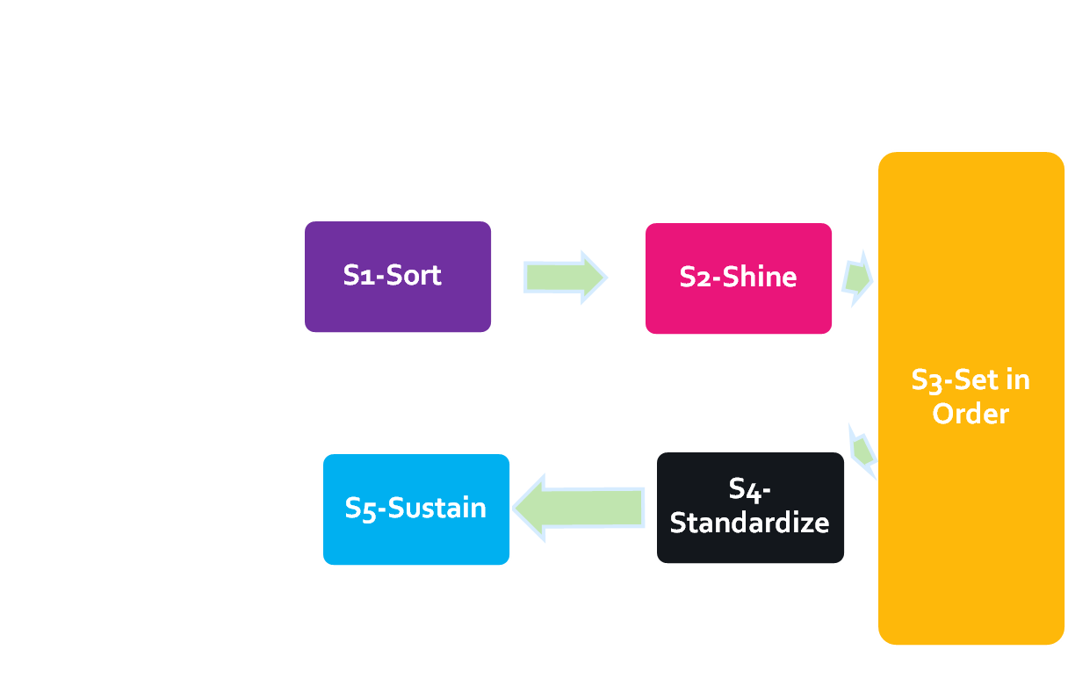
5’s Methodology
5S Workplace
A Clean, Uncluttered & Well Organized Office Space
Start
7

Slide 8
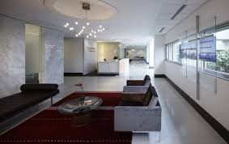
S1. Sort
Non-essential items in the office space should be eliminated.
S2. Shine
Remove dirt & debris, inspect equipment & eliminate sources of contamination.
8
Notes:
Remove from the workplace all items that are not needed for current production (or office) operation. · Sorting means leaving only the bare necessities · When in doubt, throw it away
Example—Computer Cleanup
Sort
– Check all files and software
– Get rid of unnecessary
– Benefit: Faster processing time because more memory is available.

Slide 9
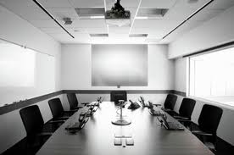
S3. Set in Order
(a) Evaluate the office space & add smart office space features.
(b) Create a well-ordered, visually instructive office space
S4. Standardize
Develop standard procedures, checklists, & other mechanisms established to maintain a work environment that is visually instructive.
9
Notes:
Set in Order” Arranging needed items so that they are readily accessible and labeled so that anyone can find them or put them away. S3’s Implementation Phase includes establishing features in the workplace that make it clear that there’s a place for everything and that provide visual signals to help people succeed.
It focuses on the need for arranging tools and equipment in an order that promotes optimum work flow. Having designated locations for all items in the work area enables employees to take control over their operations. Employees will be able to immediately see if things are out of place and if more materials, supplies, or tools need to be ordered.
In order to successfully implement S3, there are common actions that need to be performed.
• Place borders around equipment and objects that rest on the floor. This clearly identifies the location of equipment and also warns people passing by not to get too close.
• Use an address system to identify System locations, storage areas, and shelf locations.
• Label tools, fixtures, jigs, etc., for easy cross-identification with storage location markings.
• Where possible, use pictures and graphics to facilitate recognition.

Slide 10
S5.- Sustain
Monitor, expand & refine 5S results
An office space should be one that automatically restores order, regulates activity & continuously improves
10
Notes:
A management auditing process should be put into practice to ensure that employees understand that maintaining the level of workplace organization is a top priority.
Be sure to publicize success stories and provide appropriate recognition to team members
Workers should be encouraged to continue to make improvements to their workplace on a regular basis.
Continuous improvement must become part of the routine expectations and activities of the work day.

Slide 11
Office Administration- Combination
11
Office administration is now a combination of
Infrastructure,
Information technology,
Human resource management,
Office resource management,
Written communication,
Verbal communication,
Research and Training,
Budgeting

Slide 12
Infrastructure- work area should have appropriate infrastructure viz. proper ventilation, furniture, lighting etc.
Information Technology-
Latest Hardware, Software and Networking necessary to keep up with the professional expectations.
Regular back up of important files, documents and diary/working papers.
Maintenance and updation of website of PU.
Human Resource Management-
Adequate procedure for recruiting new employees and management trainees.
Maintaining proper attendance record.
Having disciplined environment.
Training in interpersonal skills and communication skills.
Assignment and rotation of work.
Monitoring and accountability.
Office Resource Management-
Proper facility to have back up of data.
12

Slide 13
Office should be clean and hygienic, remove trash and avoid wastage.
Ensure easy retrieval.
Reduce redundancy.
Communication- written and verbal –
There should be proper system for recording inward/outward mails.
Maintenance of confidentiality of client and firm information.
Training employees and apprentice trainees to be well behaved and polite.
No important communication to be done verbally.
Research & Training- requires regular and continuous updation and training on amendments and new laws.
Budgeting- Planning the area of expense, ensure proper utilization and application of resources etc.
13

Slide 14
CONCEPT OF
ENGAGEMENT TRAILS
&
ENGAGEMENT DIARY
14

Slide 15
INTRODUCTION
15
Maintenance of proper records is a very significant and indispensable part of office systems and procedures. Thus in a PCS office, Engagement Trails and maintenance of diary becomes significant while carrying out attestation services.

Slide 16
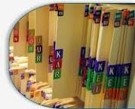
ENGAGEMENT TRAILS
16
A relevant chronological record showing who has done and what operations he or she has performed during a given period of time.
Trail also details what are the data and records referred and relied upon.
It also facilitates future reference and tracking.
Audit trails are useful both for
maintaining security
recovering lost transactions

Slide 17
17
ENGAGEMENT TRAIL is a form of documentary evidence that can be used
to trace transactions to their source
to verify their validity and accuracy.

Slide 18
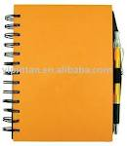
ENGAGEMENT DIARY
18
An important tool in the hands of the PU and his team.
Shall provide information on the following
Who - who has carried out the engagement
Where - where has the engagement been conducted
When - when is engagement undertaken
What - what is purpose & scope of engagement

Slide 19
CONTENTS
Contents of the diary
Basic info of the name of the company
Information about the PU
Scope & objective of the engagement being carried out
Conflict of interest, if any
Changes in terms of engagement, if any
Records and documents verified and inspected
Methodology of carrying out
Period of engagement
Documents requested, obtained and relied upon
19

Slide 20
Files Management
20

Slide 21
Files management - ensures control at the file level
Files management ensures that records relating to a specific activity or subject are securely maintained together in one file.
This enables effective decision making and also ensures that the sequence of actions
can be reconstructed, that is what happened, when, who did it, why.
21

Slide 22
Files management
Filing involves
Arranging records according to a simple, logical system
Placing records in a storage container in correct sequence
Retrieving the records so that they can be used
22

Slide 23
good filing systems…
contain complete and comprehensive files thereby enabling effective decision making
provide integrity and continuity regardless of changes in personnel
facilitate protection and preservation of records
provide low cost and efficient maintenance of records
reduce the possibility of misfiling and reduce duplication
mean less time spent searching for files and documents
23

Slide 24
Files management
Filing systems
Filing Rules
Files Equipment
Computer
Applications
24

Slide 25
CRITERIA of a good filing system…
Simplicity
Flexibility / Expansibility
Adaptability
25

Slide 26
Filing methods
numerical
alphabetic
geographic
form
chronologic
26

Slide 27
Numerical System
File units are placed in numerical sequence
Originated from the registry system, used particularly in accessioning correspondences.
Unsuited to handling name files.
Ideally useful for case files (file units containing all documents pertaining to a particular transaction, usually developed in legal or business records.
27

Slide 28
Alphabetic System
File units are placed in alphabetical sequence.
First used to arrange records relating to persons, then gradually to records relating to subjects.
The system may be modified to group records related by a common subject by:
*standardizing subject headings
*subdividing the main subject headings
Other alphabetical filing systems are:
*Alpha-numeric - uses letters to designate main subject headings and numerals for subordinate headings *Mnemonic - uses alphabetical symbols to denote subordinate headings.
28

Slide 29
Other Filing Systems
Geographic Filing: files records by location or place first, followed by the name or subject.
Forms : groups records according to their format or type (e.g. minutes, reports, invoices, receipts)
Subject Filing: places records under subject classification.
Chronologic Filing: files records by year, month, and date
29

Slide 30
Procedures in Filing
30
indexing by card or register
coding by writing symbols or captions, or highlighting indexed name or subject
sorting by tray
filing

Slide 31
Common filing problems
too many filing places
everybody a file clerk
files disorderly; show no particular plan or arrangement
system does not fit the way material is called for
some records seem to belong under more than one category
filing decisions erratic or inconsistent
bulging folders
accumulation of unnecessary or personal records
31

Slide 32
Common filing problems
related records are filed under different categories
the retrieval rate is poor (inability to locate the required document quickly)
missing and misplaced documents mean too much time spent looking for files
a high level of duplication exists
users are setting up personal records systems
incomplete files and backlogs of unfiled records exist
filing cabinets are jammed with files bulging with documents
32

Slide 33
Improve your filing…
Begin each calendar year with a new set of files
Files should not exceed ½ thickness
Dedicate time each week for filing to prevent backlog
Avoid filing extraneous unnecessary duplicate copies
Avoid tightly jammed files
Safeguard access and confidentiality of records
33

Slide 34
Documentation and Record keeping w.r.t Audit
Documentation shall take place throughout the audit process. Working papers shall be complete and appropriately detailed to provide a clear trail of the audit
PU shall establish policies and procedures for retention of Audit Documentation
Audit documentation shall be collated within a period of 45 days from the date of signing of Auditor’s report.
Audit documentation shall be maintained in physical or electronic form and retained for a period of 8 years from the date of signing of Auditor’s Report.
34

Slide 35
Training Personnel
receiving and opening mails
placing mail/other papers in
correct files
extracting and replacing files
opening/creating new files
indexing & cross-referencing
keeping a record of file
movements
retrieving lost/missing files
destroying/disposing files
retiring non-current files
maintaining confidentiality
35

Slide 36
Thank you
36

